Slide 1
Define
This work is licensed under the Creative Commons Attribution-Noncommercial-Share Alike 3.0 Unported License. To view a copy of this license, visit http://creativecommons.org/licenses/by-nc-sa/3.0/
September 28, 2015
Slides adapted from d.leadership Define + Ideate slides (https://dschool.stanford.edu/groups/dleadership/wiki/59f08/dleadership_2015.html)
Additional resources from bootcamp bootleg (http://dschool.stanford.edu/wp-content/uploads/2011/03/BootcampBootleg2010v2SLIM.pdf)
Notes:
broke at 1:15 PM (45 minutes in) to do 30 minutes team work
then 22 minutes after the break to finish slides
had 13 minutes left over at the end (IN THE FUTURE: demo a needfinding unpacking exercise or have them do one)

Slide 2
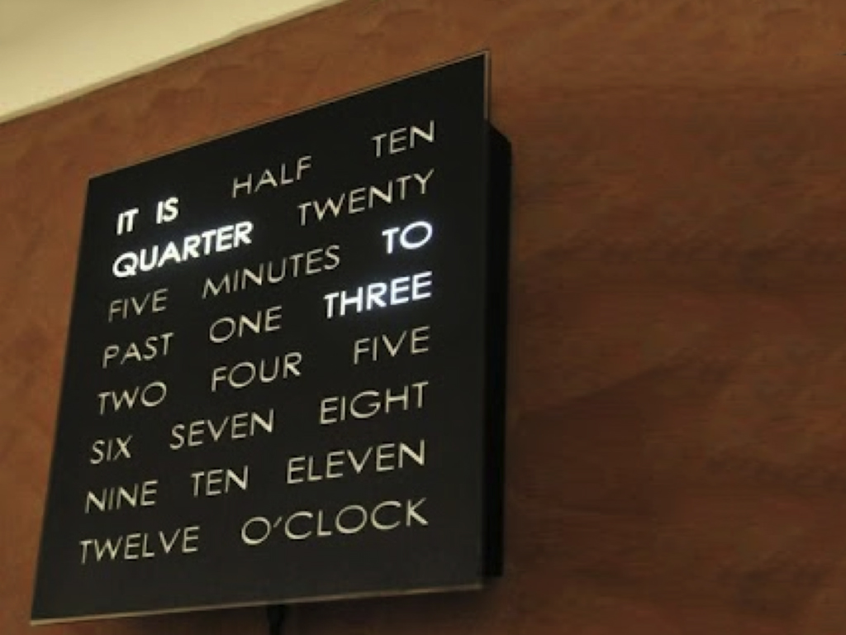
Hall of Fame or Shame?
Text Clock

Slide 3
Hall of Shame!
Text Clock
What is the purpose?
This slows you down!
Though it is fun…

Slide 4
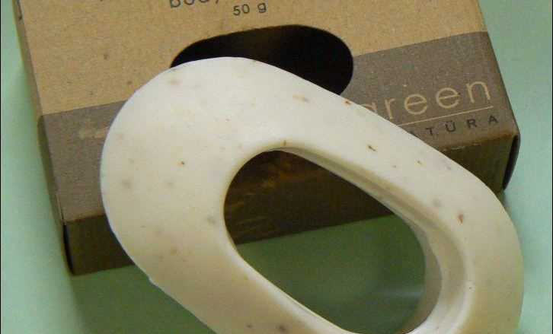
Interface Hall of Shame or Fame?
Bar of Soap

Slide 5
Interface Hall of Fame!
Bar of Soap
has a hole!
where would you find?
hotels
Easier to hold onto?
small sizes slip…
Eco-Friendly
doesn’t waste (50g)
full size is 120g
Tie a rope to it

Slide 6
Define
This work is licensed under the Creative Commons Attribution-Noncommercial-Share Alike 3.0 Unported License. To view a copy of this license, visit http://creativecommons.org/licenses/by-nc-sa/3.0/
September 28, 2015
Slides adapted from d.leadership Define + Ideate slides (https://dschool.stanford.edu/groups/dleadership/wiki/59f08/dleadership_2015.html)
Additional resources from bootcamp bootleg (http://dschool.stanford.edu/wp-content/uploads/2011/03/BootcampBootleg2010v2SLIM.pdf)

Slide 7
Outline
Design thinking process
Inferring insights
Point of views
Practice the process
Team Meeting

Slide 8
Design Thinking
Empathize
Ideate
Define
Prototype
Test
Notes:
Last time we talked about Needfinding and Contextual Inquiry. This allows you to Empathize with your target customers and to see things from their perspective.

Slide 9
Design Thinking
Define
Notes:
Now we want to use that information to focus in on a problem.

Slide 10
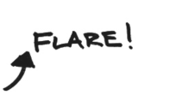
Notes:
So remember, the design process has areas where we flare and then we focus. This is often repeated. We flare by doing needfinding but then we try to use it to focus.

Slide 11
REALIZE
Define
FOCUS
Notes:
We want to realize what is happening and use that to find a focus

Slide 12
REALIZE
NEW
INSIGHTS
REFRAME THE PROBLEM.
UNCOVER OPPORTUNITIES.
Notes:
It’s about making meaning. Make sense of your empathy work to get to useful and actionable insights. Insights uncover opportunities and help you think about the problem in a different way.
This leads to more exciting, novel and relevant solutions (once you get into ideation).

Slide 13
OBSERVATION INSIGHT
INFER
NOTICE
SOMETHING
“I WONDER IF THIS MEANS . . .”
ACTIONABLE
LEARNING
ABOUT
PEOPLE
Notes:
This inference is a LEAP

Slide 14
OBSERVATION + INFERENCE = INSIGHT
INFER
Notes:
Take a LEAP of inference

Slide 15
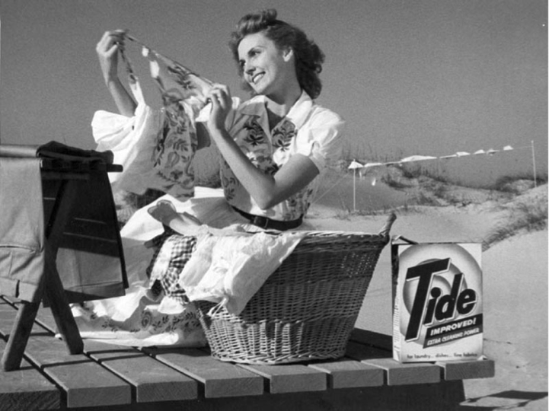
THE SELL:
TIDE REMOVES TOUGH STAINS
Notes:
As an example, one of alumni Claudia . . .
Tide used to think of their primary customer as a housewife with 2.5 children. What do you think houswives want out of their laundry detergent? Stains gone, germs killed. In the early 2000’s Tide realized that millennials were not buying laundry detergent as they had before.

Slide 16
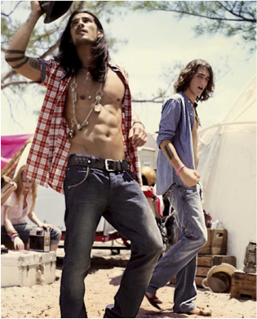
Notes:
So they did some empathy work with millenials – some in California. What do you think individuals like this want in their laundry detergent?

Slide 17
We heard:
“I rarely wash my jeans, I want them to look great longer”
Millennials care about their clothes, and that means not cleaning them
We observed:
Jeans on the back
of a chair
discrete observations
abstracted statement
Notes:
“We observed: Jeans on the back of chairs, or in the closet -- but not in the laundry basket.”
“Millennials care about their clothes, and that means not cleaning them.” It’s not just laziness, they actually do care about how they look and how their clothes look.
And for them, keeping jeans looking good, means not washing them.
[Note: on the left are discrete observations -- on the right is a statement abstracted to a level of meaning that has implications for the project]

Slide 18
The Perennial Objective:
IMPROVE THE STAIN-REMOVING PERFORMANCE OF TIDE
The Realization:
IT’S NOT ABOUT CLEANING. IT’S ABOUT CARING FOR CLOTHES.

Slide 19
REALIZE
Define
FOCUS
Notes:
The definition phase is about making realizations and then creating a focus for your work

Slide 20
FOCUS
ON ONE MEANINGFUL CHALLENGE

Slide 21
Focus by Writing a “Point of View”
A unique, concise reframing of the problem that is grounded in use needs & insights.
Notes:
A what?

Slide 22
Focus by Writing a “Point of View”
WE MET . . .
(user you are inspired by)
WE WERE AMAZED TO REALIZE. . .
(insight—verb reflecting user needs)
IT WOULD BE GAME-CHANGING TO. . .
(Synthesized statement to leverage in designing solution.
NOT just a reason for the need! )
Notes:
Focus your work by writing a Point of View. Three straight-forward sentences.
(We met): “What specific person did you meet that inspires your work?”
(We were amazed to realize:) “This is your insight. Tell us something we didn’t know or wouldn’t have thought about before we started this project. What unique new perspective do you have now?”
(It would be game-changing to:) “This is your call to action. Build on your insight and take an aspirational stance on what you can do as a team. This isn’t your solution -- it is the problem to be solved. A problem with a more informed perspective.”

Slide 23
Focus by Writing a “Point of View”
WE MET . . .
a young millennial living in SoCal
WE WERE AMAZED TO REALIZE. . .
he protects & preserves clothing by not washing them often
IT WOULD BE GAME-CHANGING TO. . .
help him care for his clothes while keeping them clean
Notes:
We met a young man living in an apartment in Southern California.
We were amazed to realize he and other millennials care about their clothes, and that means NOT cleaning them.
– this is a reflection of how much he cares for his clothes!
It would be game-changing to help them care FOR their clothes while keeping them clean.

Slide 24
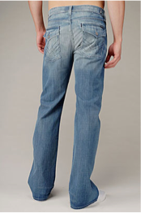
Notes:
This is the product that was developed out of the empathy and define work done by Tide. Tide Total Care doesn’t remove the yellow “stains”/dye in high-end fashionable jeans purchased by millennials

Slide 25
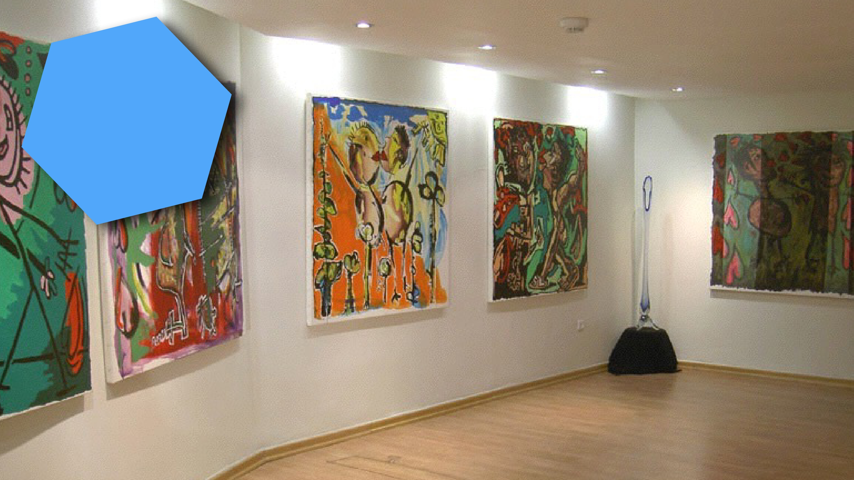
AL
UM
IO
N
CT
A
Notes:
Ethan Appleby (graduate DTBC in March 2013)

Slide 26
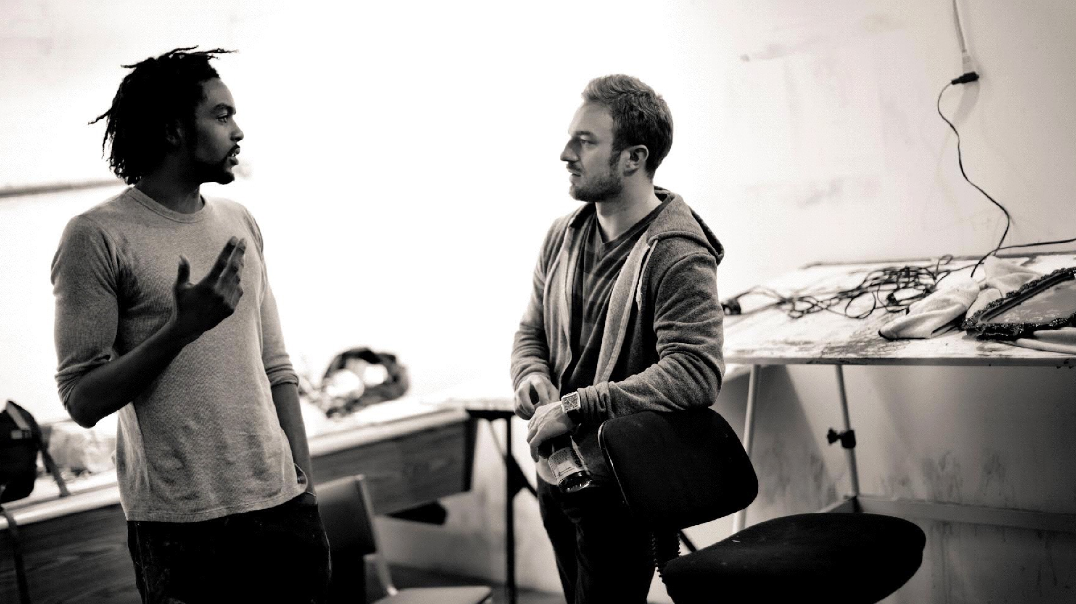
Notes:
He was interested in figuring how to make art accessible to his generation of young professionals.
People who now had some money, but didn’t know how to buy art.

Slide 27
We heard:
“I don’t understand.
Why is this $50 and this $5000. I actually like the $50 one more, but maybe it sucks.”
“What do my
friends like?”
We think of
collecting art as
deeply personal,
but in fact for
them art is about
what others are
going to think.

Slide 28
The presumed mindset:
ART IS DEEPLY PERSONAL.
The realization:
ART IS FASHION ON THE WALL.

Slide 29
WE MET . . .
(user – possibly extreme – you are inspired by)
WE WERE AMAZED TO REALIZE . . .
(what did you learn that’s new?)
IT WOULD BE GAME-CHANGING TO . . .
(frame up an inspired challenge for your team.)
(don’t dictate the solution.)

Slide 30
WE MET . . .
a guy in his twenties with a good new job and a
new apartment
WE WERE AMAZED TO REALIZE . . .
art is fashion on the wall: it’s about what other
people are going to think of you
IT WOULD BE GAME-CHANGING TO . . .
help buyers cut through the paralysis of doubt

Slide 31
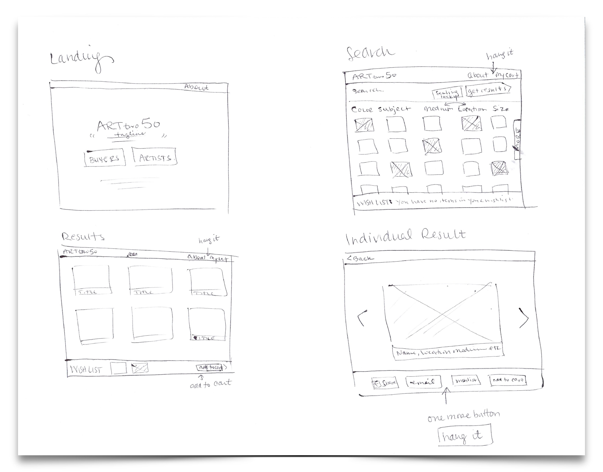
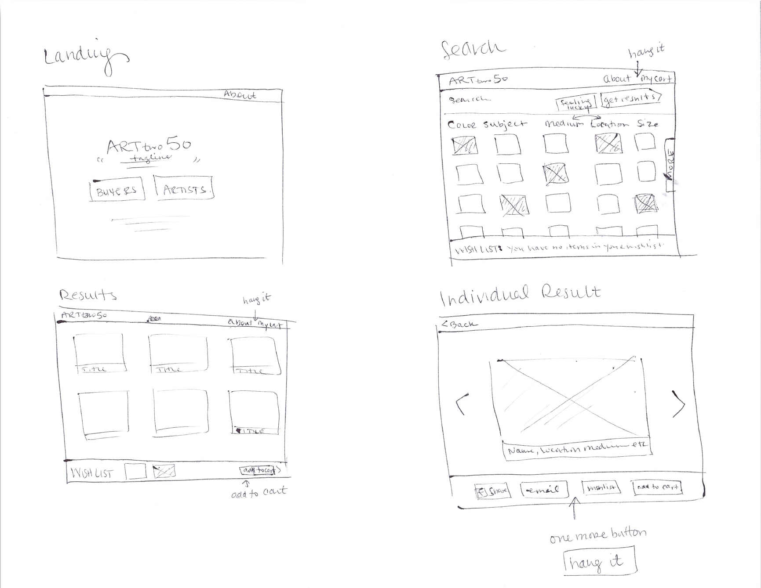
Notes:
Initial sketches for “Art Two Fifty”

Slide 32
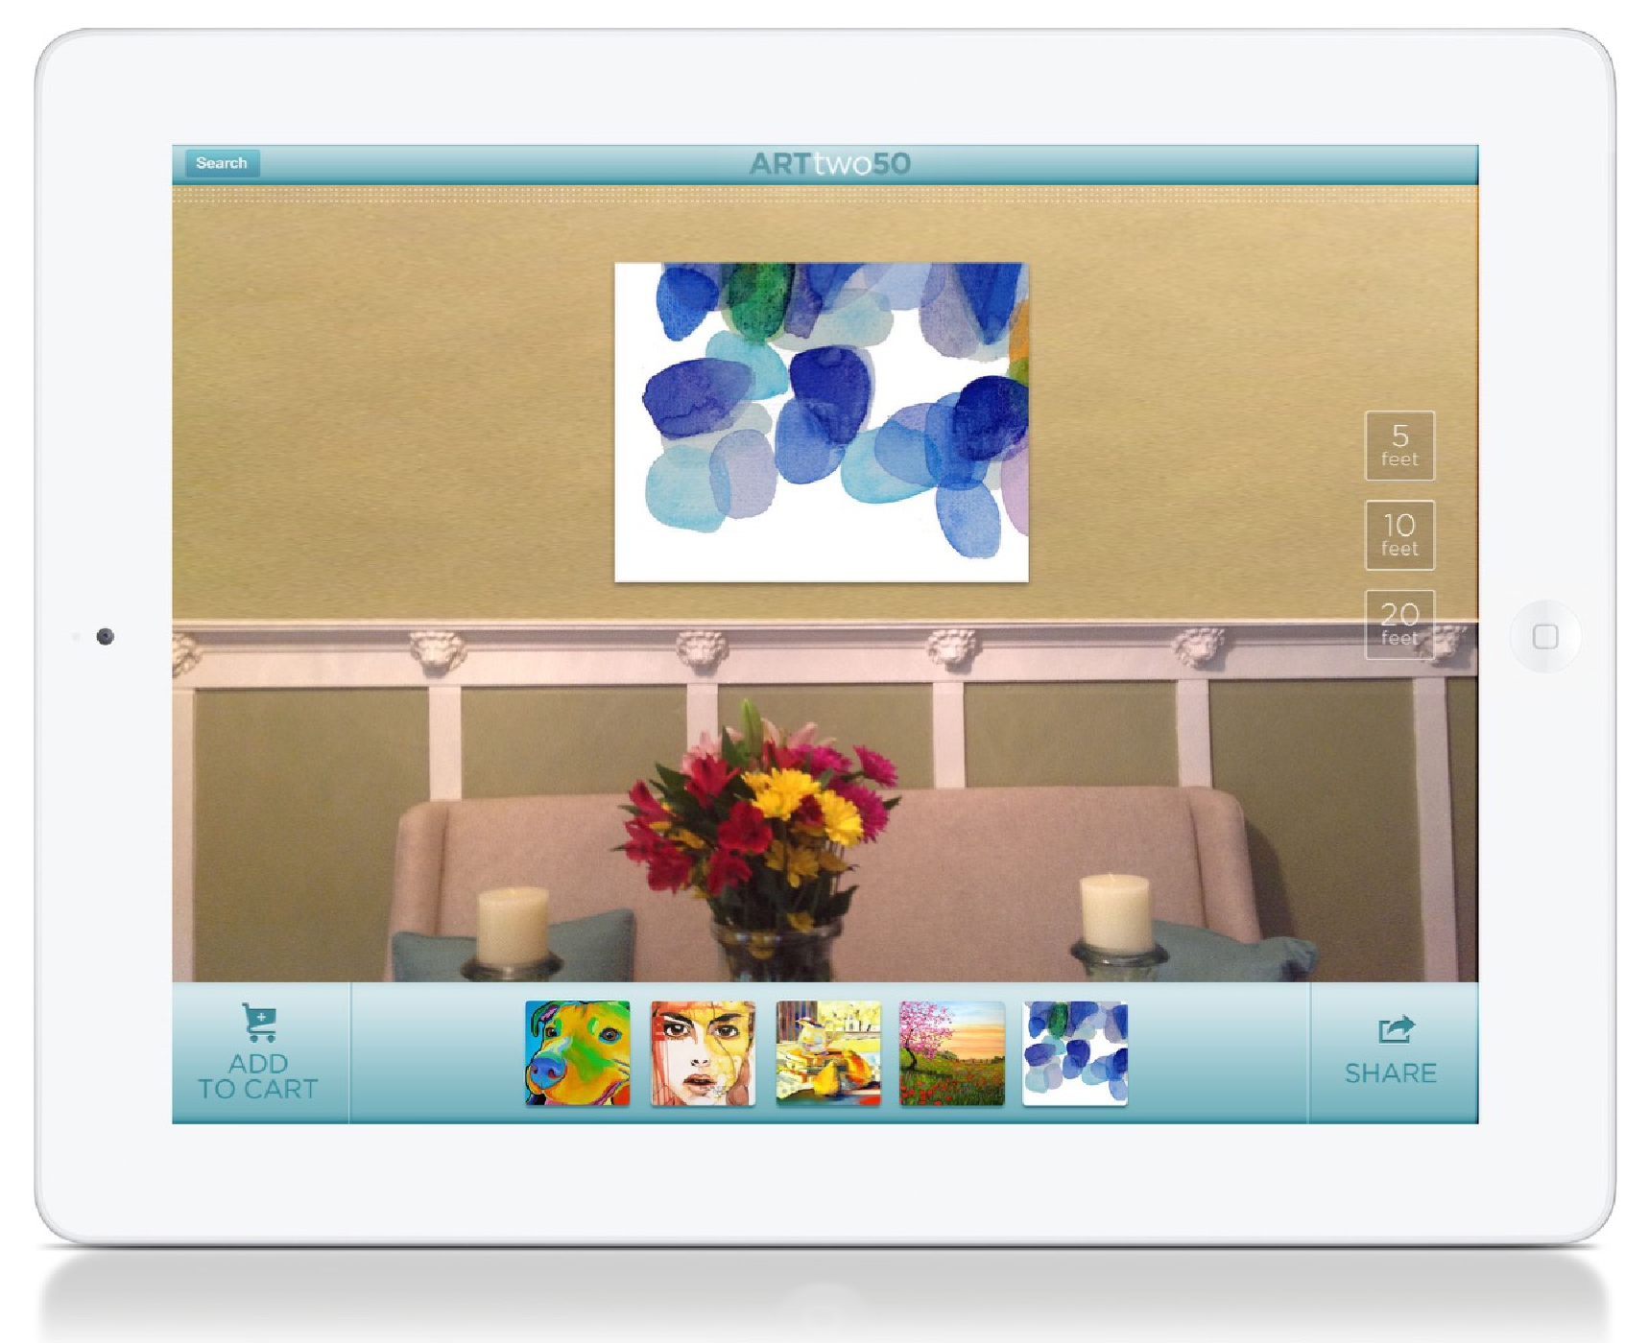

Slide 33
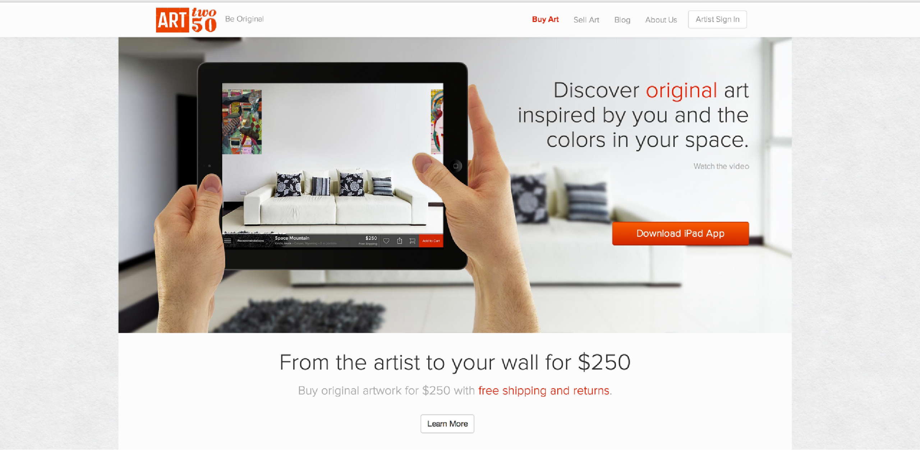

Slide 34
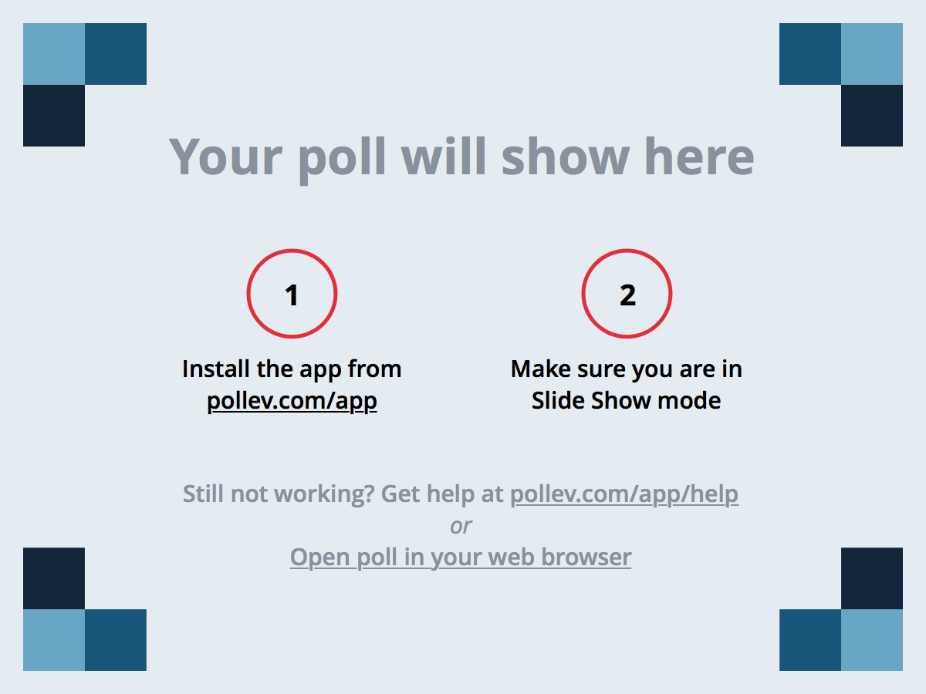
Notes:
At IDEO, the person who gets the most credit is
https://www.polleverywhere.com/multiple_choice_polls/SnfLofplJVCDf51

Slide 35
Administrivia
Studio assignment stats
Open mindedness in design
follow the needfinding!
1st choice | 2nd choice | 3rd choice | other
180 | 31 | 16 | 2

Slide 36
TEAM MEETING

Slide 37
Team Meeting Agenda
Schedule weekly meeting times (2-3)
Make a plan for how you will get the rest of your interviews & presentation slides done for Thur/Fri
Folks who have days where they know they won’t be at studio, schedule your presentations now & make sure the team is covered & work is made up
Notes:
got here at 12:15 (45 minutes in) and gave 30 minutes to work as a team

Slide 38
Point of View: How?
UNPACK YOUR EMPATHY WORK
LEAP FROM OBSERVATIONS TO IDENTIFYING USER, NEEDS, & INSIGHTS
REFRAME THE PROBLEM AS A POV
Notes:
restarted at 1:15 in (12:45)

Slide 39
UNPACK
INSIGHTS
POINT OF VIEW

Slide 40
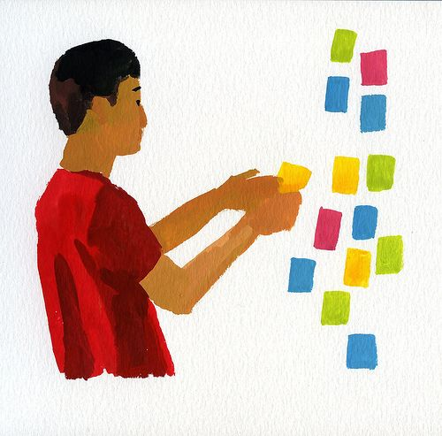
Using the Data Collected in the Field
Figure out what is important
Affinity diagramming
group info & find relations between groups
Post-Its on large surfaces
Notes:
Share your field stories with each other

Slide 41
Notes:
Share your field stories with each other

Slide 42
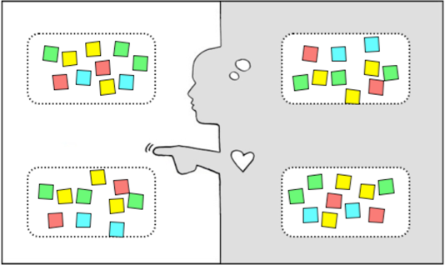
Empathy Map
say
think
do
feel
Notes:
An Empathy Map is one tool to help you synthesize your observations and draw out unexpected insights.
On The Left are observations and on the right on inferences
Use your notes, audio, & video from your fieldwork to fill out the 4 quadrants
SAY: What are some quotes and defining words your user said?
DO: What actions and behaviors did you notice?
THINK: What might your user be thinking? What does this tell you about his or her beliefs?
FEEL: What emotions might your subject be feeling?

Slide 43
Empathy Map
say
think
KEEP A LIST OF
TENSIONS, CONTRADICTIONS, SURPRISES
USE TO FIND NEEDS & INSIGHTS
do
feel
Notes:
As we unpack we look for Tensions, Contractions, and Surprises – put them to the side!
We use these to help identify Needs and Insights
Needs are human emotional or physical necessities -- verbs (activities and desires with which your user could use help)
An “Insight” is a remarkable realization that you could leverage to better respond to a design challenge

Slide 44
Identifying Needs
WHAT DOES SHE NEED?
Notes:
Now, a lot of peoples initial reactions would be things like a ladder, more books, or even an elastic arm so she can reach the top shelves
In those suggested “needs” is already the solution and no innovation is required.
Where I would challenge you is to dig deeper to find out why she is reaching for those books in the first place. Maybe her need is “acknowledgement from her student peers that she is a hard worker”, maybe her need is “a strong voice in this world driven by knowledge and education” or maybe its even “more social time with her father through reading books together”. You can feel how much more powerful that inspires you as a designer. Pull these types of needs out of your empathy.

Slide 45
identify user, needs, and insights
user
need
insight
Notes:
Categorize (and rephrase) your discoveries as USER ATTRIBUTES, NEEDS, and INSIGHTS.
"Look back to your User Empathy Map and the Tensions, Contradictions, and Surprises you captured -- and now list User Attributes (what's important about your user when you design for her?), Needs (remember, use verbs), and insights (synthesize and intepret what's on the board to get to novel, useful assertions.”

Slide 46
combine to create point of view
user
need
insight

Slide 47
combine to create point of view
user
need
insight
…NEEDS...
…GAME-CHANGING TO…
Notes:
“Select and combine elements to create your point-of-view, using a POV dashboard. Often the easiest way to start is to select your most compelling user. You could also start with a compelling insight or need you want to work with.”

Slide 48
UNPACK
INSIGHTS
POINT OF VIEW
Notes:
So, how do we use this to make insights?

Slide 49
I wonder if this means . . .
TENSIONS,
CONTRADICTIONS,
SURPRISES
INSIGHTS
think
feel

Slide 50
UNPACK
INSIGHTS
POINT OF VIEW

Slide 51
Point of View
WE MET . . .
(extreme user you are inspired by)
WE WERE AMAZED TO REALIZE . . .
(what did you learn that’s new? What is their need?)
IT WOULD BE GAME-CHANGING TO . . .
(frame up an inspired challenge for yourself – the insight.)
(don’t dictate the solution.)
Notes:
Focus your work by writing a Point of View. Three straight-forward sentences.
We use the user, their need, and the insight to write the Point of View.
(We met): “What specific person did you meet that inspires your work?”
(We were amazed to realize:) “This is your insight. Tell us something we didn’t know or wouldn’t have thought about before we started this project. What unique new perspective do you have now?”
(A game-changer would be to:) “This is your call to action. Build on your insight and take an aspirational stance on what you can do as a team. This isn’t your solution -- it is the problem to be solved. A problem with a more informed perspective.”
As a test, a good point of view (POV) is one that: • Provides focus and frames the problem • Inspires your team • Provides a reference for evaluating competing ideas • Empowers your team to make decisions independently in parallel • Fuels brainstorms by suggesting “how might we” statements • Captures the hearts and minds of people you meet • Saves you from the impossible task of developing concepts that are all things to all people • Is something you revisit and reformulate as you learn by doing • Guides your innovation efforts

Slide 52
Next Time
Lecture
Ideate
Studio
Present your initial needfinding results & work on Point of Views
Read
Tips for Working Successfully in a Group by Randy Pausch
The Discipline of Teams, by Katzenbach and Smith, Harvard Business Review
Watch the following videos (20 minutes):
Keys to Creating Awesome Teams (5:21), Cyriac Roeding, Shopkick
Working in Teams (0:56), Tina Seelig, Stanford Technology Ventures Program
Team Composition (2:33), Kathleen M. Eisenhardt, STVP
Ways to Create Ecosystems (really characteristics of group intelligence, performance, & innovation) (5:43), Sharon Vosmek, Astia
Ways of Working (5:50), Sue Siegel, GE

