Slide 1
Design Discovery
September 24, 2015
Notes:
Took 1.hour 45 mintues for lecture -- good

Slide 2
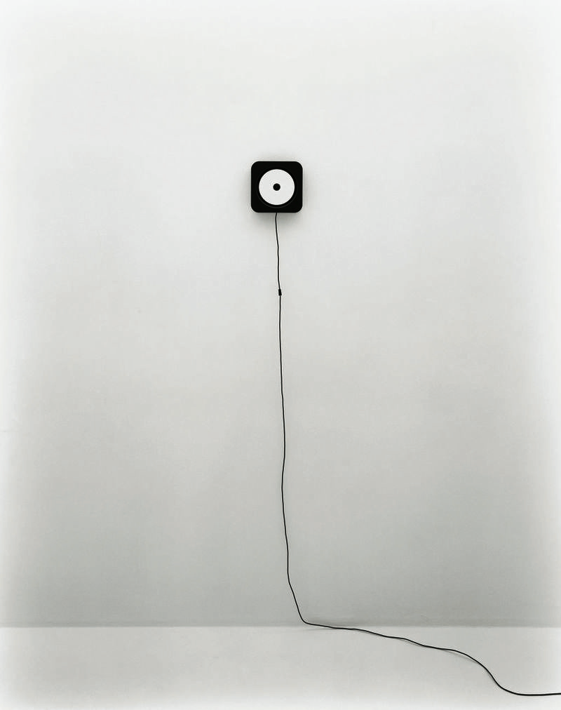
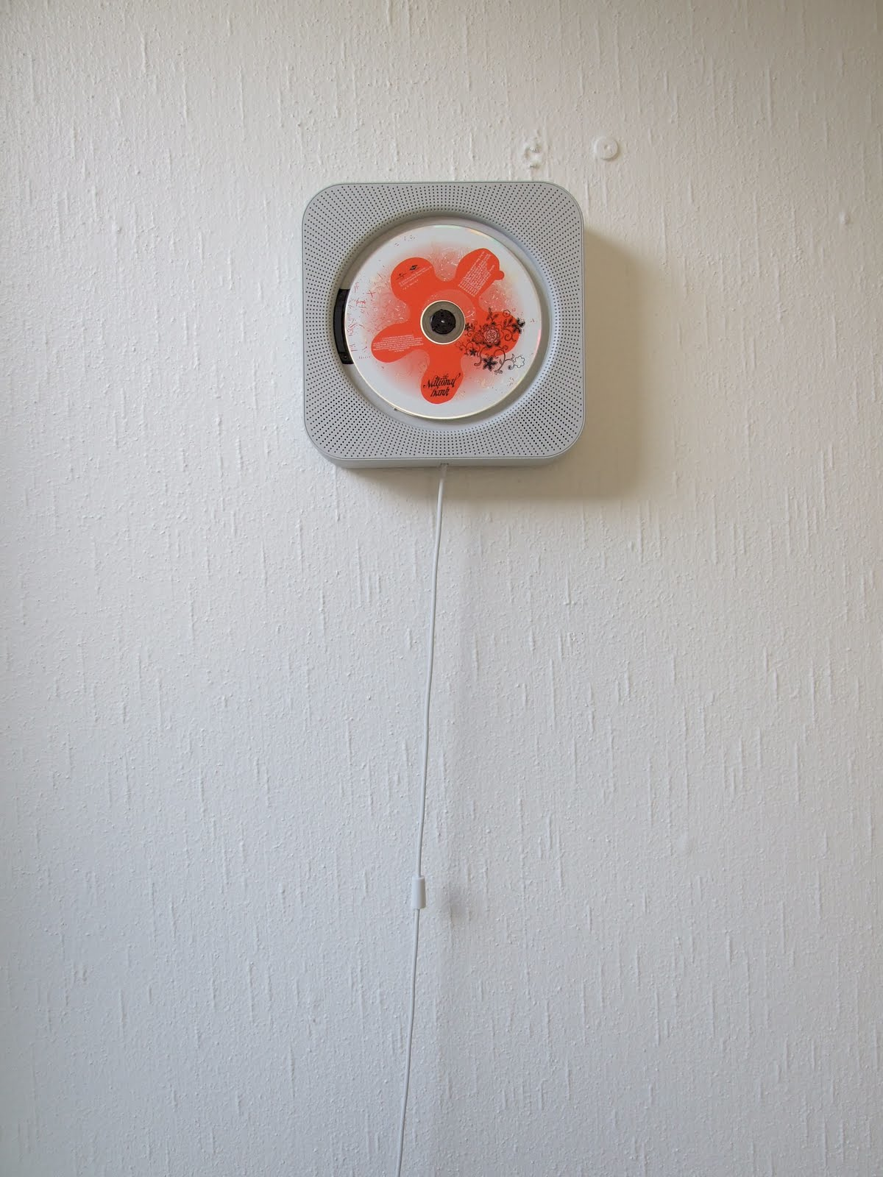

Interface Hall of Fame or Shame?
Muji CD Player
by IDEO

Slide 3

Interface Hall of Fame!
Guides the user with a familiar action
+ Perceived Affordance (string)
+ Directs user towards major function
Does not have functionality of other CD players
If unfamiliar w/ fans, may not be obvious

Slide 4

Hall of Fame or Shame?
Alessi Juicy Salif Citrus Juicer
By Philippe Stark

Slide 5

Hall of Shame!
Aesthetically pleasing but...
Does not perform it’s only function well: To make Juice.
  Amazon review:
  You’ll get almost as much juice on the wall and counter as you do in the glass since the juice will spray in every direction.
An example of where beauty can overpower purpose
Notes:
How could we fix this?

Slide 6
Design Discovery
September 24, 2015
Notes:
Took 1.5 hour for lecture Too long! (cut more lecture material)

Slide 7

Outline
Design Discovery
Needfinding
Administrivia
Contextual Inquiry
Task Analysis

Slide 8
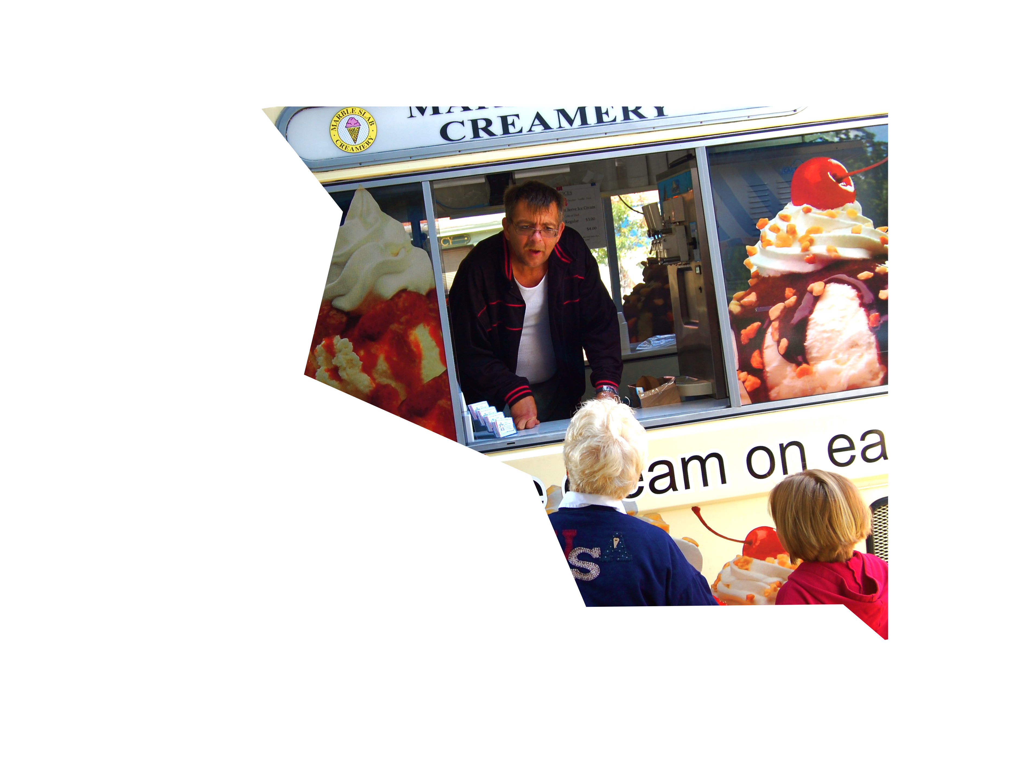
“ You Are Not the Customer”
Seems obvious, but…
  different experiences
  different terminology
  different ways of looking at the world
Easy to think of self as typical customer
Notes:
Easy to make mistaken assumptions

Slide 9
Design Process: Discovery
Needfinding
characteristics of customers & tasks
understand client’s expectations
determine scope
of project
evaluate existing practices & products
Discovery
Design Exploration
Design Refinement
Production
Notes:
To address this, we need to put our self in the customer's shoes.
To find empathy for their problems and needs.
This type of work starts at the "Design Discovery" stage of the design process.

Slide 10

Understanding the Customer
How do you learn how your customers work &
live as well as interact with technology?
  interviews, self report, logging/analytics
  & observation
How do you learn how your
customers think?
  understand human cognition
  observe users performing tasks
Important to carry out in naturalistic settings
  outside the lab → “ecologically valid”
  study behaviors in real-life situations
Notes:
Naturalistic data collection methods
Key for places we will deploy contextually-aware and/or mobile apps

Slide 11
“You Can Observe a Lot Just by Watching”
  —Yogi Berra
Notes:
As Yogi Berra supposedly said, you can observe a lot just by watching. What we’re going to talk about today is participant observation techniques for standing in someone else’s shoes. Of course, observing people isn’t the only way to begin designing an effective user interface. Great designs emerge through all sorts of approaches. That said, it’s often a good strategy to begin your design process by attuning yourself to your users.

Slide 12
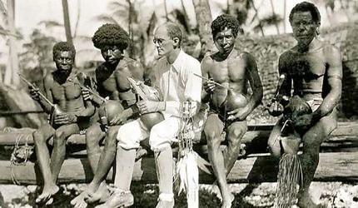
Image Courtesy Wikipedia: http://en.wikipedia.org/wiki/File:Wmalinowski_triobriand_isles_1918.jpg
Notes:
The techniques in this lecture are inspired by the fieldwork strategies that anthropologists use to learn about and document culture. In 1914, Bronislaw Malinowski traveled to Papua New Guinea), where he conducted fieldwork at Mailu and the Trobriand Islands. While he’s there, World War I breaks out. He has two options: hang out in the Trobriand islands or face internment since he’s Austrian. I think you can guess which option he picked. During this period, he developed the practices of participant observation, which remains a hallmark of ethnographic research to this day. In this photograph, Malinowski is being taught to play a string instrument.

Slide 13
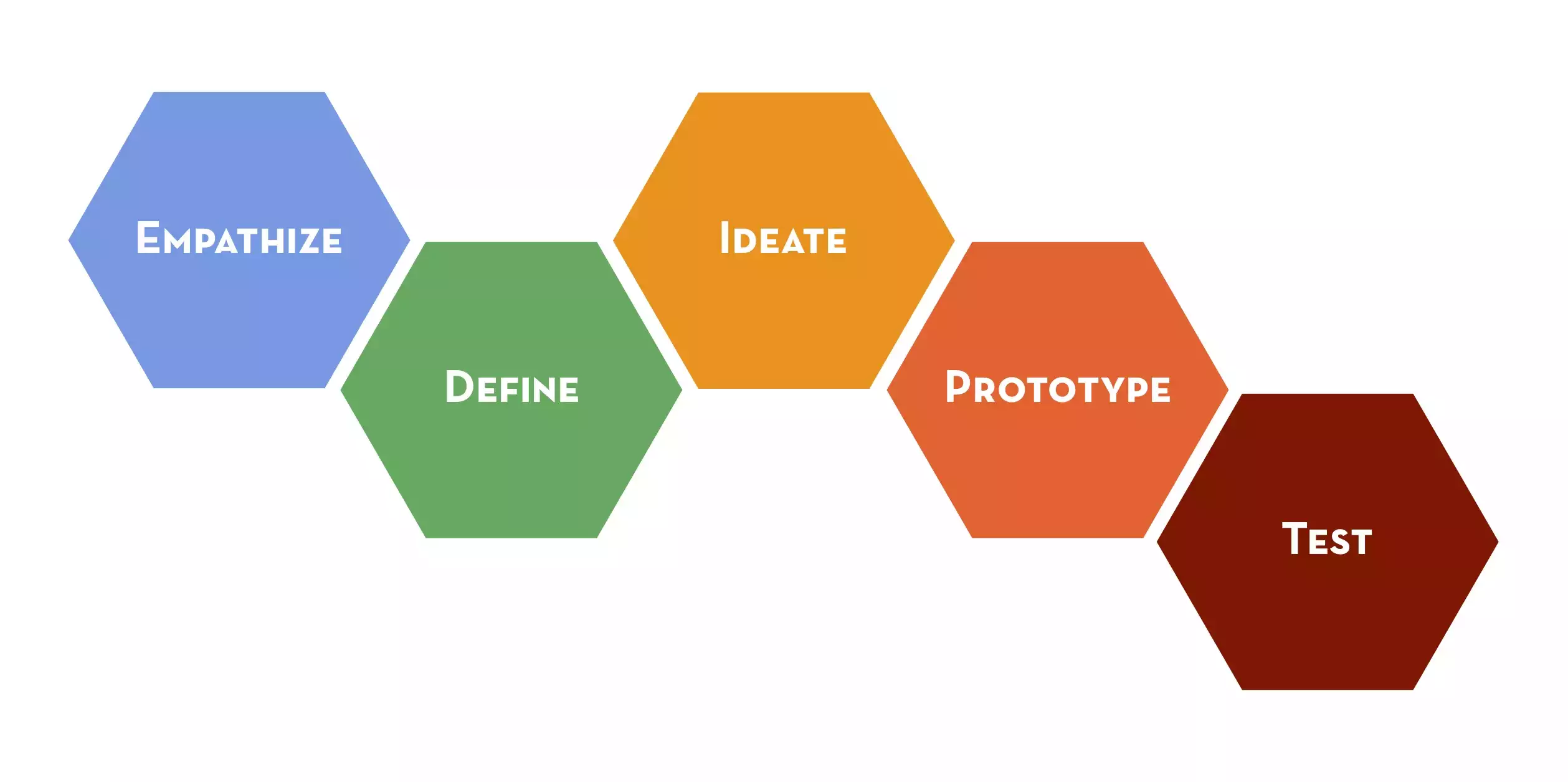
Design Thinking Process

Slide 14
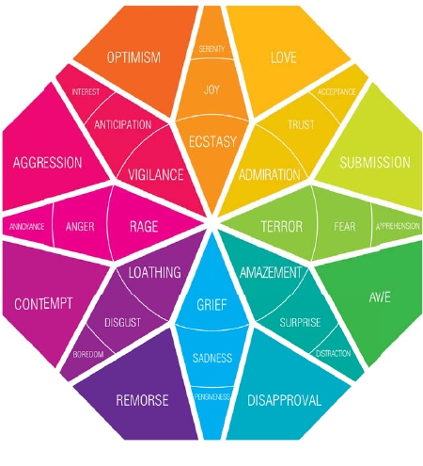
Empathy: Feel what they feel
Principles
Immerse
Observe
Engage
http://hci.stanford.edu/courses/cs147/2015/au/readings/FIELDGUIDE-Screen-DTBC-March-2015-V2.pdf

Slide 15
Look for workarounds & hacks
Pay attention to all the artifacts
“Errors” are a goldmine
Notes:
“I am not a fan of undirected, explorative ethnography. This is an excellent procedure for developing our scientific understanding of human behavior, but it is too diffuse for practical application. I prefer directed observation: search out the workarounds, hacks, and clever improvisations of everyday life. That’s where the answers lie: someone else has already encountered the need, someone else has already hinted at a solution.”
- from Don Norman’s http://jnd.org/dn.mss/workarounds_-_leading_edge_of_innovation.html
A personal favorite of mine: post-it notes. Fax machines seem especially fond of growing these yellow cheat-sheets.

Slide 16
Choosing Participants
Representative of target users
May be current users of a similar system
Might also be the non-users
Notes:
job-specific vocab / knowledge, tasks; system intended for doctors; get medical students; system intended for engineers; get engineering students

Slide 17
Approximate if Necessary (may not be ideal, but better than nothing)

Slide 18
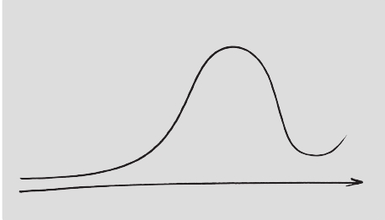
How to Interview? Have a Conversation
Be human.
Seek stories.
Talk about feelings.
Anatomy of an interview
Explore
Emotions
Evoke
Stories
Build
Rapport
Follow-up
& Question
Statements
Thank &
Wrap-up
time
Adapted from Michael Barry
Intro
Yourself
Intro
Project
Ask “WHY?”
Notes:
Observe WHAT they are doing (facts)
HOW are they doing it?
WHY are they doing it the way they are?

Slide 19
Types of Questions to Avoid
What they would do / like / want in hypothetical scenarios
How often they do things
How much they like things on an absolute scale
Avoid binary questions
“Tell me a story about yourself”
Notes:
The last time they did something

Slide 20
Good Questions
Notes:
Especially at the beginning of an interview, I recommend open-ended questions.

Slide 21
Conducting An Interview
Introduce yourself, explain your purpose
The interview is about them, not you!
Begin with open, unbiased questions
Ask the question and let them answer

Slide 22
(a little bit of)
Silence is Golden

Slide 23
Follow up
Adjust your questions to their previous answers
Ask questions in language they use / understand
Pick up on & ask for examples
Be flexible
Notes:
Prepare a set of questions, but don’t be constrained by them
Begin with Open-ended questions
Restate answers, follow up, and probe further
Don’t be afraid to call people out
Ground questions with artifacts and specific instances

Slide 24

Extreme Users
Behaviors & Feelings are amplified
Help you notice nuances & find insights
Examples for travellers
  family w/ young children
  fearful passenger
  wheelchair user
  commuter
CC : flickr/@Saigonphoto
Notes:
Email: some people get 1000 emails a day they need to deal with. Others only check their email once a month. Both can provide insights or inspire designs.
[[Question: what might Ms. Monthly lead you to? Possible answer: programs for people going on vacations and needing to catch up once back.]]
If possible, try to interview several different experts with different point of views
Remember that the real “experts” are the users you are designing for. Don’t ask experts for solutions, or take their ideas as a final solution

Slide 25
What are the gems?
You’ve uncovered a surprise or found what is missing
You can explain why people do unusual things
You want to tell others about what you have learned

Slide 26
Share with your team
Stories
Photos
Sketches
Quotes
Notes:
So what do you do? You have tons of notes, pictures, stories. How do you make sure you keep it in mind throughout the process?
We will talk about that more next lecture.

Slide 27
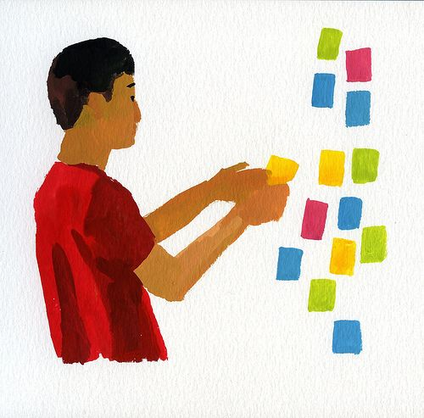
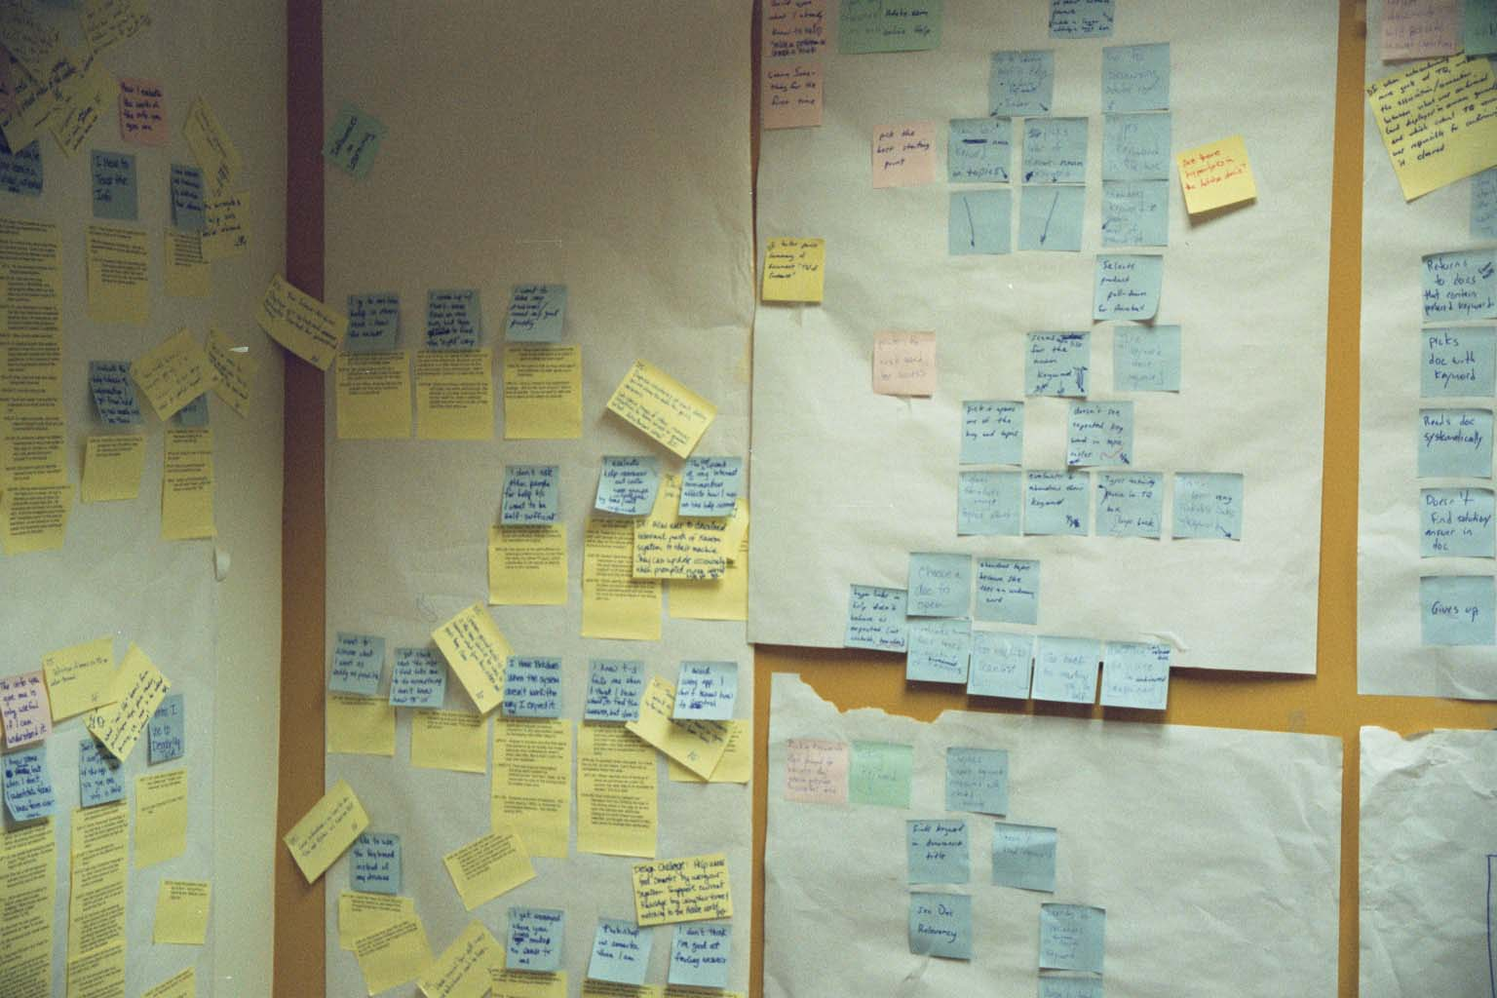
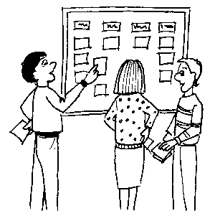
Using the Data Collected in the Field
Figure out what is important
Affinity diagramming
  group info & find relations between groups
  Post-Its on
  large surfaces
    haptic UI
    brainstorming
    immersive
    persistent
  also used for
  creating web
  info architecture
Notes:
So what do you do? You have tons of notes, pictures, stories. How do you make sure you keep it in mind throughout the process?

Slide 28
Your goal:
a point of view
Notes:
This is a term of art.
It’s your rallying cry: an actionable problem statement. Rather than trying to solve getting to Stanford, you are…making it easier for Stanford students and staff who live in SF to commute.
It encapsulates a specific person or set of people and how you can make a breakthrough in their lives.
What’s the most important, specific, problem that you can solve?

Slide 29
Flare, then focus.
Notes:
This is going to be the first time you’ll come across one of the themes of the course: flare, then focus. Generate as many observations as you can, then group them, extract higher-level themes, use those to lead to new ideas. And eventually pick the ones you like the best.
This idea will come back again, for example when we start talking about ideation and then again when prototyping.

Slide 30
Administrivia
Fill out studio survey now if you want to take the class at http://goo.gl/forms/WOuZVZ9CPp
Join the Piazza forum to keep up with questions & announcements at http://piazza.com/stanford/fall2015/cs147
Thursday studio accepts have been sent email – attend today
Friday studio assignments will be announced by 6 PM – stay tuned
  attend assigned studio unless pre-cleared by staff

Slide 31
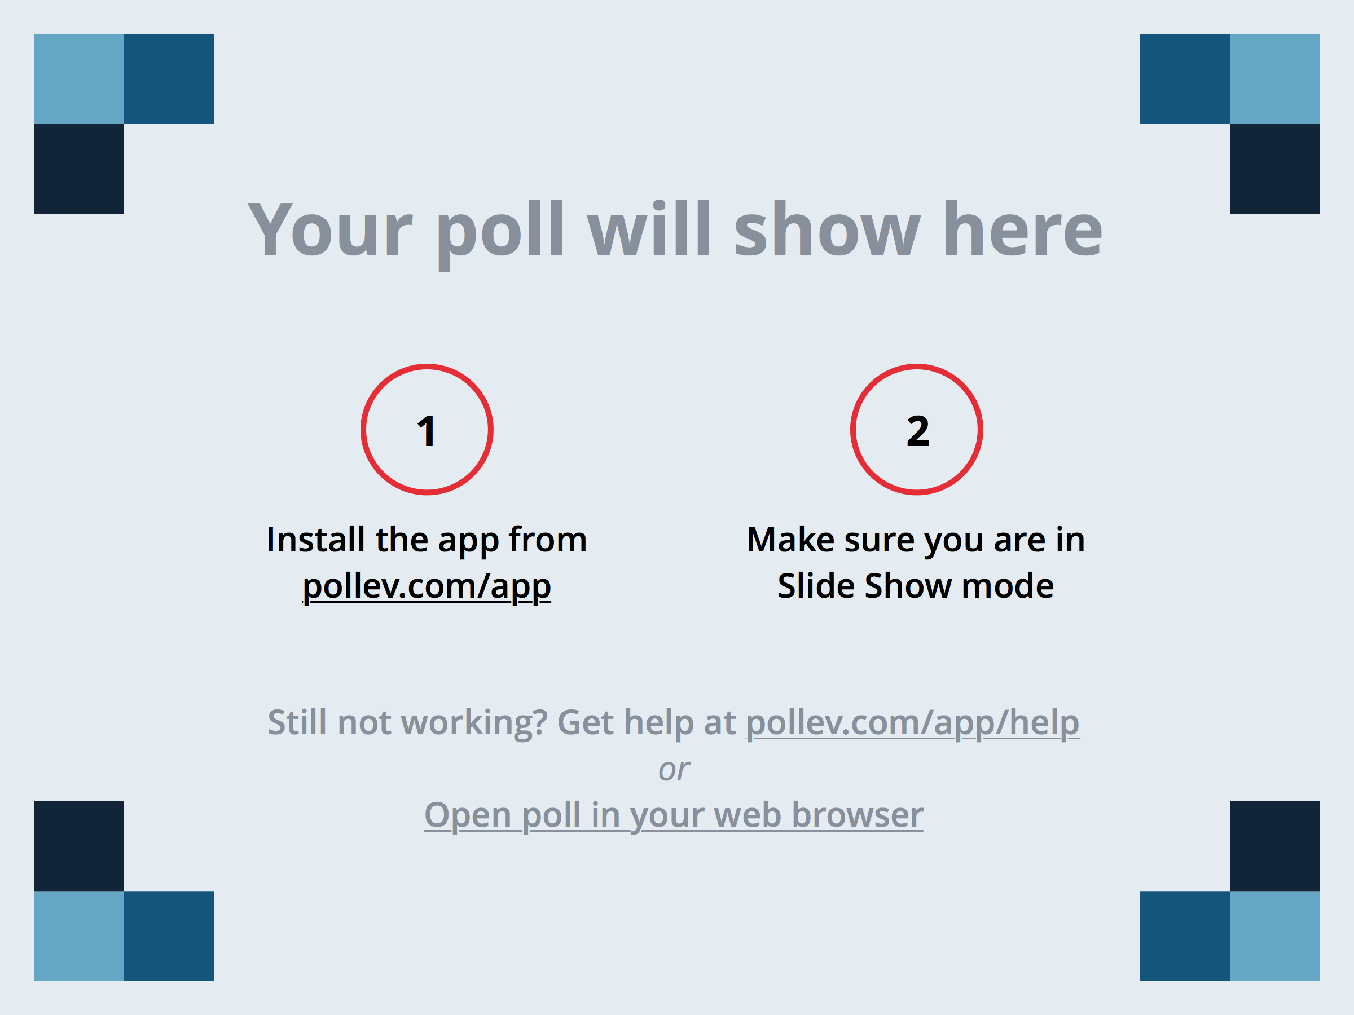
Notes:
What is the key technique used by Contextual Inquiry?
https://www.polleverywhere.com/multiple_choice_polls/VE0g9KWFFDXqava

Slide 32
Contextual Inquiry
Specific needfinding method for understanding customers’ needs & work practices
Master / Apprentice model allows customer to teach us what they do! ?
  master does the work & talks about it while working
  we interrupt to ask questions as they go
The Where, How, and What expose the Why
Notes:
Master apprentice in contrast to other kinds of relationships, ex. scientist-observer or parent-child

Slide 33
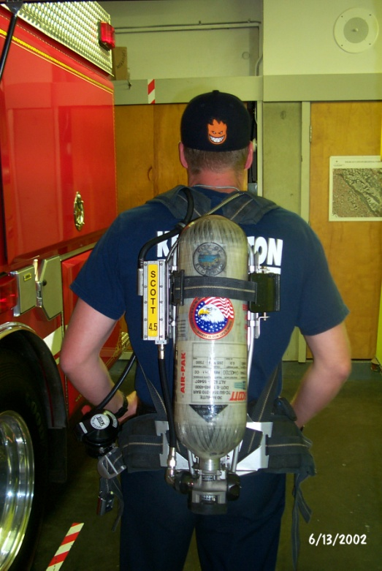
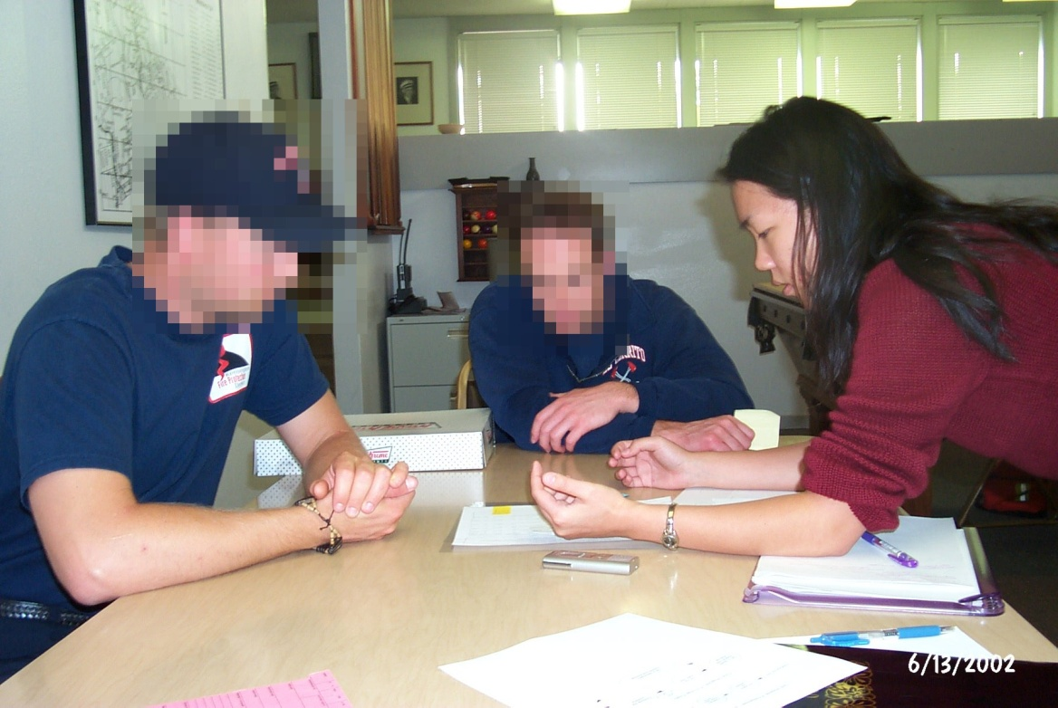
Principles
1) Context
  contact real/intended customers
  go to the target setting & see the activity as it unfolds
  people summarize, but we want details
    keep it concrete when people start to abstract
      “We usually get reports by email”, ask “Can I see one?”
Notes:
not there to get a list of questions answered
not there to answer their questions either (easy traps to fall into)
Contextual inquiry is not an interview, more of an process for understanding

Slide 34
Principles (cont.)
1) Context
  contact real/intended customers
  go to the target setting & see the activity as it unfolds
  people summarize, but we want details
    keep it concrete when people start to abstract
      “We usually get reports by email”, ask “Can I see one?”
2) Interpretation
  facts are only the starting point, design based on interpretation
  validate & rephrase
    share interpretations to check your reasoning
      Ex. “So accountability means a paper trail?”
      No, not here. It means safety for personnel/equipment
    people will be uncomfortable until the phrasing is right
      be committed to listening (“Huh?”, “Umm…”, “Yes, but…”)
Notes:
not there to get a list of questions answered
not there to answer their questions either (easy traps to fall into)
Contextual inquiry is not an interview, more of an process for understanding

Slide 35
Principles (cont).
3) Focus
  interviewer needs data about specific kind of activity
    “steer” conversation to stay on useful topics
  respect triggers (flags to change focus)
    shift of attention (someone walks in)

Slide 36
Users: Unique or One of Many?
“Take the attitude that nothing any person does is done for no reason; if you think it’s for no reason, you don’t yet understand the point of view from which it makes sense.
Take the attitude that nothing any person does is unique to them, it always represents an important class of customers whose needs will not be met if you don’t figure out what’s going on.”
(p. 63, Contextual Design)

Slide 37
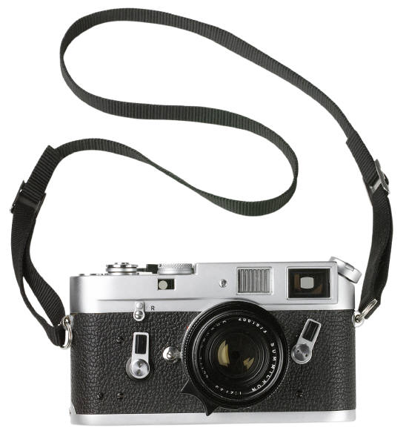
Thoughts on Interviews
Use recording technologies
  notebooks, digital/phone recorders, still & video images
Structure
  conventional interview (10 minutes)
    introduce focus, deal with ethical issues, get summary data
  transition (30 seconds)
    state new rules – they work while you watch & interrupt
  contextual interview (20-60 minutes)
    take notes, draw, be nosy! (“who was on the phone?”)
  wrap-up (15 minutes)
    summarize your notes & confirm what is important
Master / apprentice can be hard
  e.g., sometimes need to put down your company

Slide 38
Contextual Inquiry Exercise
Turn to someone on your right
Interview that person using Master-Apprentice model to find out how they schedule appointments
2 minutes
Switch places & repeat
2 minutes

Slide 39
Notes:
What are some of the key terms you learned about scheduling appointments? (tools, issues, etc. - up to 3)
https://www.polleverywhere.com/free_text_polls/40syjyOt1QwJeUY

Slide 40

Task Analysis
Use this to organize field data
Find out
  who customers are
  what tasks they need to perform

Slide 41
Task Analysis Questions (11)
Who is going to use the system?
What tasks do they now perform?
What tasks are desired?
How are the tasks learned?
Where are the tasks performed?
What’s the relationship between customer & data?

Slide 42
Task Analysis Questions (cont.)
What other tools does the customer have?
How do users communicate with each other?
How often are the tasks performed?
What are the time constraints on the tasks?
What happens when things go wrong?

Slide 43
Who?
Identity
  in-house or specific customer is easy
  need several typical users for broad product
Background
Skills
Work habits and preferences
Physical characteristics
  height?

Slide 44
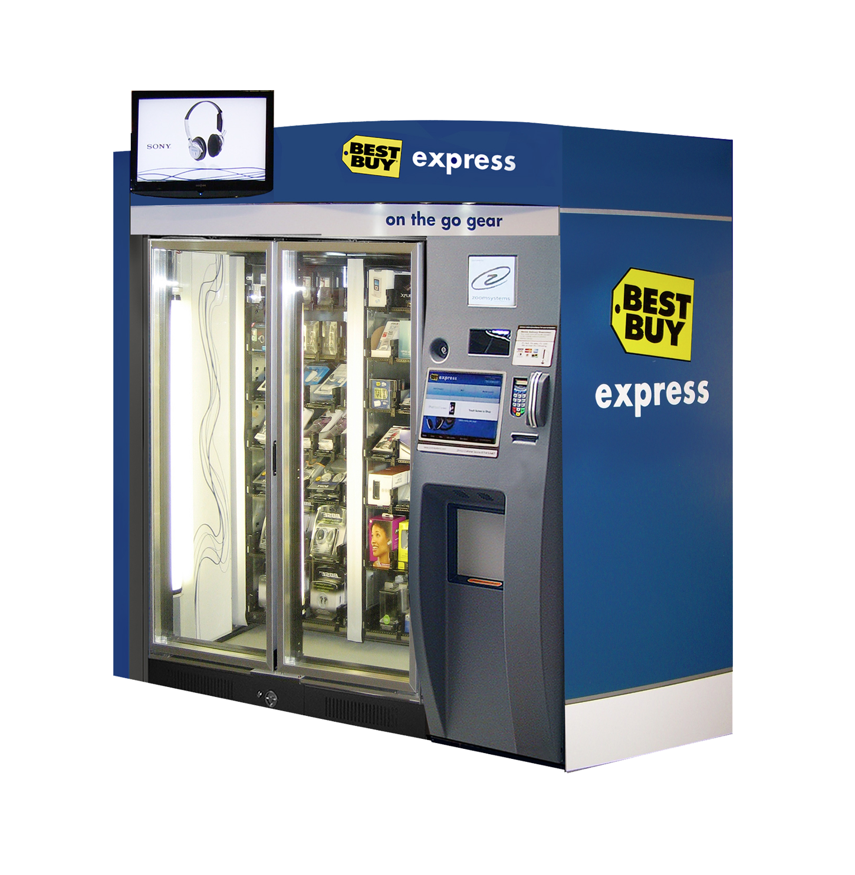
Best Buy Express: On the Go Gear

Slide 45
Who (Best Buy Express)?
Identity?
  people who are passing through airport
    business people, tourists, airline employees…
Background?
  must have an ATM card or credit card
  have used other vending/ticket machines before
Skills?
  may know how to put cards into ATM

Slide 46
What Tasks?
Important for both automation and
new functionality
Relative importance of tasks?
Observe customers, see it from their perspective
  on-line billing example
    small dentists office had billing automated
    assistants were unhappy with new system
    old forms contained hand-written margin notes
      e.g., patient A’s insurance takes longer than most, etc.

Slide 47
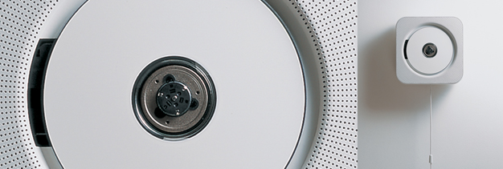
How are Tasks Learned?
What does the customer need to know
Do they need training?
  academic
  general knowledge / skills
  special instruction / training

Slide 48
Where is the Task Performed?
Office, laboratory, point of sale?
Effects of environment on customers?
Users under stress?
Confidentiality required?
Do they have wet, dirty, or slippery hands?
Soft drinks?
Lighting?
Noise?

Slide 49
How Often Do Customers Perform the Tasks?
Frequent customers remember more details
Infrequent customers may need more help
  even for simple operations
  make these tasks possible to do
Which function is performed
  most frequently?
  by which customers?
  optimize system for these tasks will improve perception of good performance

Slide 50

What are the Time Constraints on the Task?
What functions will customers be in a hurry for?
Which can wait?
Is there a timing relationship between tasks?

Slide 51
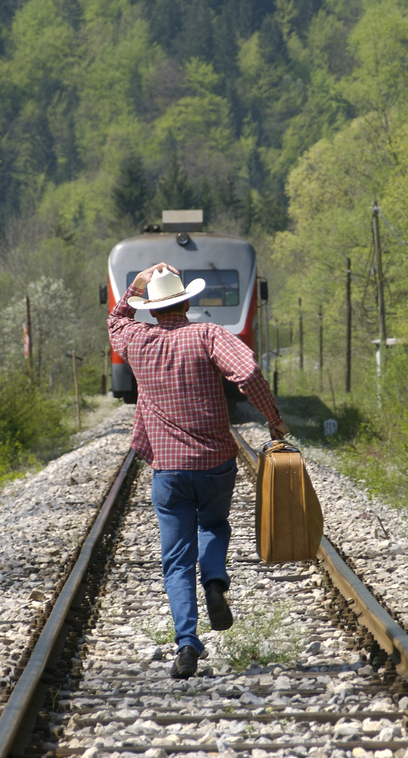
What Happens When Things Go Wrong?
How do people deal with
  task-related errors?
  practical difficulties?
  catastrophes?
Is there a backup strategy?

Slide 52
Caveats of User-Centered Design
Politics
  “agents of change” can cause controversy
  important to get buy-in from all those involved
Customers are not always right
  cannot anticipate new technology accurately
  job is to build system customers will want
    not system customers say they want
Design/observe forever without prototyping
  rapid prototyping, evaluation, & iteration is key
Notes:
get a sense of organization & bond w/ interviewee
not system customers say they want
be very careful about this (you are outsider)
if you can’t get customers interested in your hot idea, you’re probably missing something

Slide 53
Further Reading
Books
  User and Task Analysis for Interface Design by
  Joann T. Hackos, Janice C. Redish
  The Inmates are Running the Asylum by Alan Cooper
  Don Norman, The Design of Everyday Things
  Kuniavsky, Observing the User Experience
Institute of Design at Stanford
  lots of online materials at
  http://dschool.stanford.edu

Slide 54
Summary
Know thy user & involve them in design
Needfinding
  build empathy with customers
  listen to them to discover interesting insights
Contextual inquiry
  way to answer the task analysis questions
  interview & observe real customers in situ
  use what model to get them to teach you?
    the master-apprentice model
Notes:
CI is specific interviewing method used in needfinding

Slide 55
Next Time
Lecture
  Define: Unpacking the needfinding results to better define the problem/domain of interest
  Ideate: How might we solve the problem?
Readings
  None
Watch
  ABC News Nightline IDEO Deep Dive, July 1999 (22 minutes)
  Bonus video: ABC News, IDEO Design Thinking, January 2013 (60 minutes)

