Slide 1
Problem Finding
CA First Last
Time, Location
Sept. 25-26, 2014
* slides based on those of Prof. Tad Hirsch, UW Design

Slide 2
Wicked Problems
Ill-defined
Complex, interrelated
Multiple stakeholders, differing perspectives
Example: Air pollution
No stopping rule
Problems are managed, not solved
Examples: Aging
Notes:
See Rittel 1973, Buchanan 1992.

Slide 3
Implications for Design
Solutions depend on how the problem is Framed… and vice-versa
Solutions are not optimal
There’s no right or wrong… but there is better and worse
Every problem is unique
Creative approaches are required
Notes:
“a purely scientific-rational approach cannot be applied because of the lack of a clear problem definition and differing perspectives of stakeholders”

Slide 4

Approach
Explore the problem
Find a leverage point
Design an intervention
See what happens
Repeat

Slide 5
Methods
Concept mapping
create a model
find out what you already know
Ideation
explore a solution space

Slide 6

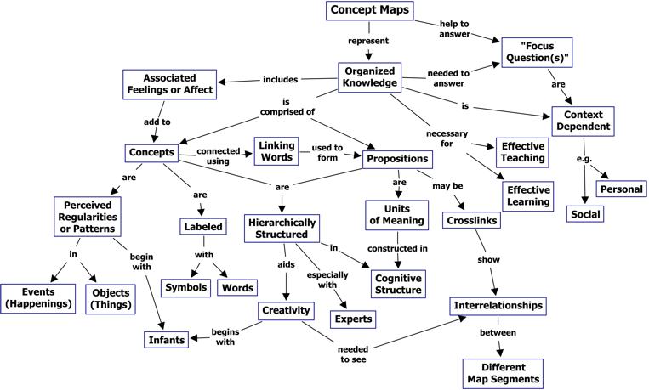
Concept mapping
A technique for visualizing relationships between ideas
Notes:
“A concept map is a diagram showing the relationships among concepts. It is a graphical tool for organizing and representing knowledge.” (wikipedia)

Slide 7
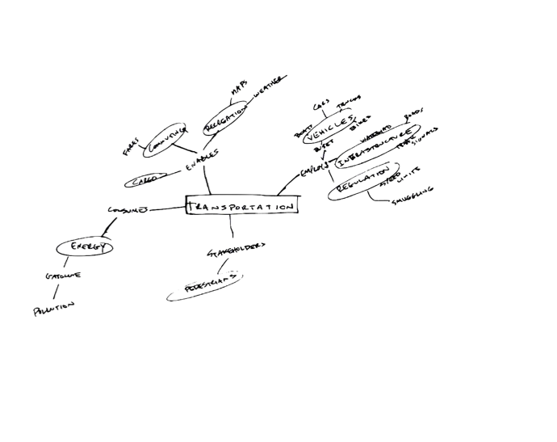
Concept mapping
Process
List 10-20 words associated with the topic
Group them into named categories
Start diagramming
Add categories + examples
Label the relationships
Keep going until you lose momentum (and/or run out of time)
Highlight areas for further investigation
Outcomes
A model (not definitive!)
A few design directions

Slide 8
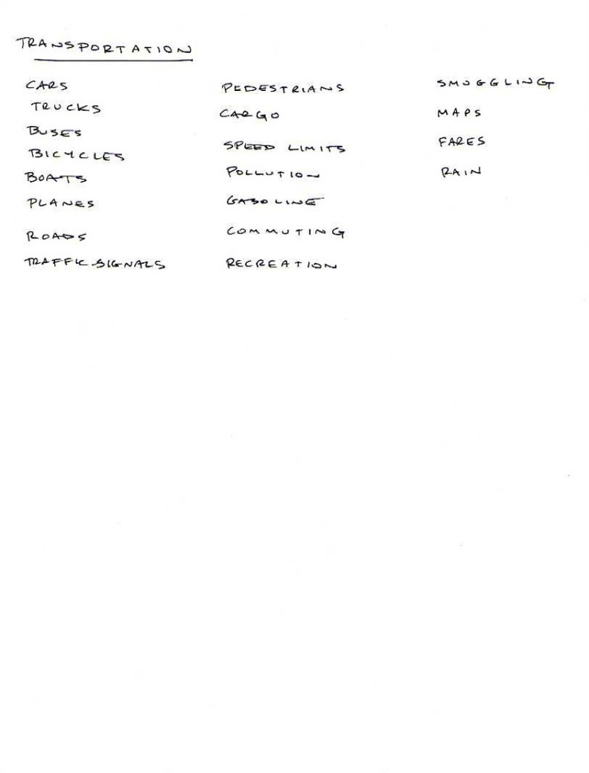
Step 1: List associated words

Slide 9
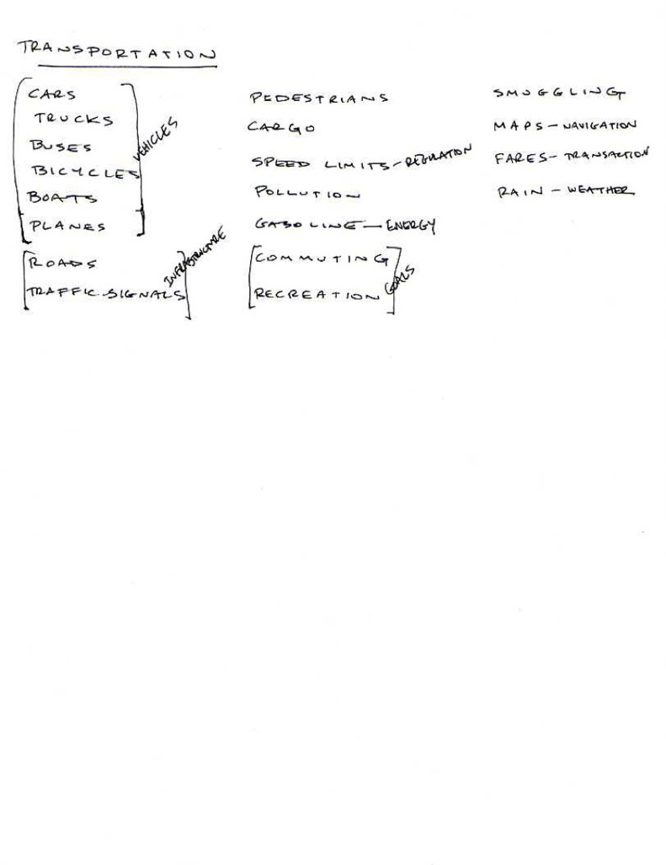
Step 2: Group into Categories

Slide 10
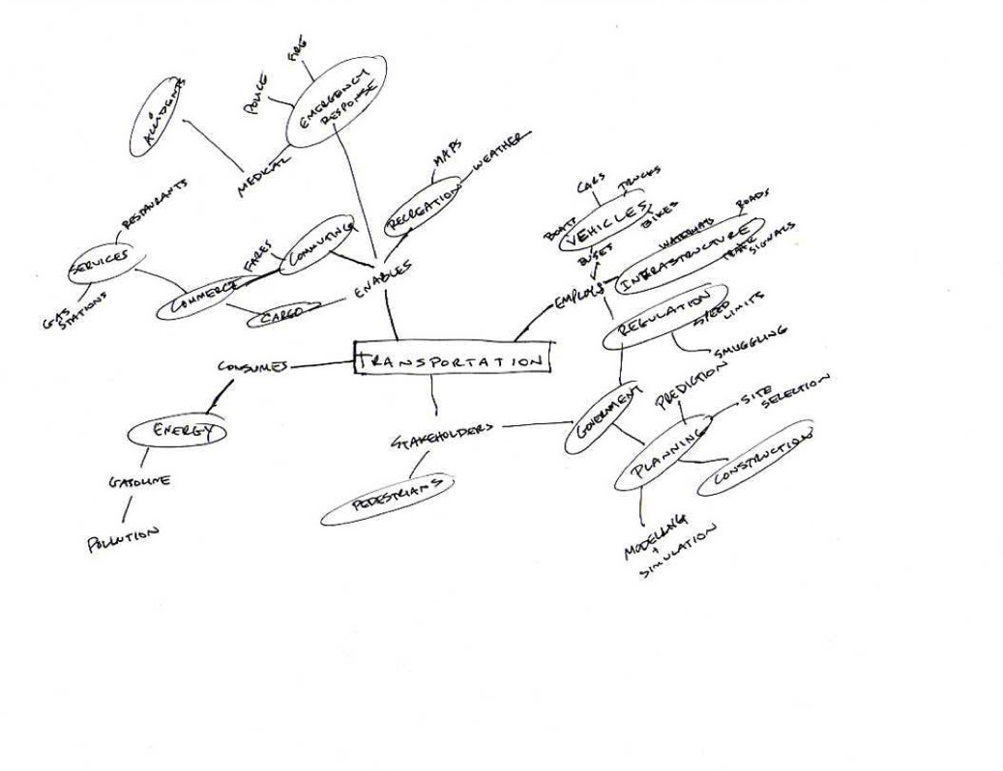
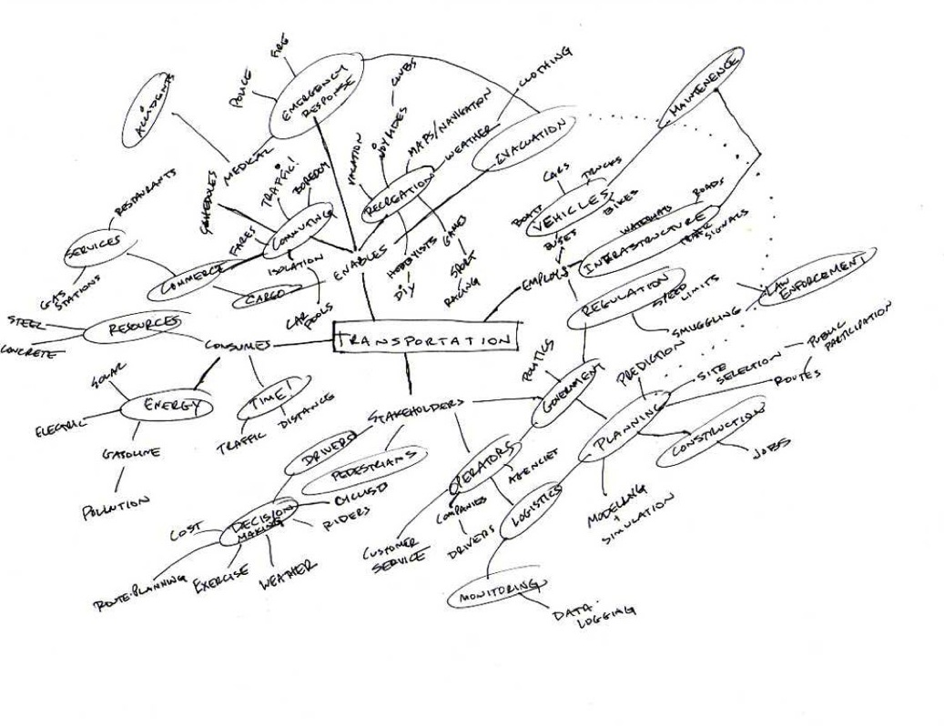
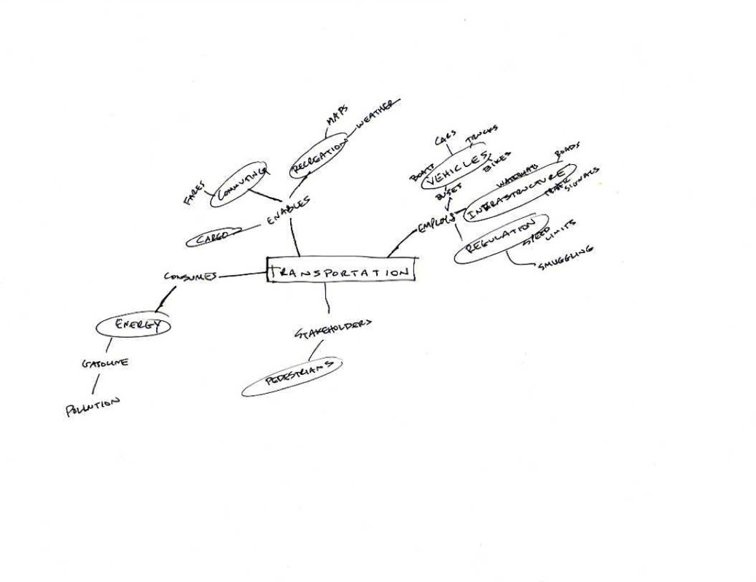
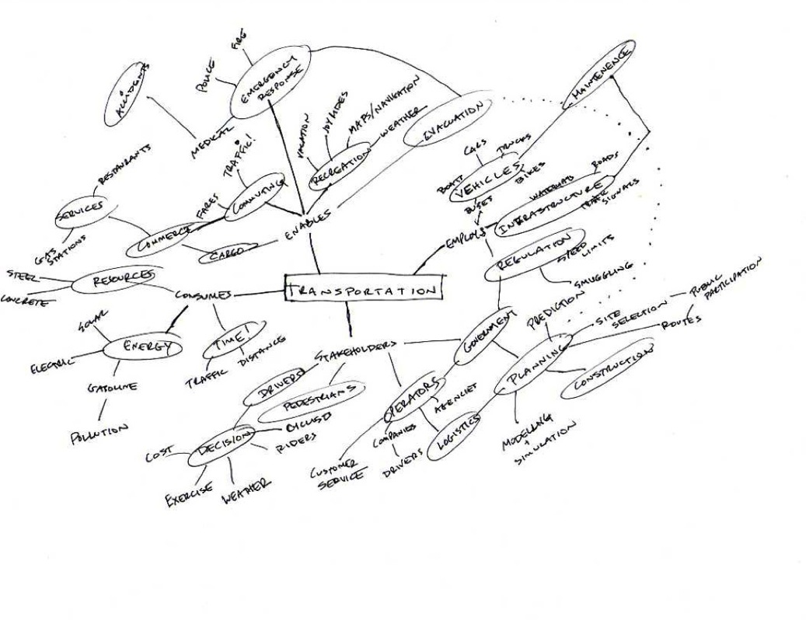
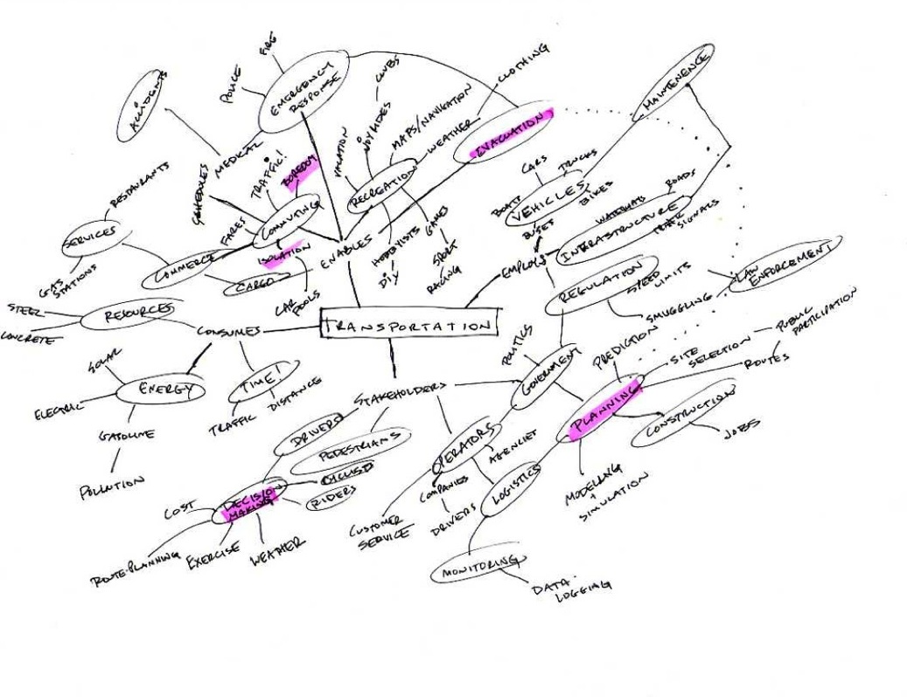
Step 3: Start Diagramming

Slide 11
Step 4: Add Categories + Examples

Slide 12
Step 5: Keep Going

Slide 13
Step 6: And going…

Slide 14
Step 7: Highlight/Circle Areas for further Investigation

Slide 15
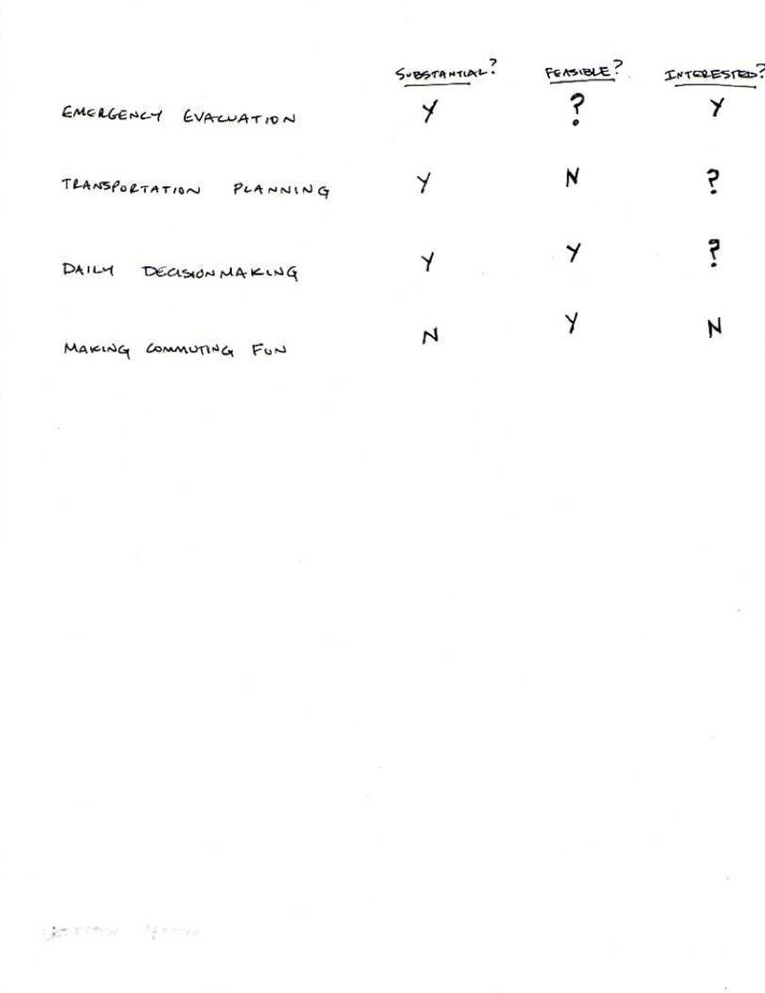
Step 8: Edit and Prioritize

Slide 16
Next step: Research + Analysis
How big a problem is it? (market)
Whose problem is it? (stakeholders)
What’s already out there? (competition)
How are things done currently? (status quo)
How can they be improved? (innovation)

