Slide 1
Stanford CS: HCI+Design CS 147 Overview

Slide 2
Outline
Course overview
Project presentations
Poster session/demos

Slide 3
balance
design
technology
Notes:
You need to find a balance between:
design & technology, human-centered approaches & CS approaches
Especially now HCI needs to find a balance between careful controlled experiments of existing technologies or minor tweaks on technology and building major new systems that can solve important world problems.

Slide 4
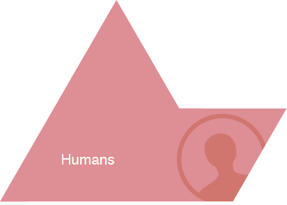
HCI Approach to UI Design
Notes:
Examples of Tasks/Activities:
activity:
learning history
high level task:
- writing a paper
- drawing a picture
low level task (operation):
- copying a word from one paragraph to another
- coloring a line

Slide 5
Goals of CS 147
Learn to design, prototype, & evaluate UIs
tasks & work practices of prospective users
cognitive/perceptual constraints affecting design
techniques for evaluating UI designs
importance of iterative design for usability
technology used to prototype UIs
how to work together as a team
communicating results to a group

Slide 6
Iterative Design
Driven by the variability in human performance
Design
Prototype
Evaluate

Slide 7
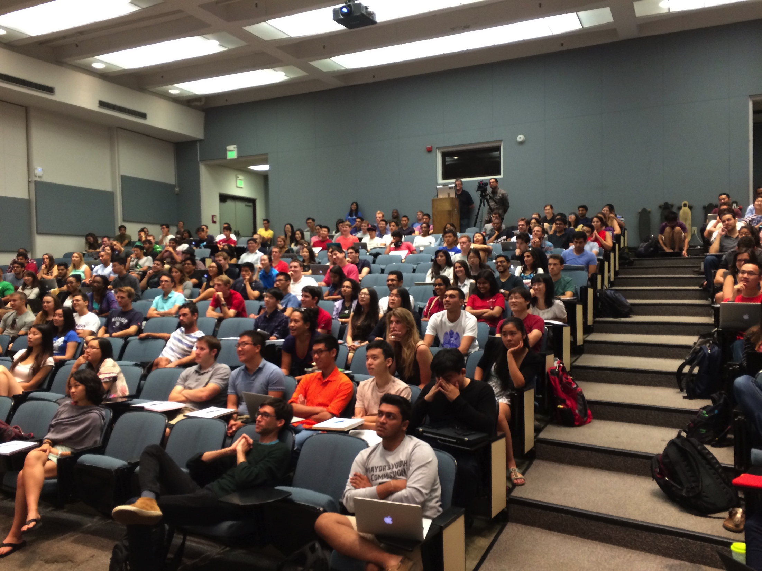
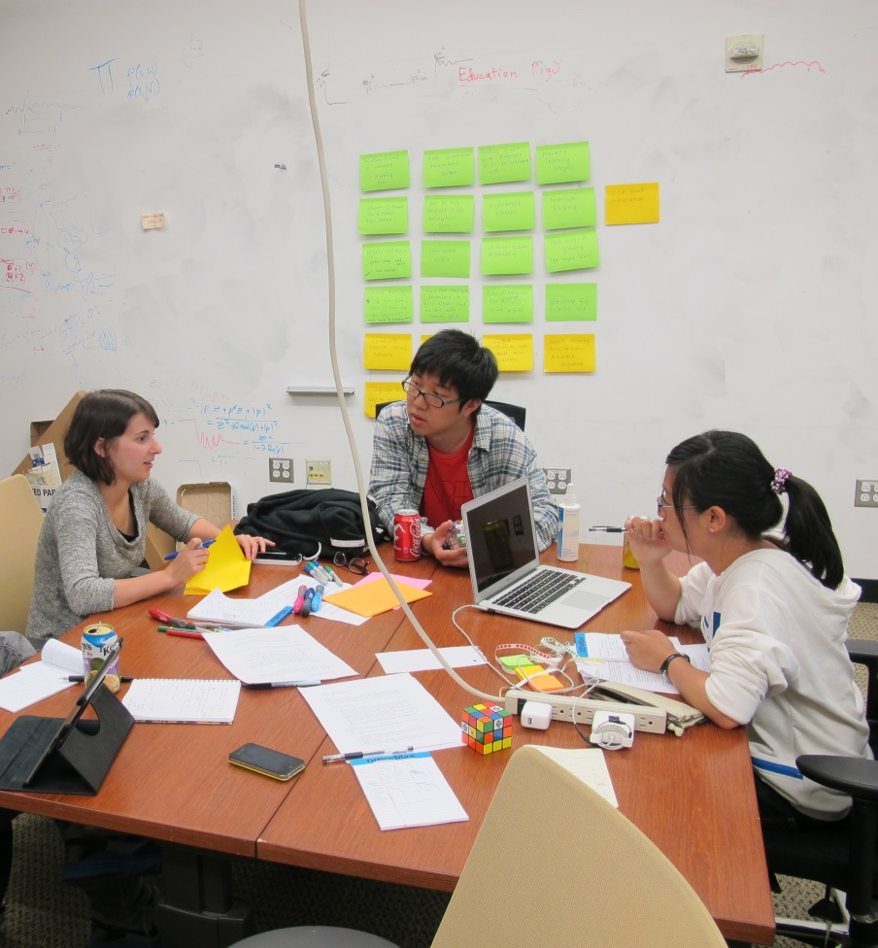
Project Based Course
Iterative design of a real UI
Theme: mobile computing
Quarter long projects
Students
200 across CS, Symbolic Systems …
54 Teams
3-4 members
8 major group assignments
group work ~60% of course grade
Four presentations
every team member presents

Slide 8
Timeline
Contextual Inquiry / Task Analysis + Sketches
Paper Prototype
+ User Testing
Heuristic Evaluation
Project Fair
Sketches + Concept Videos
Interactive Medium-fi
Prototype #1
Interactive Hi-Fi Prototype
Problem Finding
Proposal
Week 1
Week 2
Week 3
Week 4
Week 5
Week 6
Week 7
Week 8
Week 9
Week 10

Slide 9
Design Studios
Each team attended small weekly studio (8-16 students/studio)
critique/feedback in more intimate environment
Individual/studio assignments
Project proposal
Problem finding & research
Hall of Fame/Shame
Guerilla ideation
Heuristic evaluation

Slide 10
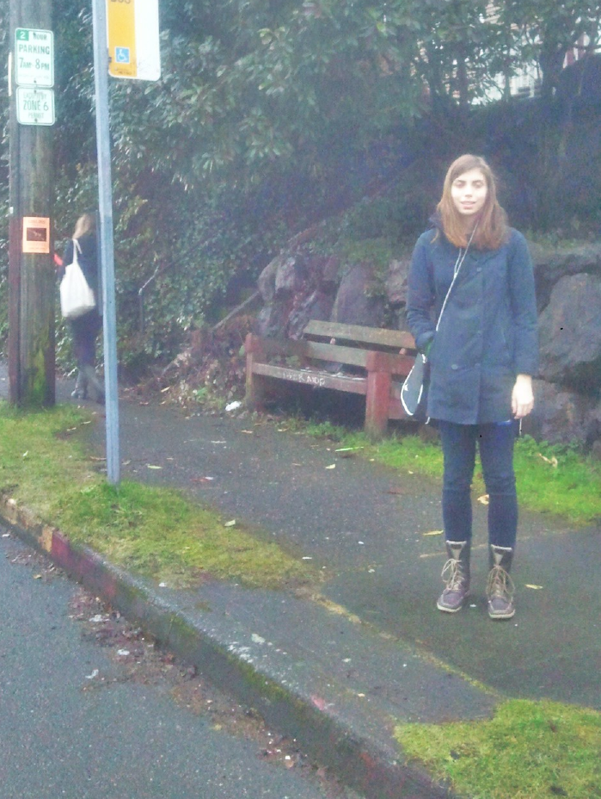
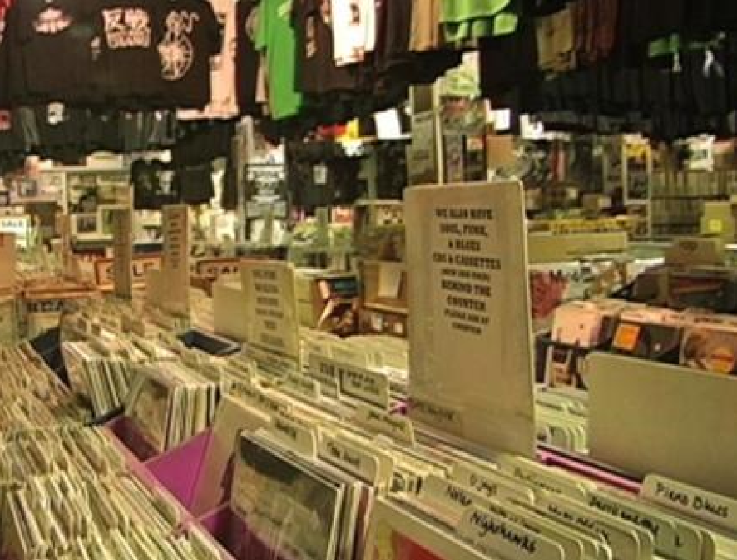
User-centered Design: Fieldwork
Contextual Inquiry & Task Analysis
observe existing work practices
make sure key questions answered
Tuned CI participant
Tuned field work in record store
Notes:
Start with this CI design sketch, but required many examples (over 30 on 1st assignment) on each subsequent assignment from different folks on the team

Slide 11
Sketching & Storyboarding
tagbuster
Notes:
1. Idea generation, Pick 3 or 4… and show in depth

Slide 12
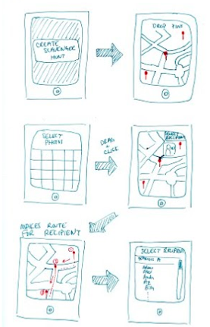
Sketching & Storyboarding
Parcel
Notes:
1. Idea generation, Pick 3 or 4… and show in depth

Slide 13
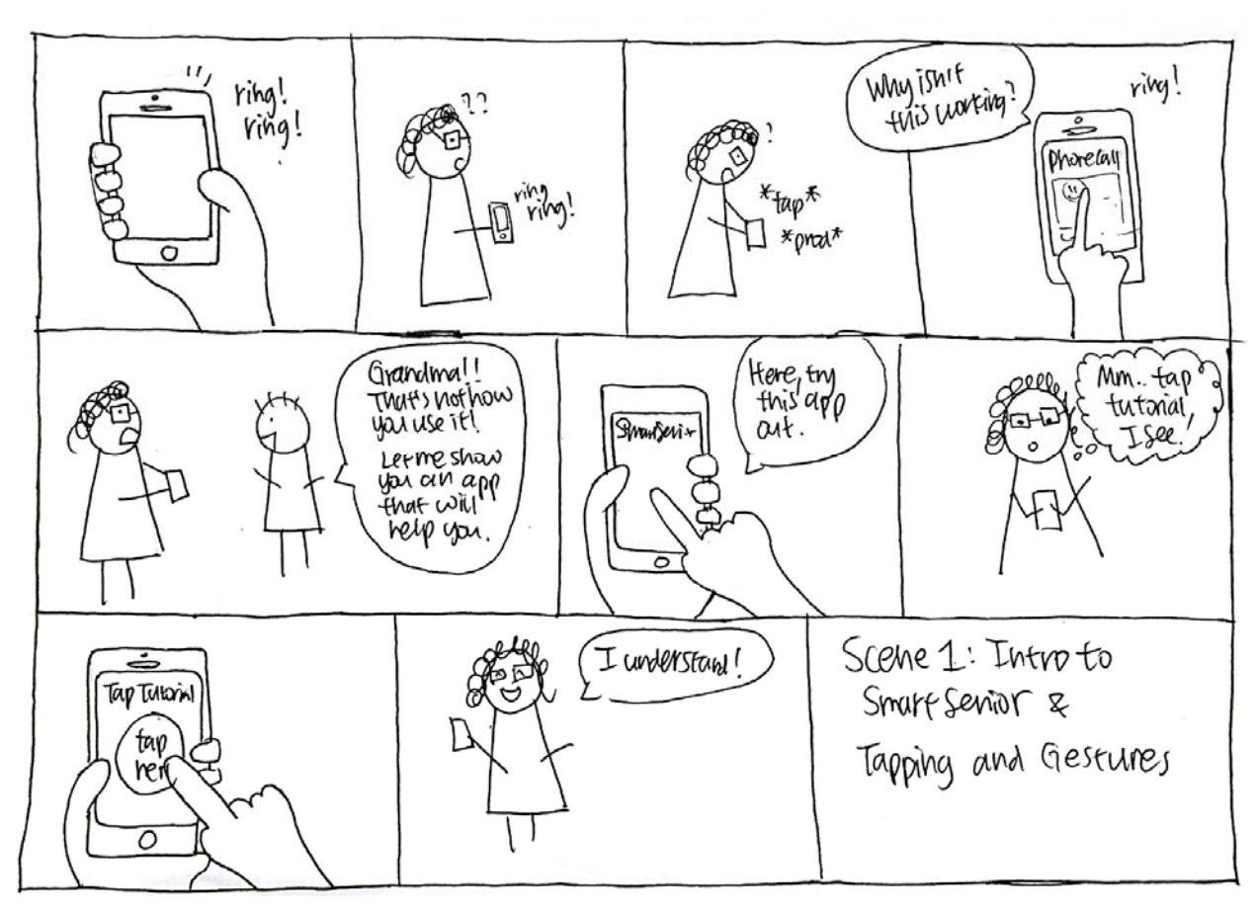
Concept Videos
SmartSenior
Notes:
1. Idea generation, Pick 3 or 4… and show in depth

Slide 14
Concept Videos
InvestorScope
Notes:
1. Idea generation, Pick 3 or 4… and show in depth

Slide 15
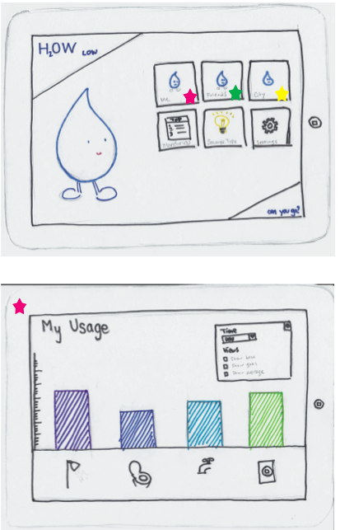
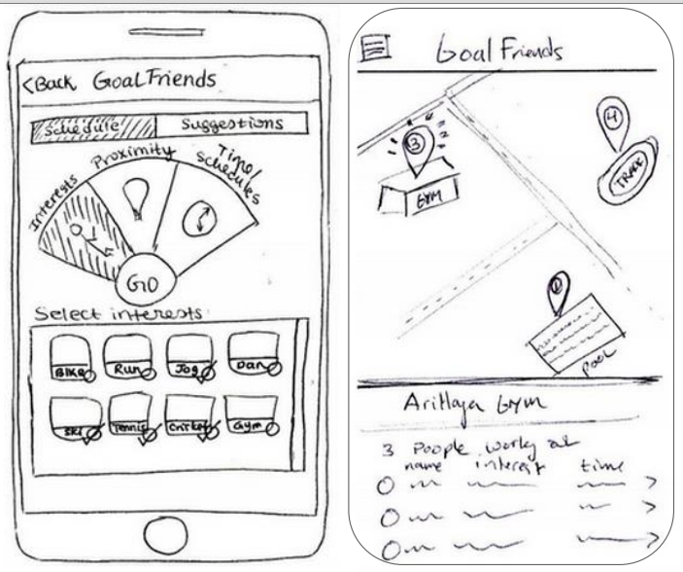
Low-fi Prototyping & Testing
How Low
Goal Friends

Slide 16
Interactive Prototypes Medium Fidelity
Insidejob

Slide 17
Interactive Prototypes Hi-Fidelity
Tutera
Uncharted

Slide 18
Evaluation
Test with real users (participants)
Low-cost techniques
expert evaluation (HE)

Slide 19
How CS 147 Fits into the Curriculum
Most CS courses teach underlying technology
compilers, operating systems, databases, etc.
CS 147 concerned w/ design & evaluation
technology is simply a tool to evaluate designs by prototyping
build skills that will be important upon graduation
design & evaluation
creating complex systems
working on large teams
communicating results
Goal: Make Stanford the place for interaction & design
Notes:
Part of making Stanford the place for leading edge interaction & design across research & education

Slide 20
http://cs147.stanford.edu
Project web sites w/ all materials
Lecture topics, slides, & video
Homework assignments

Slide 21
The Projects
16 Judges will be picking the best projects (announced at 7:50 PM)
You too will have a say by voting for The People’s Choice Award
http://bit.ly/cs147-people-choice

Slide 22
The Judges
John Tang, Microsoft Research
Sunny Consolvo, Google
Vivek Wadhwa, Stanford & Singularity University
Ravi Mhatre, Lightspeed Venture Partners
Dan Maynes-Aminzade, Google
Manu Kumar, K9 Ventures
Shumin Zhai, Google Research
Terry Winograd, Stanford
Beverly Harrison, Yahoo
Zhiwei Guan, Google
Anoop Sinha
Susumu Harada
Micah Laaker, Google
Paul Fu, Alibaba
Dave Bags, Stanford d.School
Roberto Ortiz, Yahoo
Scott Doorley, Stanford d.School
James Cham, Bloomberg Beta
Michael Bernstein, Stanford
Chen Zhao, Alibaba.com

Slide 23
Thanks! Get Involved!
Team mentors in CS 194H (Winter Quarter)
Co-teach Stanford HCI/Design courses
studio faculty in CS 247 (Winter Quarter)
Engelbart Legacy course in d.School (Spring)
Hire students and interns
Support HCI+Design research at Stanford

Slide 24
The Projects
The People’s Choice Award
http://bit.ly/cs147-people-choice

Slide 26
THE AWARDS

Slide 27
Best in Each Theme
Behavior Change 1
Runner Up: TutorNow
Winner: SpringBoard
Behavior Change 2
Runner Up: FoodShed
Winner: RightToVote
Creation
Runner Up: VirtualVenues
Winner: Unguided
Crowd Power
Runner Up: Musit
Winner: Tongues
Discovery
Runner Up: UnCharted
Winner: Huddle
Information
Runner Up: PlateList
Winner: Clarity
Learning
Runner Up: Tutera
Winner: SmartSenior
Motivation
Runner Up: FunPod
Winner: PassItOn

Slide 28
Best Pitch
Runner Up
Math Outside The Box
The Winner
AdventureCraft

Slide 29
Best Poster
Runner Up
Museit
The Winner
Usher

Slide 30
Best Demo
Runner Up
PassItOn
The Winner
Huddle

Slide 31
Best Startup Idea
Runner Up
Huddle
The Winner
UnGuided

Slide 32
Biggest Moonshot
Runner Up
Civility
The Winner
VirtualVenues

Slide 33
Biggest Social Impact
Runner Up
Clarity
The Winner
SpringBoard

Slide 34
Best Design
Runner Up
SmartSenior
The Winner
PassItOn

Slide 35
Most Creative
Runner Up
PassItOn
The Winner
Right To Vote

Slide 36
The People’s Choice
Runner Up
Token
The Winner
UnCharted

Slide 37
Best Overall Project
2nd Runner Up
Clarity
1st Runner Up
SpringBoard
The Grand Prize Winner
PassItOn

