Slide 1
(1) Action Analysis (2) Automated Evaluation
November 18, 2014
Notes:
1:02 – could add a little more examples of GOMS, graphics, and more on automated techniques would be more interesting

Slide 2
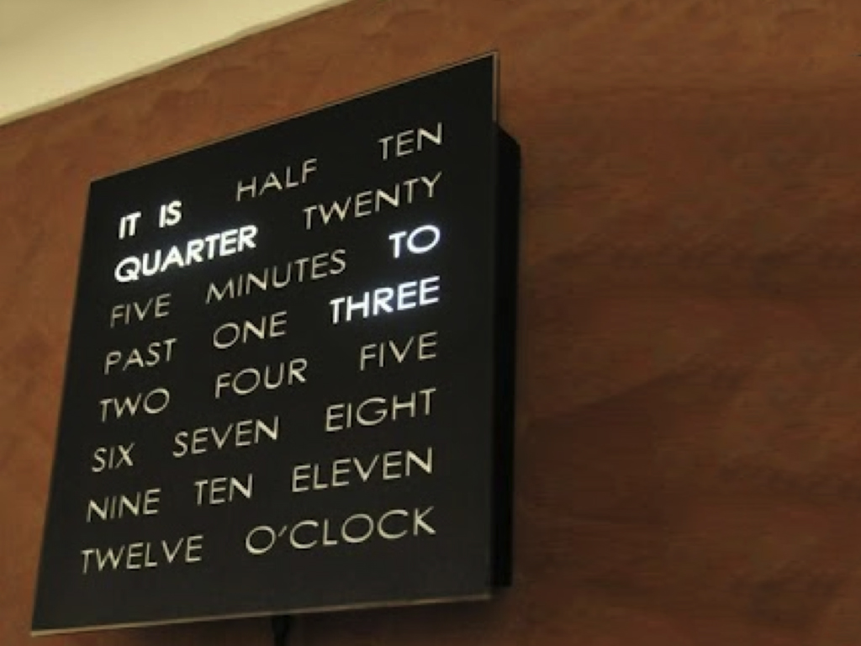
Hall of Fame or Shame?
Text Clock

Slide 3
Hall of Shame!
Clock
What is the purpose?
This slows you down!
Though it is fun…

Slide 4
(1) Action Analysis (2) Automated Evaluation
November 18, 2014
Notes:
1:02 – could add a little more examples of GOMS, graphics, and more on automated techniques would be more interesting

Slide 5
Outline
Action analysis
GOMS? What’s that?
The G, O, M, & S of GOMS
How to do the analysis
Automated evaluation tools
Team Break (~50 minutes)

Slide 6
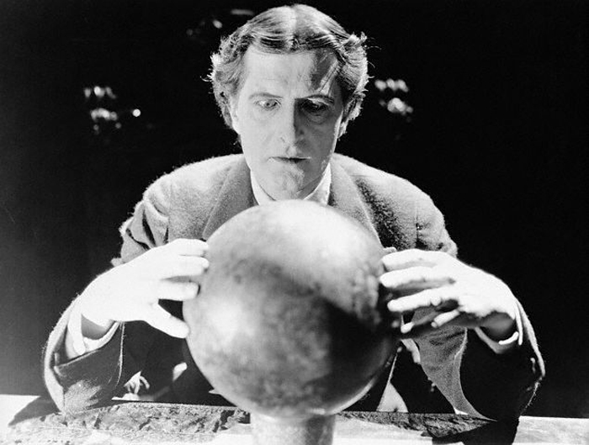
Action Analysis Predicts Performance
Cognitive model ?
model some aspect of human understanding, knowledge, intentions, or processing
two types
competence
predict behavior sequences
performance
predict performance, but limited to routine behavior
Action analysis uses performance model to analyze goals & tasks
generally done hierarchically (similar to task analysis)

Slide 7
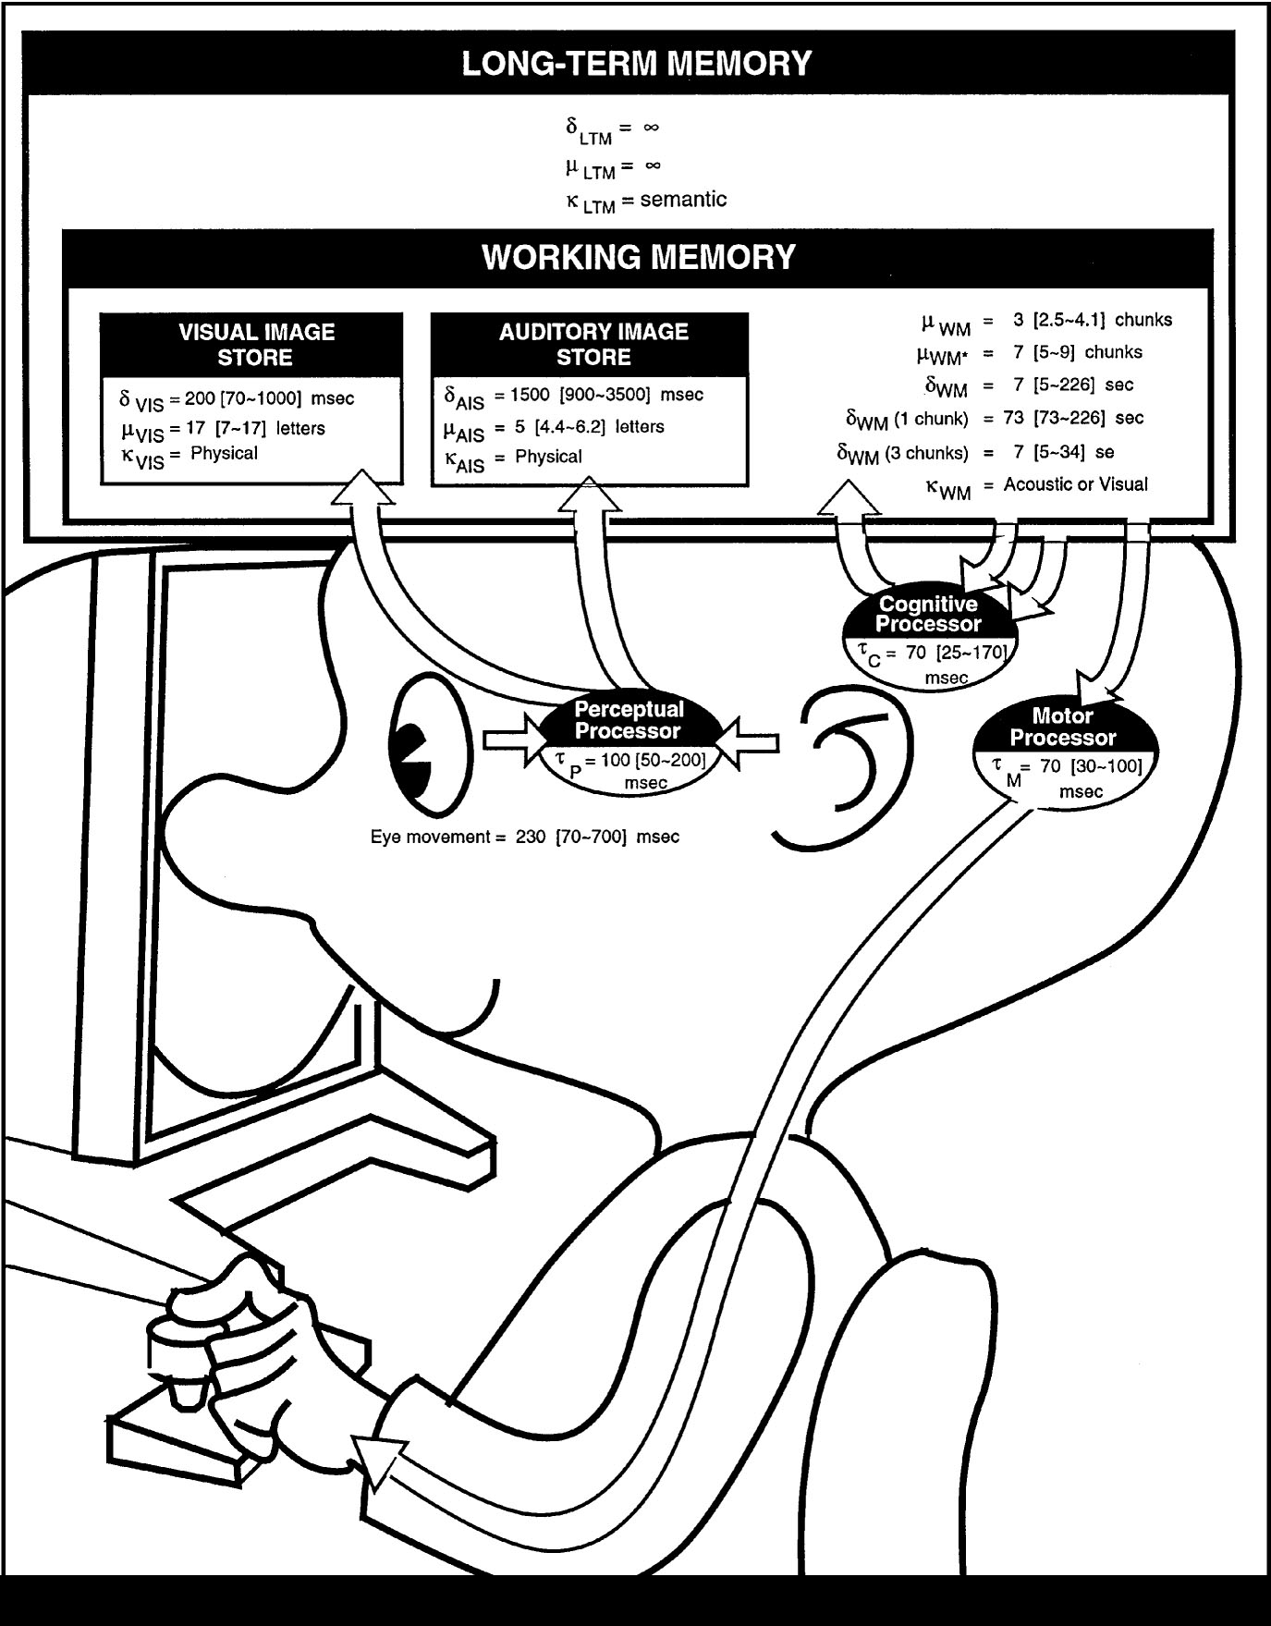
GOMS – Most Popular AA Technique
Family of UI modeling techniques
based on Model Human Processor cognitive model
GOMS stands for
Goals
Operators
Methods
Selection rules
Input: detailed description of UI/task(s)
Output: qualitative & quantitative measures

Slide 8
Quick Example
Goal (the big picture)
go from hotel to the airport
Methods (or subgoals)?
walk, take bus, take taxi, rent car, take train
Operators (or specific actions)
locate bus stop; wait for bus; get on the bus;...
Selection rules (choosing among methods)?
Example: Walking is cheaper, but tiring and slow
Example: Taking a bus is complicated abroad

Slide 9
Goals
Something the user wants to achieve
Examples?
go to airport
delete file
create directory
Hierarchical structure
may require many subgoals

Slide 10
Methods
Sequence of steps to accomplish a goal
goal decomposition
can include other goals
Assumes method is learned & routine
Examples
drag file to trash
retrieve from long-term memory command

Slide 11
Operators
Specific actions (small scale or atomic)
Lowest level of analysis
can associate with times
Examples
Locate icon for item on screen
Move cursor to item
Hold mouse button down
Locate destination icon
User reads the dialog box

Slide 12
Selection Rules
If > 1 method to accomplish a goal, Selection rules pick method to use
Examples
IF <condition> THEN accomplish <GOAL>
IF <car has automatic transmission> THEN <select drive>
IF <car has manual transmission> THEN <find car with automatic transmission>

Slide 13
GOMS Output
Execution time
add up times from operators
assumes ?
experts (mastered the tasks) & error free behavior
very good rank ordering
absolute accuracy ~10-20%
Procedure learning time (NGOMSL only)
accurate for relative comparison only
doesn’t include time for learning domain knowledge

Slide 14
GOMS Output Used To
Ensure frequent goals achieved quickly
Making hierarchy is often the value
functionality coverage & consistency
does UI contain needed functions?
consistency: similar tasks performed similarly?
operator sequence
in what order are individual operations done?

Slide 15
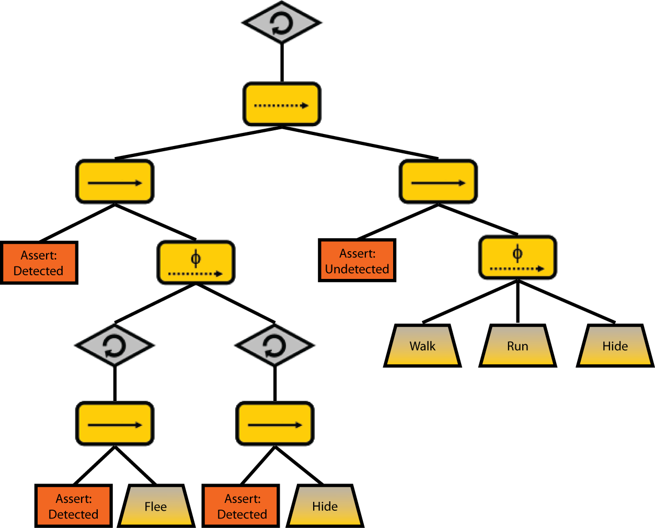
How to do GOMS Analysis
Generate task description
pick high-level user Goal
write Method for accomplishing Goal
may invoke subgoals
write Methods for subgoals
this is recursive
stops when Operators are reached
Evaluate description of task
Apply results to UI
Iterate!

Slide 16
Comparative Example – Unix shell
Goal: Delete a File
Method for accomplishing goal of deleting file
retrieve from Long term memory that command verb is “rm”
think of directory name & file name and make it the first listed parameter
accomplish goal of entering & executing command
return with goal accomplished

Slide 17
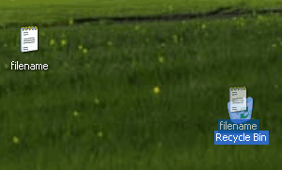
Comparative Example - Windows
Goal: Delete a File
Method for accomplishing goal of deleting file
find file icon
accomplish goal of dragging file to trash
return with goal accomplished

Slide 18
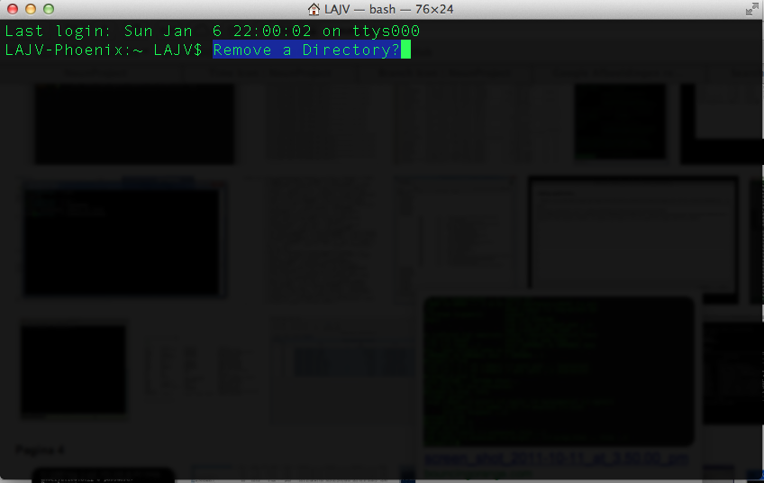
Comparative Example – Unix shell
Goal: Remove a directory
Method for accomplishing goal of removing a directory
?????

Slide 19
Comparative Example – Unix shell
Goal: Remove a directory
Method for accomplishing goal of removing a directory
accomplish goal of making sure directory is empty
retrieve from long term memory that command verb is ‘rmdir’
think of directory name and make it the first listed parameter
accomplish goal of entering & executing command
return with goal accomplished

Slide 20
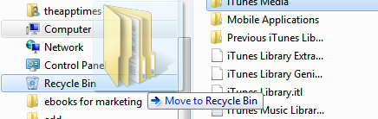
Comparative Example - Windows
Goal: Remove a directory
Method for accomplishing goal of removing a directory
????

Slide 21
Comparative Example - Windows
Goal: Remove a directory
Method for accomplishing goal of removing a directory
find folder icon
accomplish goal of dragging folder to trash
return with goal accomplished
Note the consistency with delete file on Windows (GUI)! This makes it much easier.

Slide 22
What GOMS Can Model
Task must be goal-directed
some activities are more goal-directed
creative activities may not be as goal-directed
Task must use routine cognitive skills
as opposed to problem solving
good for things like machine operators

Slide 23
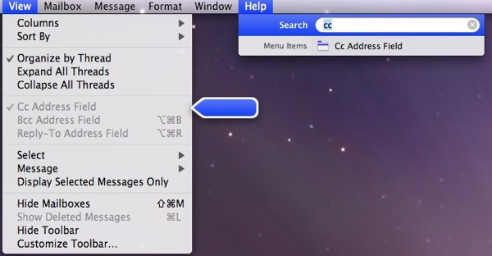
Applications of GOMS
Compare different UI designs
Profiling (time)
Building a help system? Why?
modeling makes user tasks & goals explicit
can suggest questions users might ask & the answers

Slide 24
Real-world GOMS Applications
Keystroke Level Model (KLM)
Mouse-based text editor
Mechanical CAD system
NGOMSL
TV control system
Nuclear power plant operator’s associate
CPM-GOMS
Telephone operator workstation

Slide 25
Advantages of GOMS
Gives qualitative & quantitative measures
Model explains the results
Less work than large user study – no users!
Easy to modify when UI is revised
Research: tools to aid modeling process since it can still be tedious

Slide 26
Disadvantages of GOMS
Not as easy as HE, guidelines, etc.
Takes lots of time, skill, & effort
Only works for goal-directed tasks
Assumes tasks performed by experts without error
Does not address several UI issues,
readability, memorizability of icons, commands…

Slide 27
Rapid Iterative Design is the Best Practice for Creating Good UIs
We have seen how computer-based tools improve
the Design (e.g., Denim) & Prototyping (e.g., Proto.io) phases
Design
Prototyping
Evaluation

Slide 28
Automated GOMS Tools
Can save, modify & re-use the model
Automation of execution time calculation, etc.

Slide 29
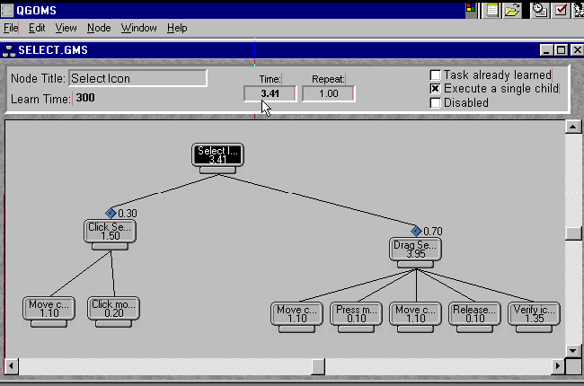
QGOMS tool

Slide 30
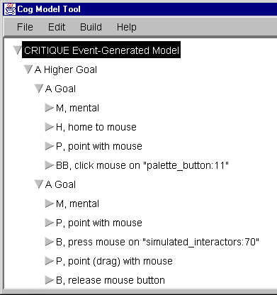
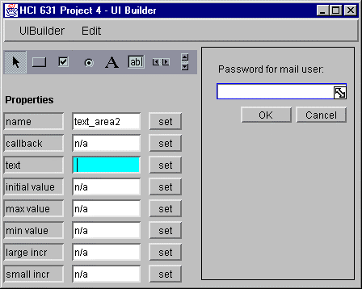
CRITIQUE Hudson et al (1999)
Prototype system by programming
in this case with the SubArctic toolkit
Demonstrate a task
record events
apply rules
Automatically generate KLMs
Semi-automatically generate classic GOMS models

Slide 31
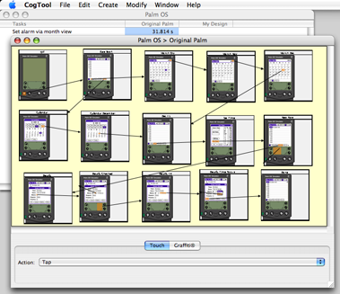
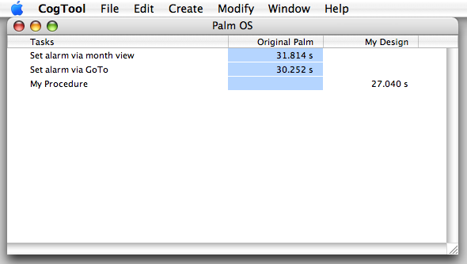
CogTool John & Salvucci (2005)
Prototype system by storyboarding
Demonstrate a task
record events
apply rules
Automatically generate ACT-R model

Slide 32
Automated Analysis & Remote Testing
Log analysis
infer user behavior by looking at web server logs
A-B Testing
show different user segments different designs
requires live site (built) & customer base
measure outcomes (profit), but not why?
Remote user testing
similar to in lab, but online (e.g., over Skype)

Slide 33
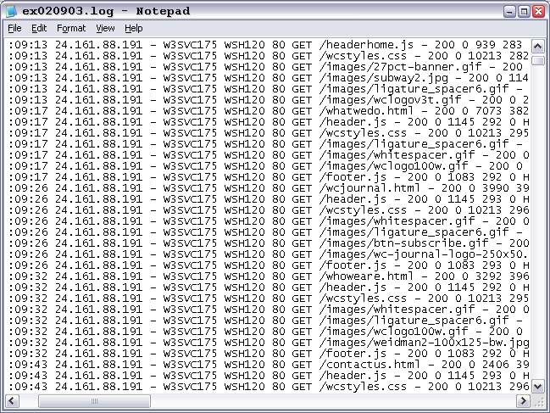
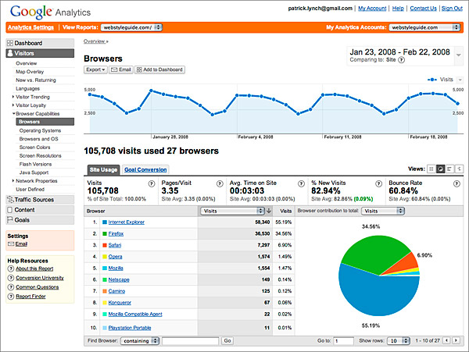
Web Log Analysis Difficult
Notes:
Just tell you IP address of folks, what resource they are accessing (clicked on link, etc.)
Google Analytics & other tools try to make this analysis more user friendly

Slide 34
Google Analytics – Server Logs++
http://www.redflymarketing.com/blog/using-google-analytics-to-improve-conversions/

Slide 35
Google Analytics – Server Logs++
http://www.redflymarketing.com/blog/using-google-analytics-to-improve-conversions/
2.3% → 6.4% after change in text from “Tools” to “Free Tools”

Slide 36
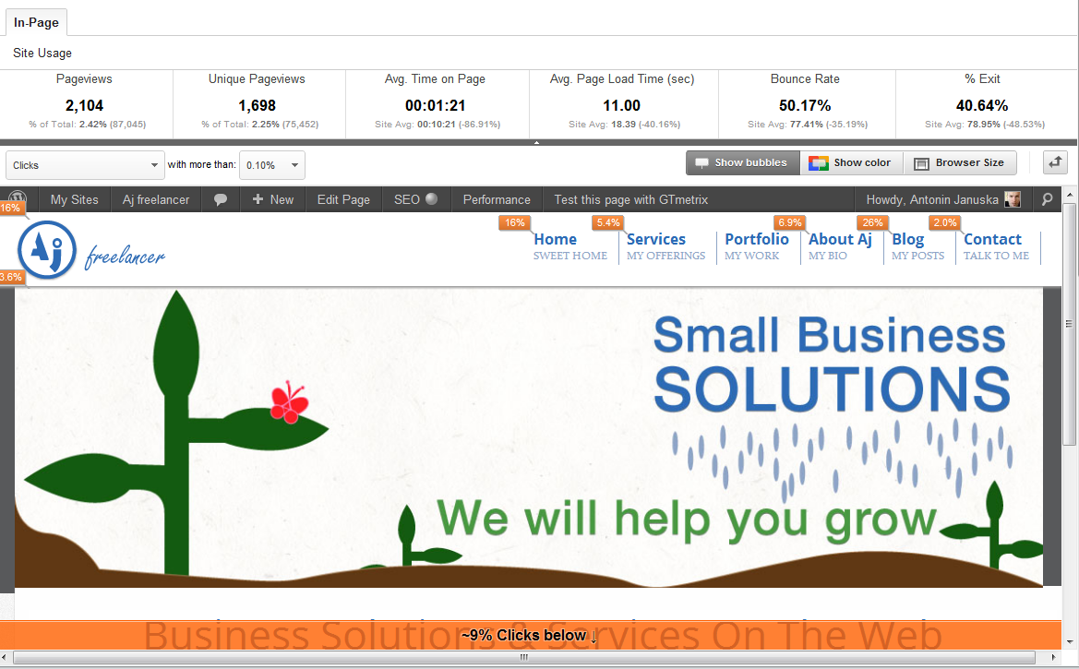
Google Analytics – Server Logs++
From: :http://antjanus.com/blog/web-design-tips/use-google-analytics-to-improve-your-design-and-user-experience/
http://www.redflymarketing.com/blog/using-google-analytics-to-improve-conversions/

Slide 37
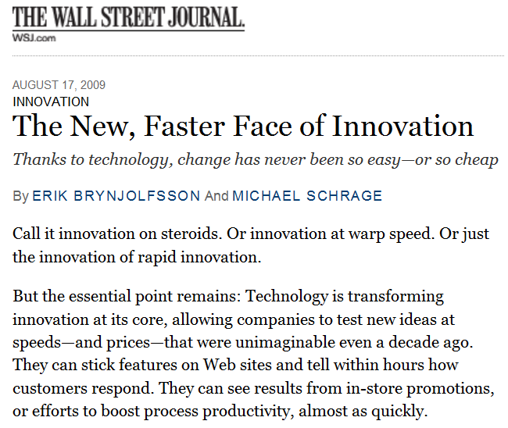
Notes:
The simplest example of data driving innovation is on the web. Even the WSJ has picked this up (though it has been going on for at least 5-10 years)

Slide 38
Web Allows Controlled A/B Experiments
Example: Amazon Shopping Cart
Add item to cart
Site shows cart contents
Idea: show recommendations based on cart items
Arguments
Pro: cross-sell more items
Con: distract people at check out
Highest Paid Person’s Opinion “Stop the project!”
Simple experiment was run, wildly successful
Shopping Cart Image
Goes Here
From Greg Linden’s Blog: http://glinden.blogspot.com/2006/04/early-amazon-shopping-cart.html
Notes:
show recommendations based on cart items
The rest is history. Recommendations are now standard on many sites

Slide 39
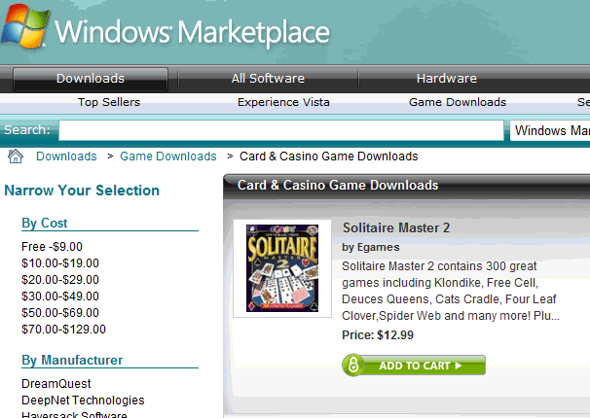
Windows Marketplace: Solitaire vs. Poker
Which game has the higher clickthrough? By how much?
A: Solitaire game
B: Poker game
A is 61% better. Why?
Courtesy of Ronny Kohavi
Notes:
How many think Poker? How many think Solitaire?
B is 38% worse, or A is 61% better Why?
Note: THIS IS EASY TO DO ON THE WEB. But how do we do for OTHER PRODUCTS? The products of the future will be more a combination of hardware, software, and adaptive to environment/context. And How do we know WHAT product to make? And How do we find out WHY they preferred one over the other?

Slide 40
The Trouble With Most Web Site Analysis Tools
Unknowns
Who?
What?
Why?
Did they find it?
Satisfied?
Leave
Notes:
Who are they?
What are they looking for?
Why did they go where they went?
Did they find what they were looking for?
Did they leave satisfied?

Slide 41
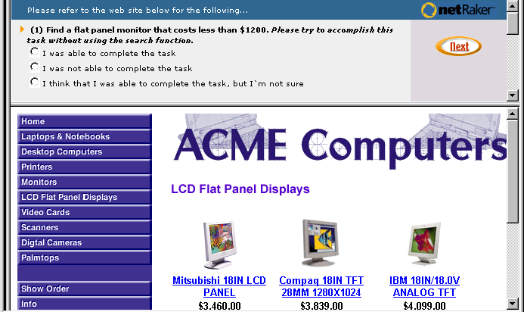
NetRaker Usability Research See how customers accomplish real tasks on site

Slide 42
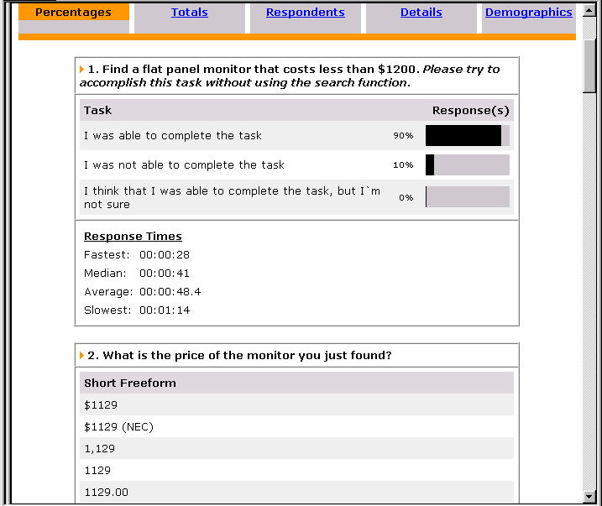
NetRaker Usability Research See how customers accomplish real tasks on site

Slide 43
NetRaker Usability Research See how customers accomplish real tasks on site

Slide 44
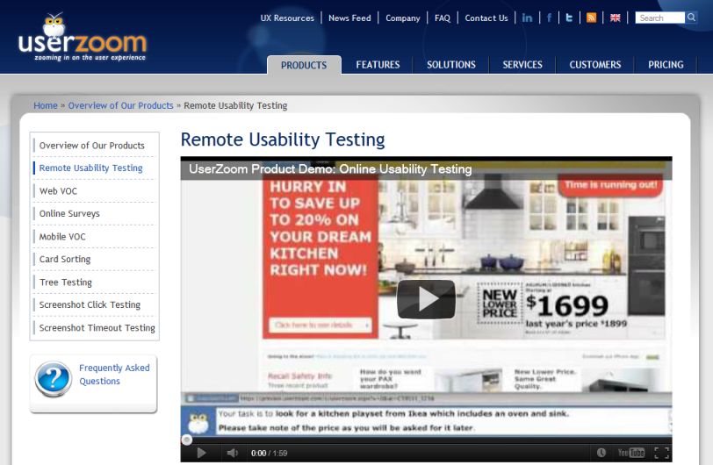
UserZoom

Slide 45
Advantages of Remote Usability Testing
Fast
can set up research in 3-4 hours
get results in 36 hours
More accurate
can run with large samples (50-200 users → stat. sig.)
uses real people (customers) performing tasks
natural environment (home/work/machine)
Easy-to-use
templates make setting up easy
Can compare with competitors
indexed to national norms

Slide 46
Disadvantages of Remote Usability Testing
Miss observational feedback
facial expressions
verbal feedback (critical incidents)
Need to involve human participants
costs some amount of money (typically $20-$50/person)
People often do not like pop-ups
need to be careful when using them

Slide 47
Summary
GOMS
provides info about important UI properties
doesn’t tell you everything you want to know about UI
only gives performance for expert, error-free behavior
hard to create model, but still easier than user testing
changing later is much less work than initial generation
Automated usability
faster than traditional techniques
can involve more participants → convincing data
easier to do comparisons across sites
tradeoff with losing observational data

Slide 48
Next Time
Guest Lecture
Irene Au (Design Operating Partner at Khosla Ventures)
She will mainly be taking questions – please come up with one question each so we have a lively discussion
Assignments
#5 Web site (online by late Thur night)
if you need a few extra days let your CA know
#12 Hi-fi Prototype #3 (midway milestone on Fri)

Slide 49
team break
(45-50 minutes)

