Slide 1
Conceptual Models &
Interface Metaphors
October 23, 2014
Notes:
started 5 minutes late, ended 2 minutes late, gave 22 minutes for team time. Zoomed through metaphor/consistency… cut?
spent too long on mid-quarter feedback

Slide 2

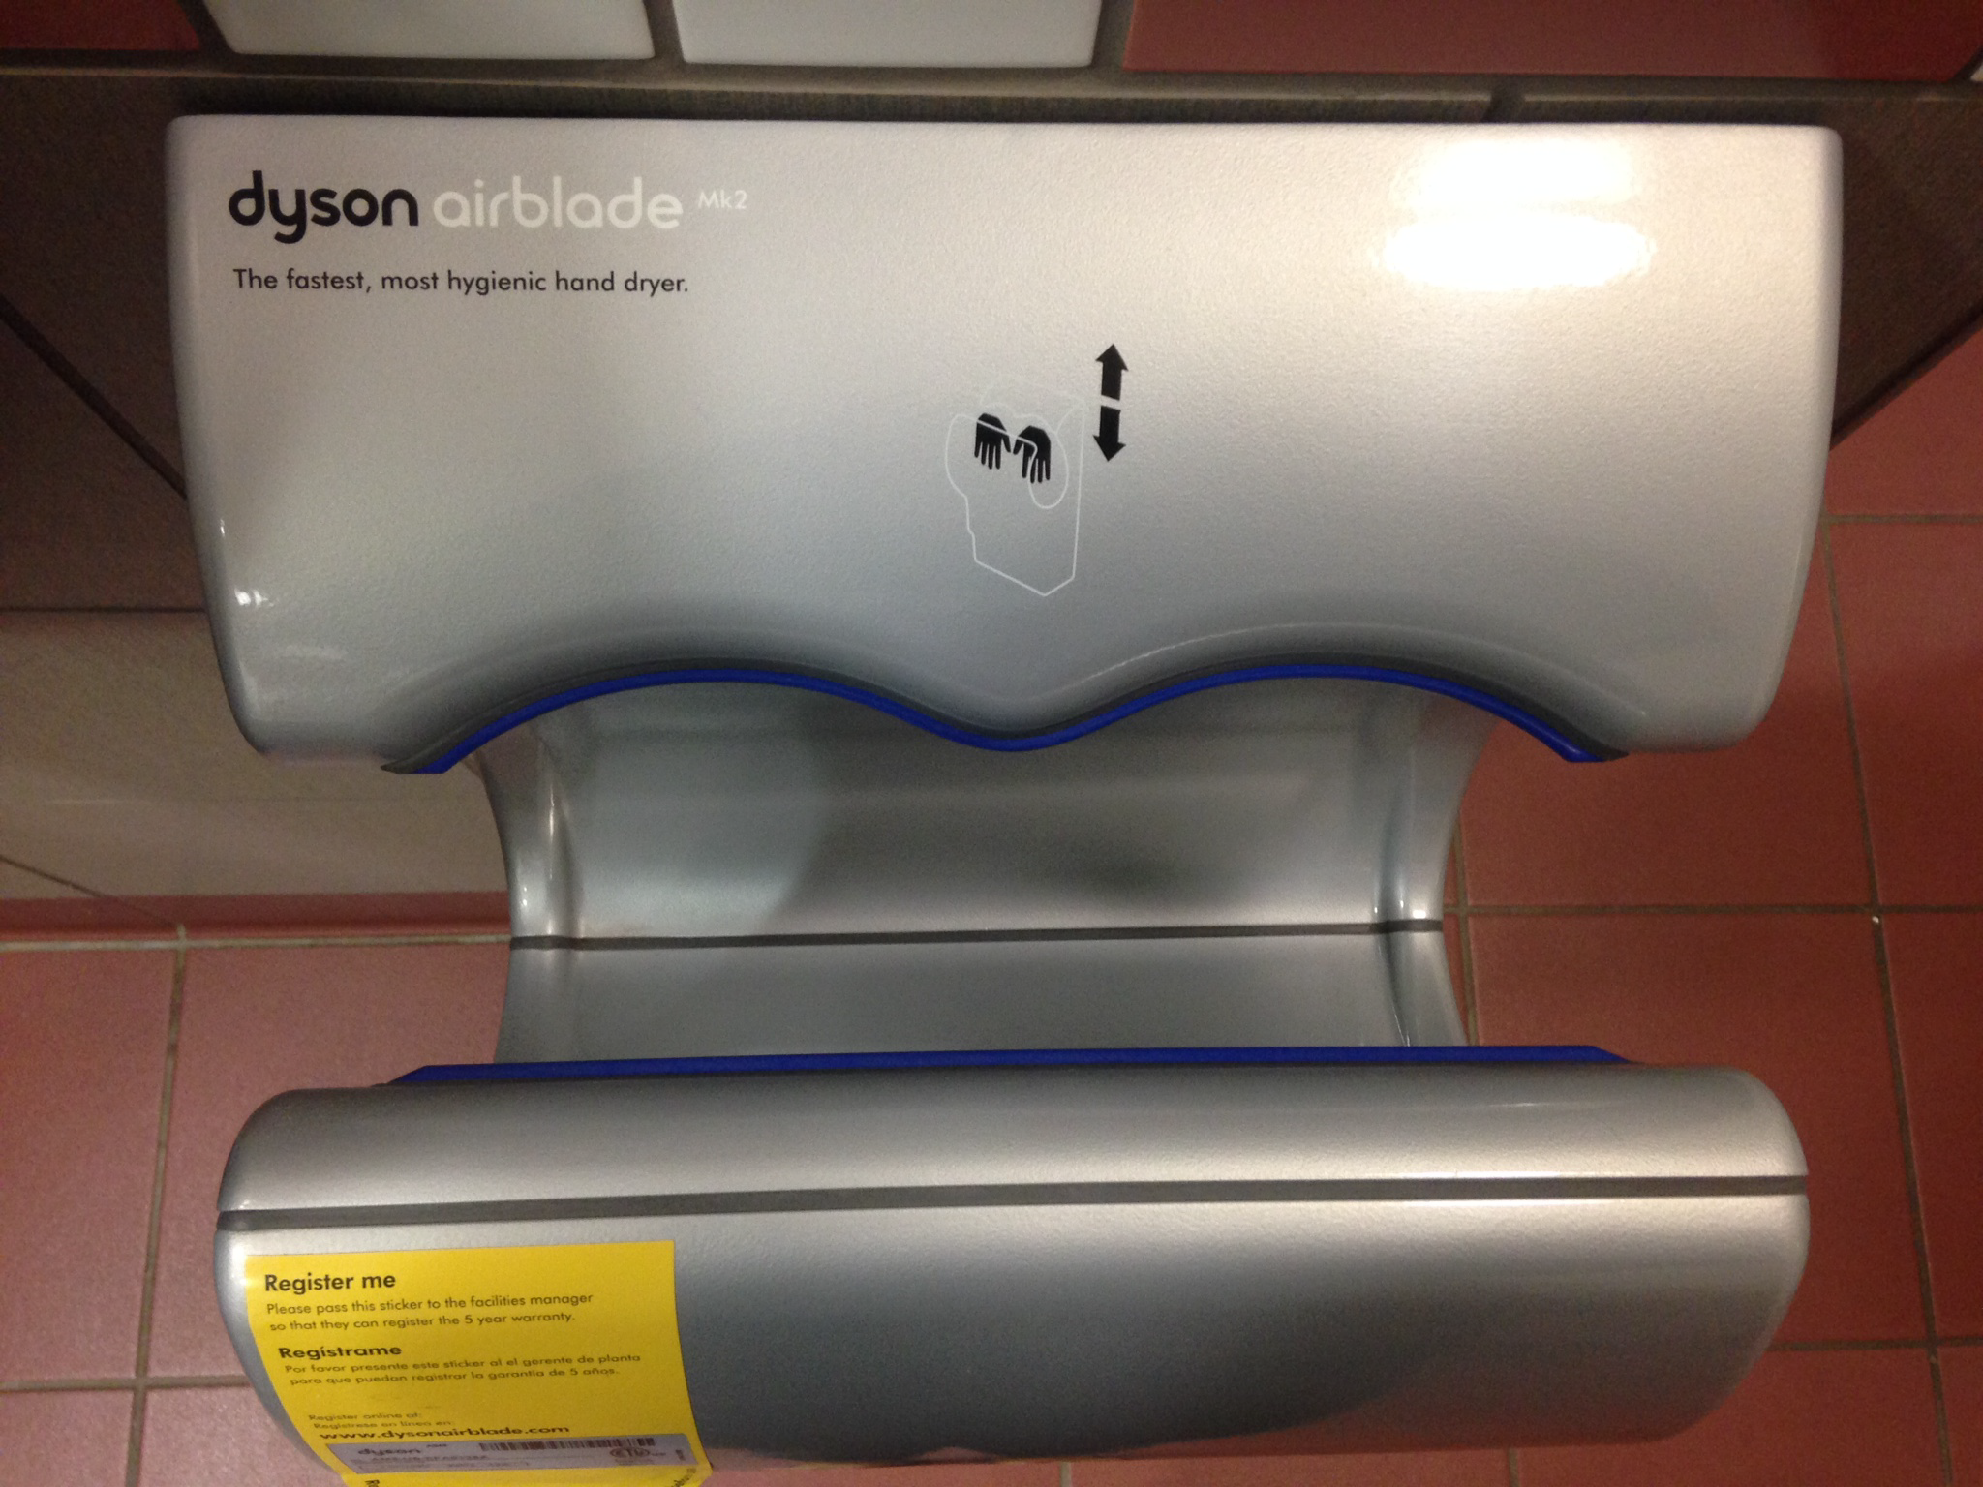
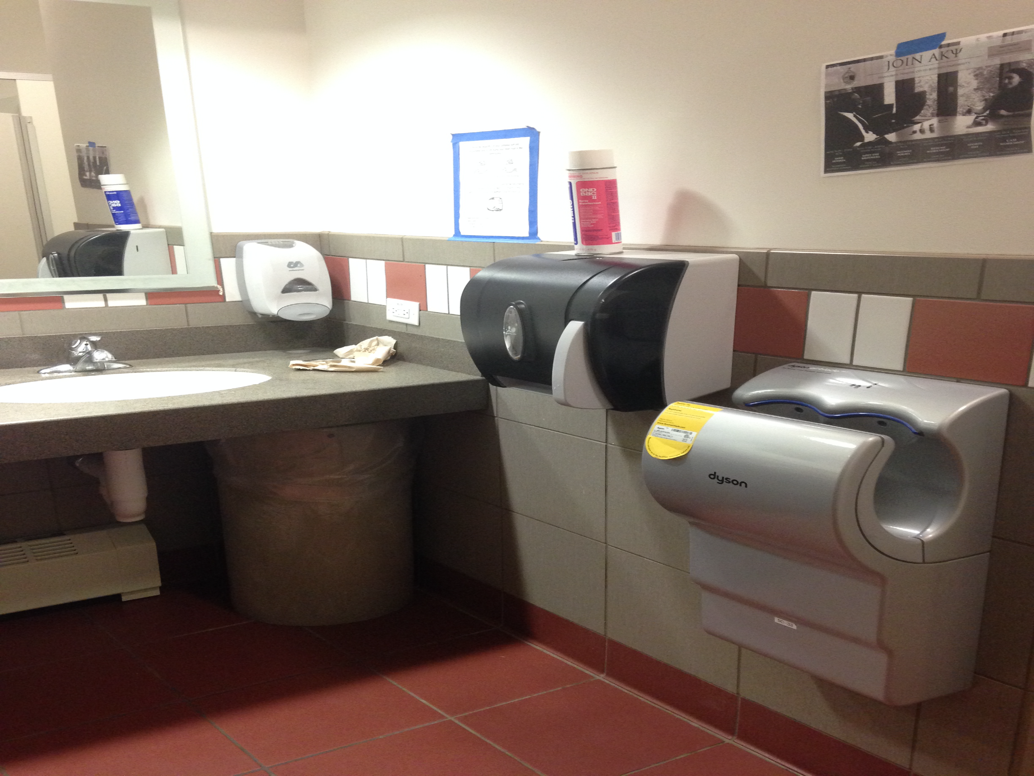
Interface Hall of Fame or Shame?
Dyson AirBlade hand dryer
example courtesy of Maya I.

Slide 3


Interface Hall of Fame!
Good
  shape indicates function
  so simple that instructions fit in 1 image
  fun!
Bad
  dripping water?
  too much noise
  still takes too long
Dyson AirBlade hand dryer
example courtesy of Maya I.

Slide 4


Interface Hall of Fame or Shame?
Tabbed dialog for setting options in MS Web Studio
  more tabs than space to display them
Clicking on the right arrow once gives

Slide 5

Interface Hall of Shame!
Tabbed dialog for setting options in MS Web Studio
  more tabs than space to display them
Clicking on the right arrow once gives
Inconsistent display of possible tabs
  where did the “Editor” tab go?
Position of arrows awkward (split to each side?)
  also, small targets near each other (Fitts’ Law)

Slide 6
Conceptual Models &
Interface Metaphors
October 23, 2014

Slide 7
Outline
Mid-quarter Evaluation Summary/Response
Review
Design of Everyday Things
Conceptual models
Team Break
Interface metaphors
UI Consistency

Slide 8
Mid-quarter Evaluation Summary/Response
Features you like
Hall of fame/hall of shame
Interactive lectures
Overall concept of the class & what is being learned about design/iteration
Hands-on assignments that are relevant
… and lots more! Thanks, we will try to keep those things

Slide 9
Mid-quarter Evaluation Summary/Response
Things to improve
Assignments very fast paced, course load heavy (unlike prior quarters), & feedback not coming back quickly enough
Lectures could be shorter given the content
Students are struggling to get group work done in such a compressed timeline
Assignment instructions / grading unclear or inconsistent
Students want more control over projects

Slide 10
Mid-quarter Evaluation Summary/Response
Things to improve
Assignments very fast paced, course load heavy (unlike prior quarters), & feedback not coming back quickly enough
The course IS fast paced & really doing this process is the only way to learn the material.
Note: The work tapers in the last ½.
BUT, we can make it less painful:
feedback will come every Friday from CAs
reduced writing on written assignments
get at least 2 project assignments online ahead

Slide 11
Mid-quarter Evaluation Summary/Response
Things to improve
Lectures could be shorter given the content
Students are struggling to get group work done in such a compressed timeline
We will start building in 25-30 minutes of group project time in the lecture break
Will try to move up some of the “work on project” lectures (now 11/11, 11/20, 12/4).

Slide 12
Mid-quarter Evaluation Summary/Response
Things to improve
Assignment instructions / grading unclear or inconsistent
Some felt instructions too long & others liked (try to make them as explicit as possible – will keep trying to improve)
CAs go over example assignments in group meeting to encourage consistency & also align grades after grading to make sure some aren’t harsher or easier than the group
BUT, this material is inherently subjective. There is NO right answer and grading will have ambiguity. So will your real world work!

Slide 13
Mid-quarter Evaluation Summary/Response
Things to improve
Students want more control over projects (e.g., picking teams, changing topics, kicking off people not doing their share…)(folks were split on how teams were created)
Pick teams for diversity as it leads to better design & this is authentic “working on a team” experience (course goal)
Some teams did change topics early on & we approved it, but could have been more transparent about the process
Team slackers: part of being a high performing team is communicating performance to teammates (exercise today) & contacting us if it doesn’t work–grades will reflect

Slide 14
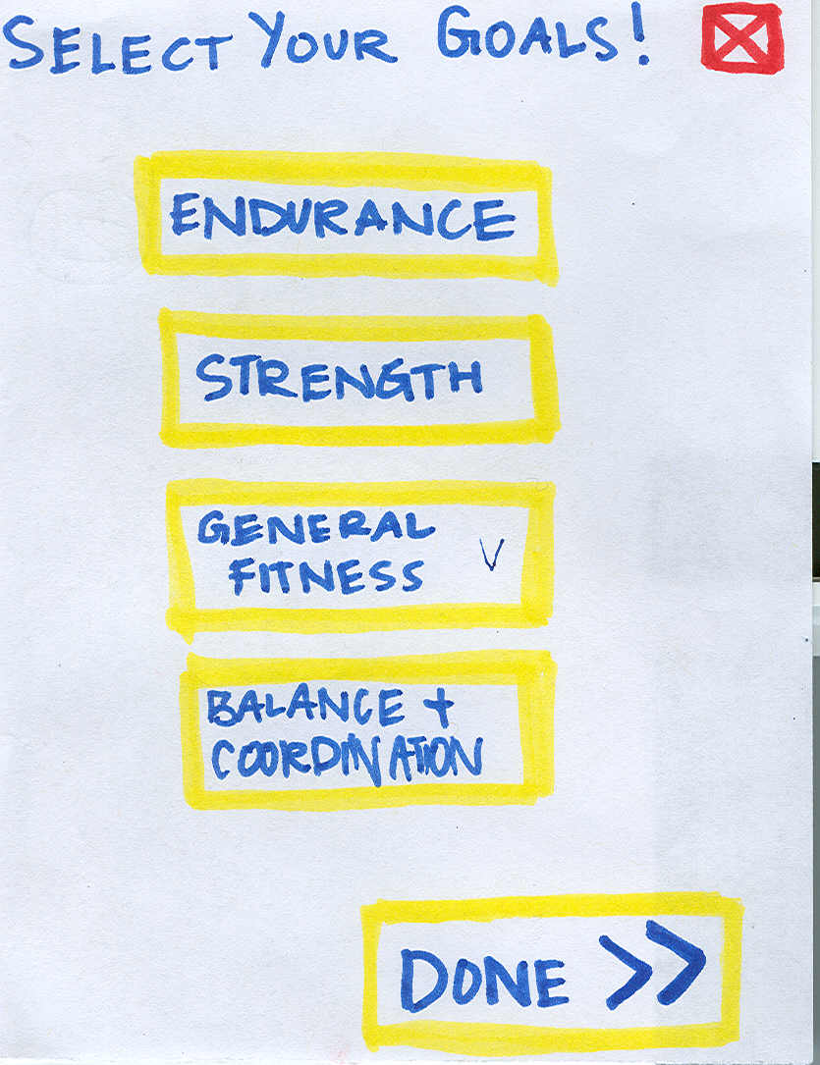
Review of Early Stage Prototyping
Prototypes are a ?
  concrete representation of a design or final product
High-fi prototypes may cause viewers to?
  focus on low-level details (e.g., colors, fonts, & alignment) rather than high-level structure
High-fi prototypes may cause designers to?
  1) spend too much time on details
  2) be less creative in exploring other ideas
Low-fi testing allows us to quickly iterate
  get user feedback & change right away
Informal UI prototyping tools combine
advantages of paper w/ electronic tools

Slide 15
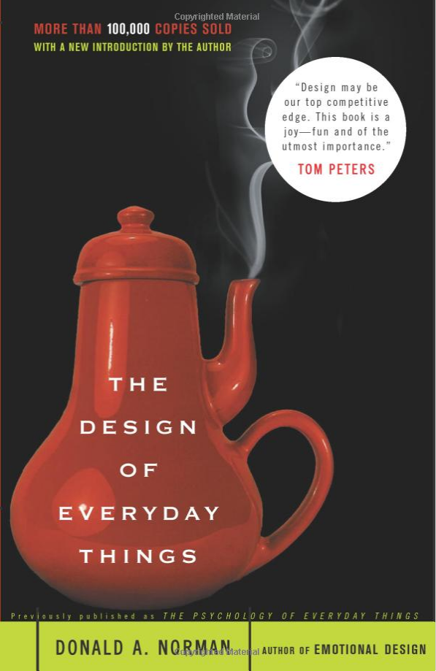
Design of Everyday Things
By Don Norman (UCSD, Apple, HP, NN Group, NU)
Design of everyday objects illustrates problems faced by designers of systems
Explains conceptual models
  doors, washing machines, digital watches, telephones, ...
Resulting design guides
→ Highly recommended

Slide 16
Conceptual Models
    Mental representation of how an artifact works & how interface controls affect it
People may have preconceived models that are hard to change
  (4 + 5) vs. (4 5 +)
  dragging to trash?
    deletes file but ejects disk
Interface must communicate model
  visually (& possibly physically or using sound)
  online help and documentation can help,
  but shouldn’t be necessary

Slide 17
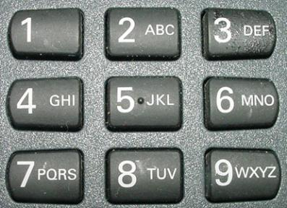

Affordances as Perceptual Clues
Well-designed objects have affordances
  clues to their operation
  often visual, but not always (e.g., speech)
What affordances do you see here?
Notes:
In DOET, affordances are visual. But affordances are more than that. Affordances can be physical or audio

Slide 18
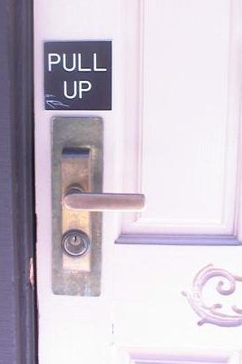

Affordances as Perceptual Clues
Poorly-designed objects
  no clues or misleading clues
French artist Jacques Carelman
Crazy design for a screw punch!
Notes:
misleading

Slide 19
Refrigerator
freezer
fresh food
Problem: freezer too cold, but fresh food just right

Slide 20
Refrigerator Controls
Normal Settings C and 5
Colder Fresh Food C and 6-7
Coldest Fresh Food B and 8-9
Colder Freezer D and 7-8
Warmer Fresh Food C and 4-1
OFF (both) 0
A B C D E
7 6 5 4 3
What is your conceptual model?
Spend 30 sec. drawing a diagram showing your model (where the cooling units are & how controlled)
Notes:
Take 30 seconds to draw it

Slide 21
A Common Conceptual Model
A B C D E
cooling
unit
7 6 5 4 3
cooling
unit
independent controls

Slide 22
Actual Conceptual Model
A B C D E
cooling
unit
7 6 5 4 3
Can you fix the problem?
Possible solutions
  make controls map to customer’s model
  make controls map to actual system

Slide 23
Design Model & Customer Model
Design Model
Customer Model
System Image
Customers get model from experience & usage
  through system image
What if the two models don’t match?

Slide 24
Conceptual Model Mismatch
Mismatch between designer’s & customer’s conceptual models leads to…
  slow performance
  errors
  frustration
  ...

Slide 25
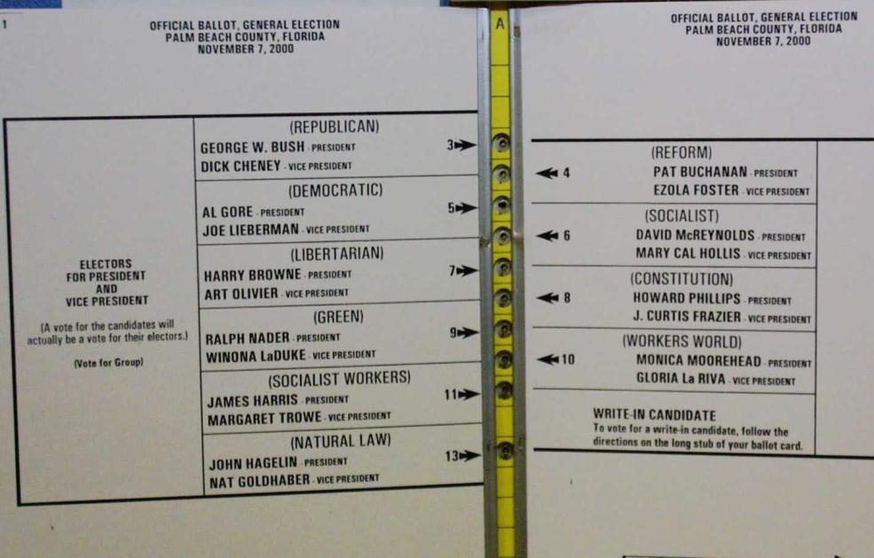
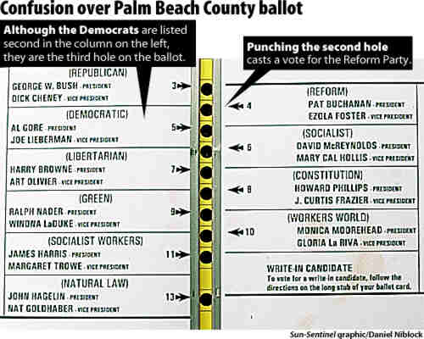
Notorious Example
Notes:
2000 Presidential Election. Palm Beach Florida

Slide 26
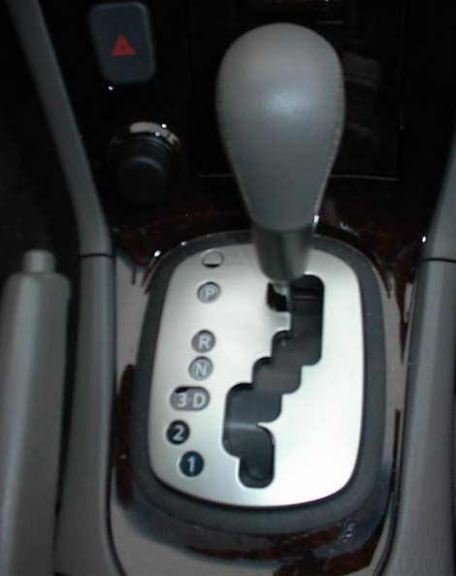
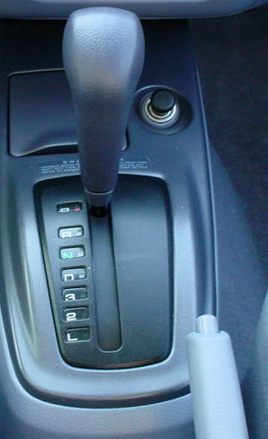
Car Automatic Shifter
Notes:
Image at left seems obvious, but many first time users of this design don’t notice the difference between “3 and D” and in fact put the car in third gear when they mean to put it in Drive.
The more standard gear shift distinguishes these more directly.
On the other hand, the newer design has a more PHYSICAL feedback

Slide 27
Design Guides
Provide good conceptual model
  customer wants to understand how UI controls impact object
Make things visible
  if object has function, interface should show it
Map interface controls to customer’s model
  infix vs. postfix calculator – whose model is that?
Provide feedback
  what you see is what you get! (WYSIWYG)

Slide 28
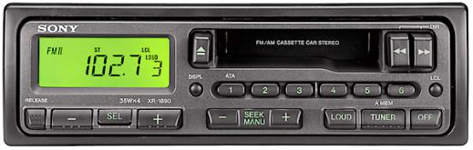
Make Things Visible
Refrigerator (?)
  make the A..E dial something about percentage of cooling between the two compartments?
Controls available on watch w/ 3 buttons?
  too many and they are not visible!
Compare to controls on simple car radio
  #controls = #functions
  controls are labeled (?) and grouped together

Slide 29
Map Interface Controls to Customer’s Model
Which is better for car dashboard speaker front / back control?
Control should mirror real-world
Dashboard
1
2

Slide 30
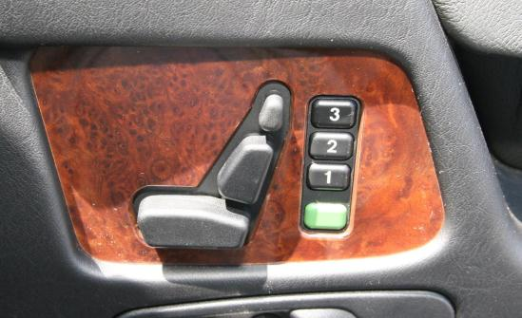
Map Interface Controls to Customer’s Model
Which is better for car dashboard speaker front / back control?
Control should mirror real-world
Mercedes Benz Seat Control

Slide 31
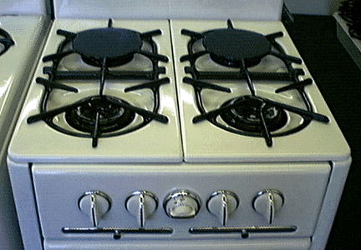
Map Interface Controls to Customer’s Model
Problem?
Which knob controls which burner?

Slide 32
Map Interface Controls to Customer’s Model
Possible fixes?

Slide 33
team break
(25 minutes)

Slide 34
Team Exercise
What are your goals/deliverables?
Are you on track to meet your team goals/deliverables?
If no, why not? What can you change?

Slide 35
Metaphor
Definition ?
  “The transference of the relation between
  one set of objects to another set for the
  purpose of brief explanation.”
Lakoff & Johnson, Metaphors We Live By
  “...the way we think, what we experience, and what we do every day is very much a matter of metaphor.”
  in our language & thinking – “argument is war”
    … he attacked every weak point
    … criticisms right on target
    … if you use that strategy
We can use metaphor in interface design to
leverage existing conceptual models

Slide 36
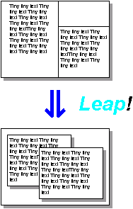
Desktop Metaphor
Suggests a conceptual model
  not really an attempt to simulate a real desktop
  a way to explain why some windows seemed blocked
  leverages existing knowledge about files, folders, & trash

Slide 37
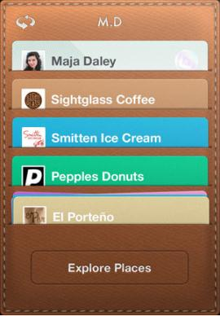
Example Metaphors
Global metaphors
  personal assistant, wallet, clothing, pens, cards, telephone, eyeglasses
Data & function
  rolodex, to-do list, calendar,
  applications documents, find, assist
Collections
  drawers, files, books,
  newspapers, photo albums
Square Card Case

Slide 38
How to Use Metaphor
Develop interface metaphor tied to
conceptual model
Communicate that metaphor to the user
Provide high-level task-oriented operations, not low-level implementation commands
Notes:
38
Develop interface metaphor or conceptual model
Communicate that metaphor to the user
Provide high-level task-oriented operations not low-level implementation commands

Slide 39
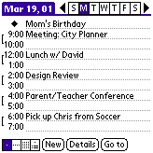
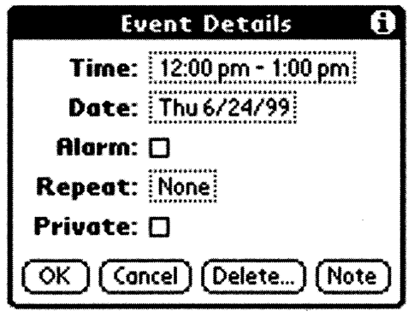
Is Consistent Always Better?
NO
Palm PDA example: should “new appointment” & “delete appointment” be in the same place?
New (add) is common, but delete is not
Notes:
Consistency of having add/delete together always, vs. making it faster for common task

Slide 40
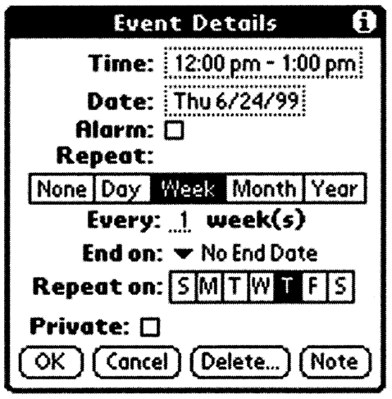
Is Consistent Always Better?
NO
Early Palm design
(like desktop version)
Streamlined design
Notes:
Consistency with desktop (early design) vs. making it better for mobile

Slide 41
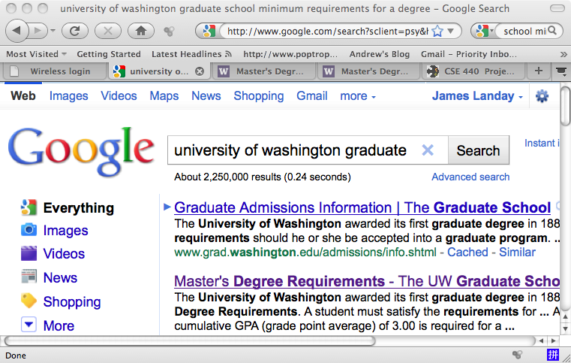
Is Consistent Always Better?
NO
Firefox 3 Back/Forward Buttons

Slide 42
Ways of Being Consistent
Interfaces should be consistent in a
meaningful way
  e.g., ubiquitous use of same keys for cut/copy/paste
Types of consistency
  consistent internally
    e.g., same terminology and layout throughout app
  consistent with other apps
    ex. works like MS Word, uses keyboard conventions
    design patterns (across many apps)
  consistent with physical world

Slide 43
Summary
Conceptual models ?
  mental representation of how the object works & how interface controls effect it
Design model should equal customer’s model ?
  mismatches lead to errors
  use customer’s likely conceptual model to design
Design guides ?
  make things visible
  map interface controls to
  customer’s model
  provide feedback
Design Model
Customer Model
System Image

Slide 44
Further Reading
Design of Everyday Things, Donald Norman
Design as Practiced, Donald Norman
  Talks about failure to make changes to Macintosh
  http://www.jnd.org/dn.mss/Design_as_Practiced.html
Computing the Case Against User Interface Consistency, Jonathan Grudin
  Talks about why interfaces should not always be consistent
  http://www1.ics.uci.edu/~grudin/Papers/CACM89/CACM89.html

Slide 45
Next Time
Visual Information Design
“Readings”
  Watch Scott Klemmer’s HCIOnline lectures
    6.1 Visual Design (7:37)
    6.2 Typography (10:47)
    6.3 Grids & Alignment (17:33)
Next team assignment
  Medium-fidelity Prototype
    start to think about how idea fits on target platform (doesn’t have to be exact yet)
    use a prototyping tool (we suggest three – ask to use another)
      Marvel
      InVision
      proto.io
    Let’s go over it now so it is clear

Slide 46
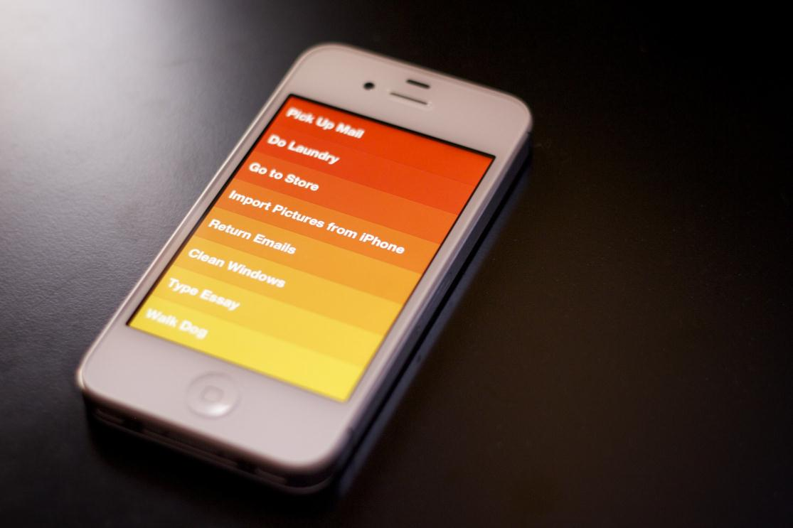
Interface Hall of Fame or Shame?
Clear iOS App
By Realmac Software

Slide 47

Interface Hall of Fame or Shame?
Clear iOS App
By Realmac Software

Slide 48
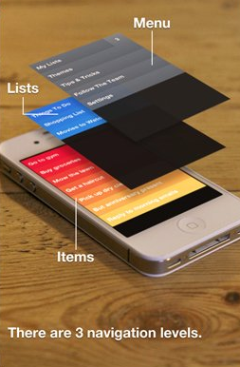
Interface Hall of Fame!
Good
  discoverable gestures
  keeping things simple means gestures don’t cause unexpected problems
  logical hierarchy of items
  sounds & animations are pleasurable & beautiful → app is FUN
Bad
  does not have some features of major competitors (e.g., priorities)
Clear iOS App
By Realmac Software

