Slide 1
Early Stage Prototyping
October 16, 2014
Notes:
started 15 minutes late due to projector malfunction (had 6 minutes left at end for team work – so should have had 20-25 minutes).

Slide 2
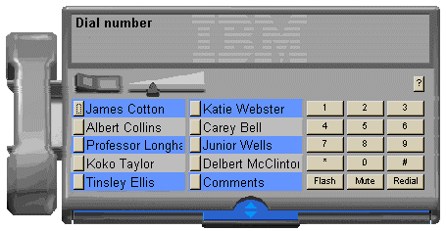
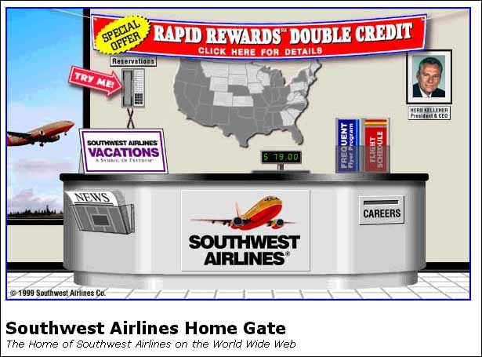
Hall of Fame or Shame?
Direct translations
software telephony solution where users dial a number by clicking on a simulated keypad
airline web site that simulates a ticket counter

Slide 3
Hall of Shame!
Direct translations
software telephony solution where users dial a number by clicking on a simulated keypad
airline web site that simulates a ticket counter
Misused Metaphors!
Notes:
What do I come to an airline site to do????

Slide 4
Improved southwest.com
Notes:
Southwest.com as of 2/25/2014
Note how it highlights the obvious things you’ll want to do on a airline web site.
Purchase air flights
Hotels, cars, vacations
Frequent flyer
Special offers

Slide 5
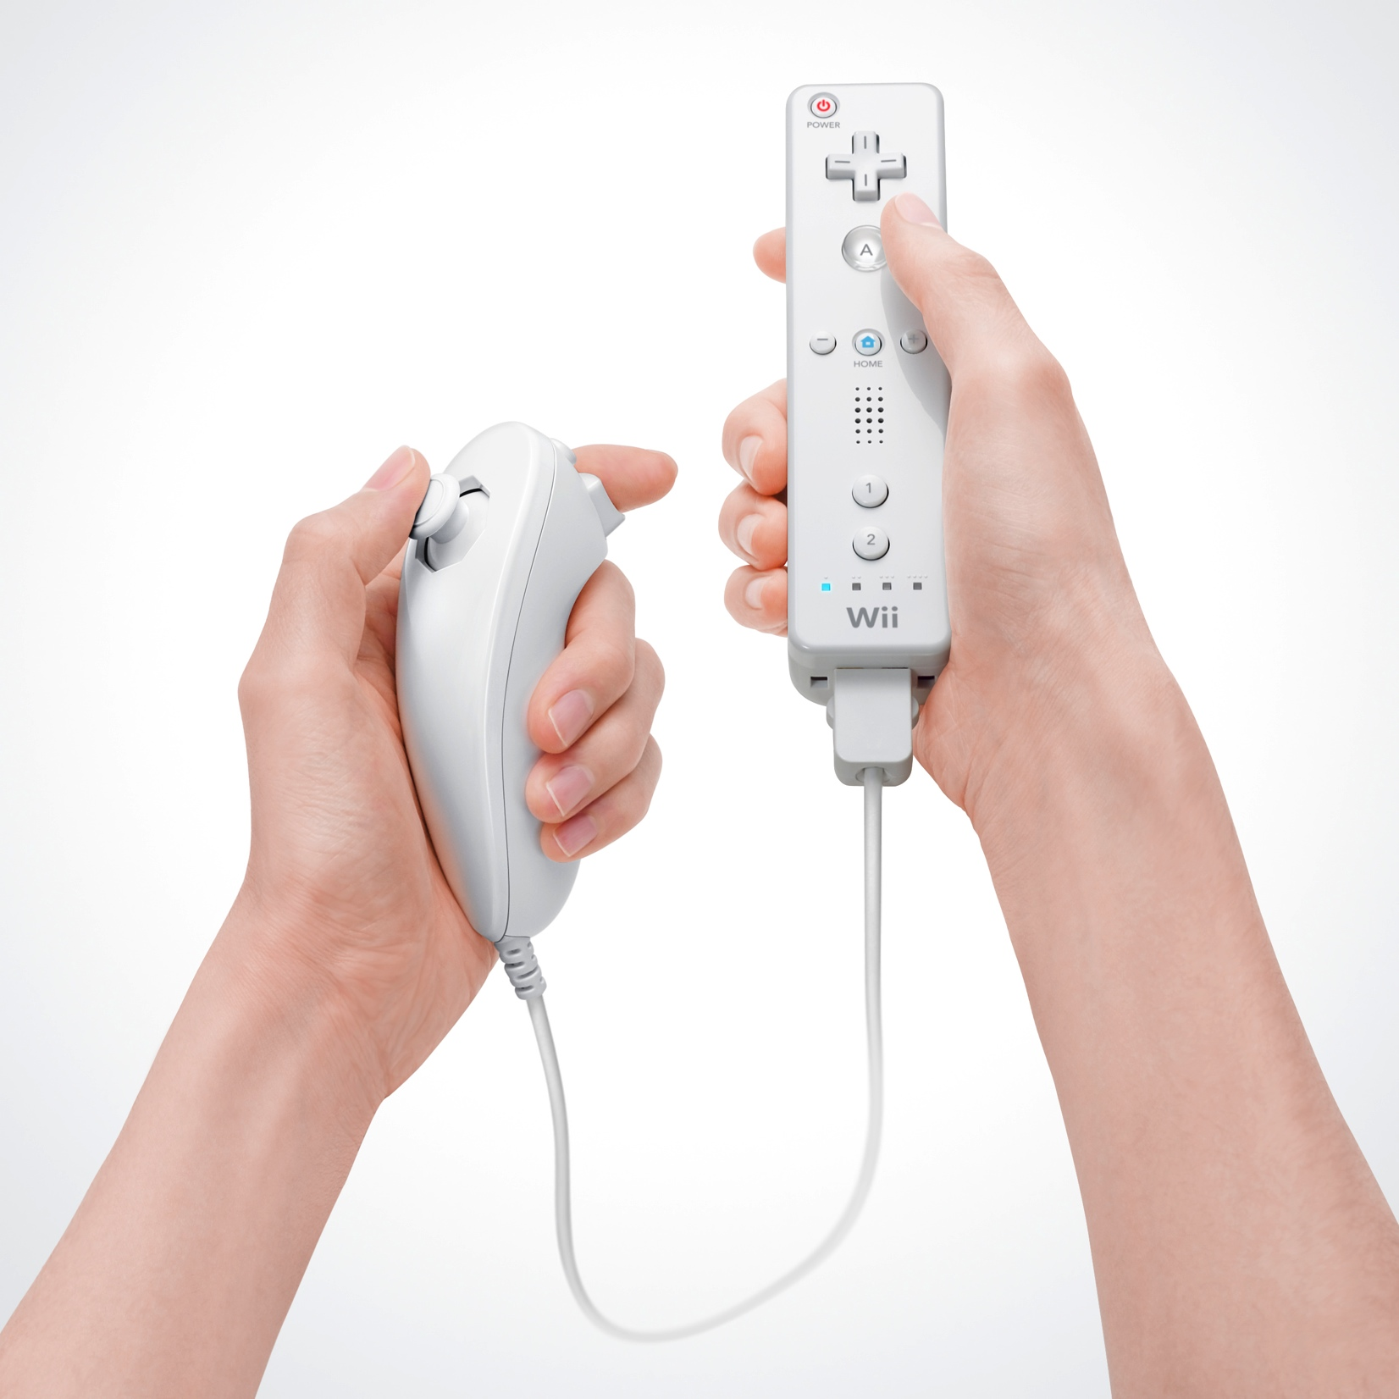
Hall of Fame or Shame?
Wiimote
By Nintendo
Notes:
What was good about this when it came out?
What might have been wrong?

Slide 6
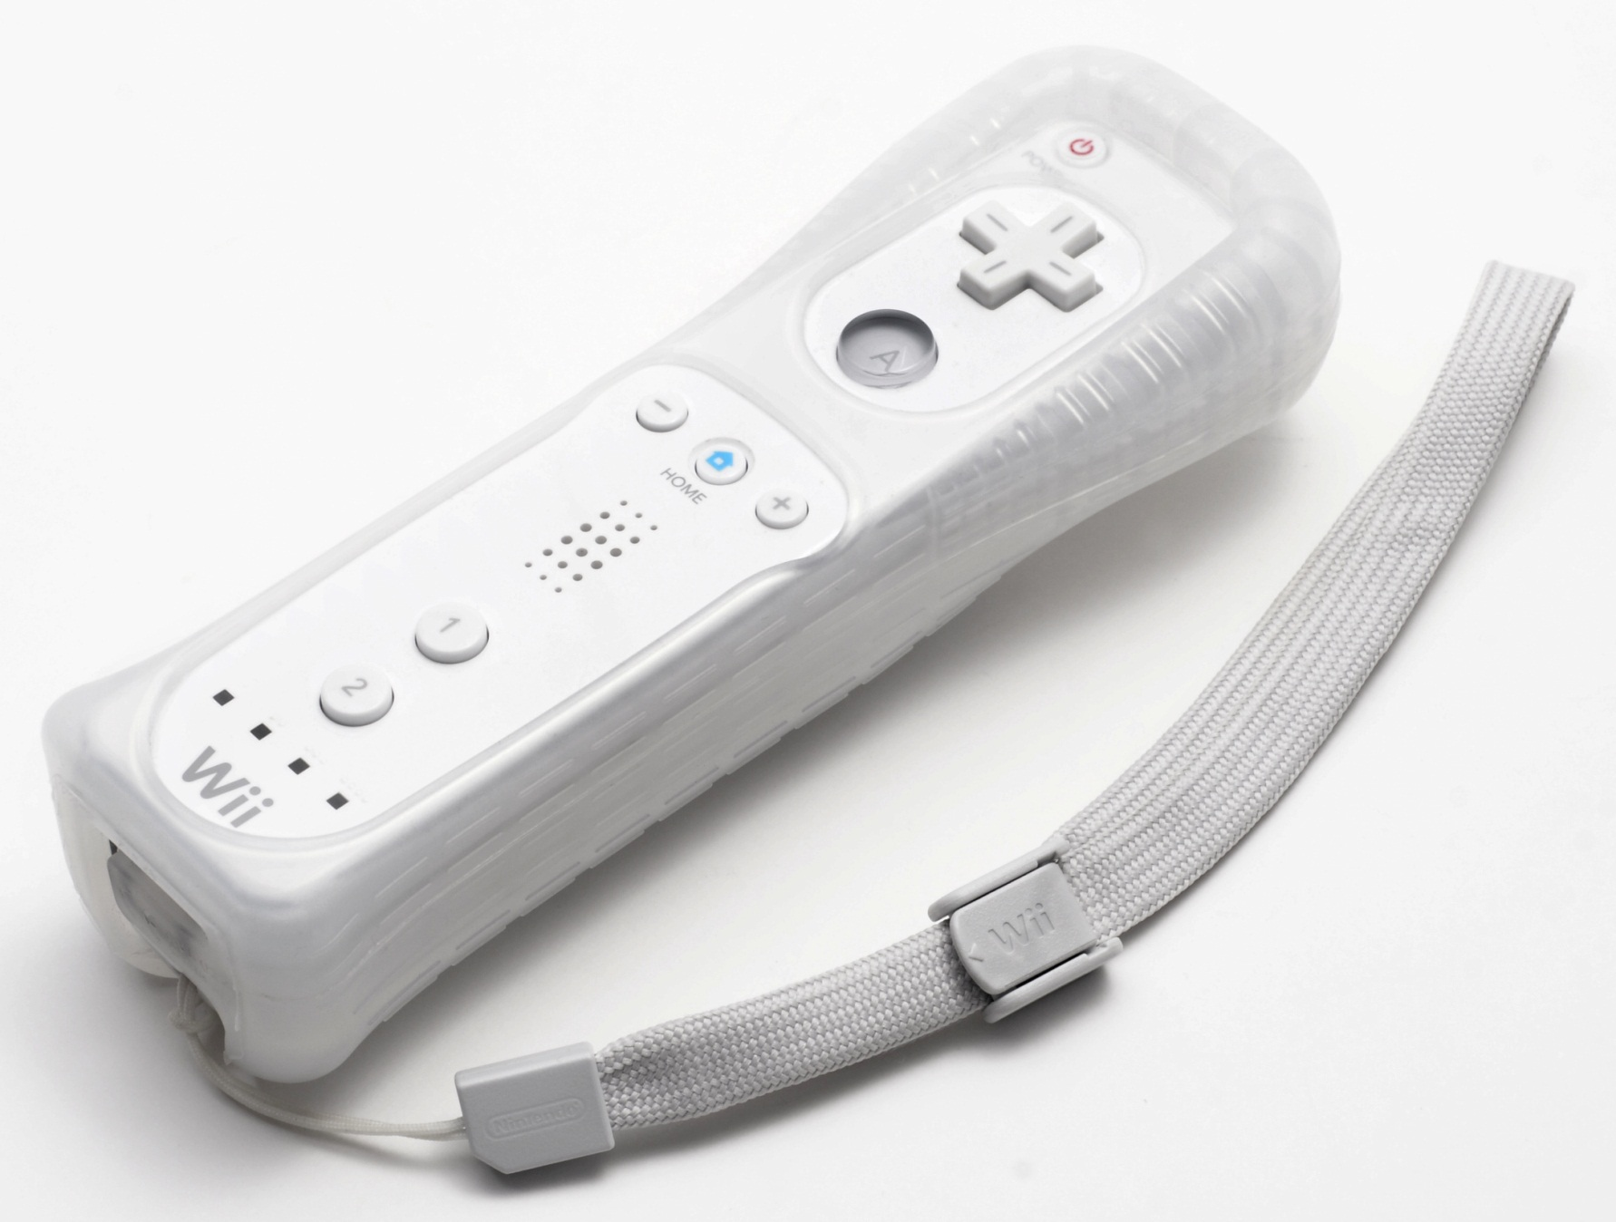
Hall of Shame!
The main thing that differentiated the product (movement in gaming) resulted in it being thrown at windows/TVs
Slippery plastic hard to hold onto. Later designs added rubber case & strap
Lack of a joystick was initial problem resulting in a second controller

Slide 7
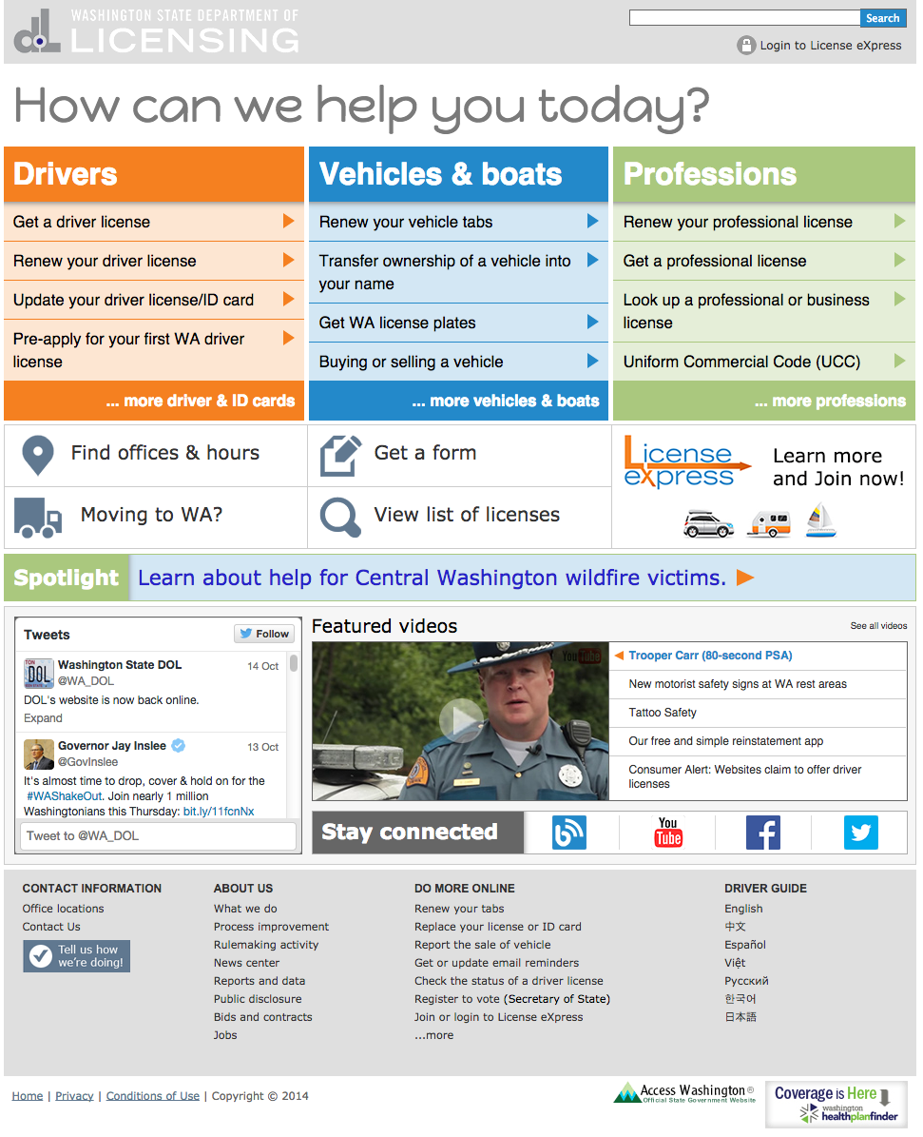
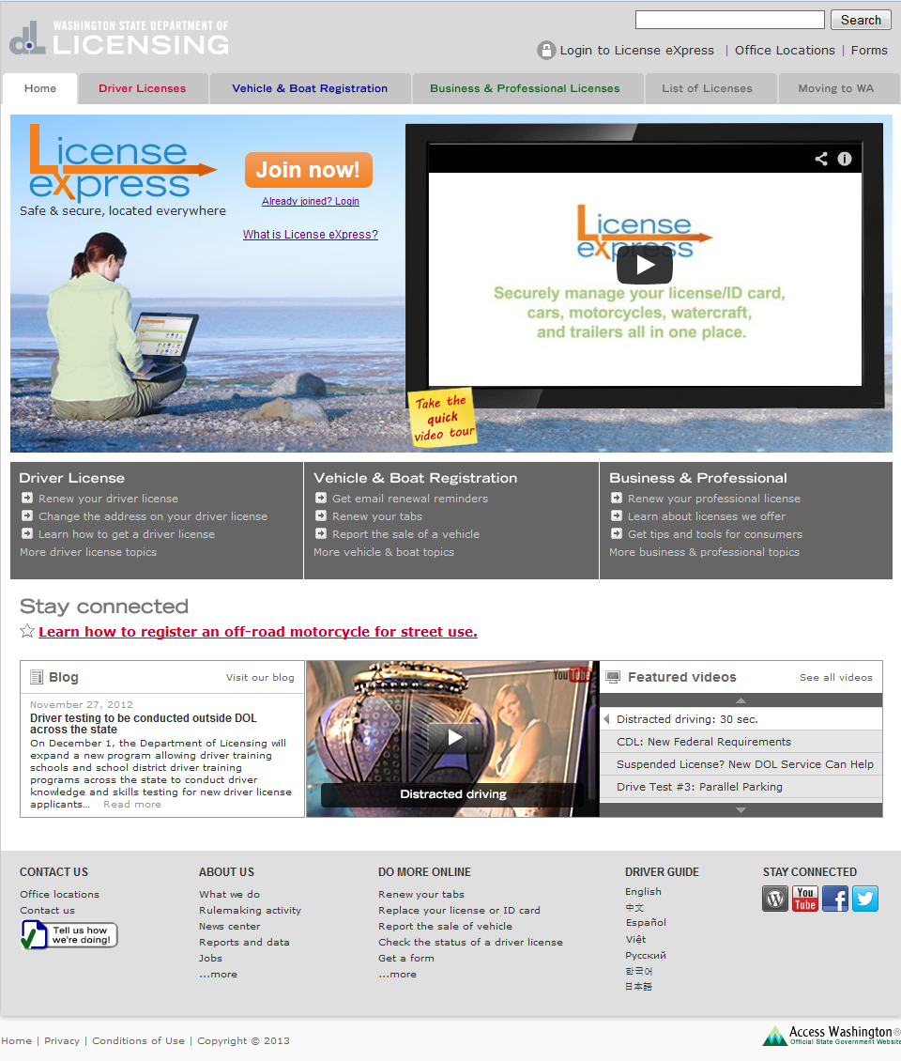
Hall of Fame or Shame?
http://www.dol.wa.gov/

Slide 8
Notes:
New version of the site
Not as good in my opinion as the first but better than the 2nd as the 3 tasks are again dominant
2nd version May be they really want to move people to this License Express system and they emphasize this!
“How can we help you today?” seems like a REAL waste of space

Slide 9
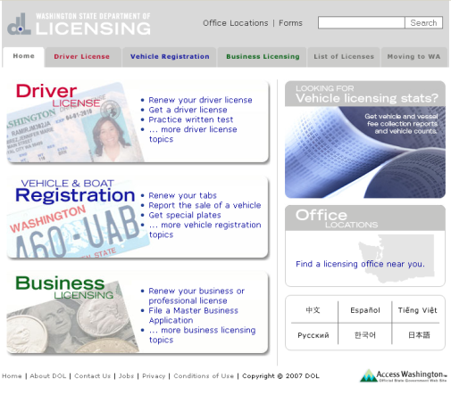
Hall of Fame!
http://www.dol.wa.gov/
+ UI is clean & uncluttered
+ Multiple language options are clearly indicated
+ Similarity & connectedness gives strong aesthetic & indicates navigation
+ “How can we help you today?” wastes real estate

Slide 10
Early Stage Prototyping
October 16, 2014

Slide 11
Outline
Human Abilities Review
Types of Prototypes
Low-fi prototyping
Wizard of Oz technique
Part II: Project Team Meetings

Slide 12
Human Abilities Review
Why is blue a poor choice for small text/objects?
no blue cones in center of retina, fewer of them, lens yellows w/age
Why not use spectrally distant colors together?
constant refocusing (change lens shape) can cause fatigue
Color can be helpful, but pay attention to
how colors combine
limitations of human perception
people with color deficiency
Model Human Processor
3 processors ?
perceptual, motor, cognitive
3 types of memory ?
sensor, WM, & LTM
Key time to remember in MHP model ?
100ms – ~cycle time, memory access time, …
interference can make hard to access LTM
cues in WM can make it easier to access LTM

Slide 13
Design Process: Exploration
Expand Design Space
Brainstorming
Sketching
Storyboarding
Prototyping
Discovery
Design Exploration
Design Refinement
Production
Notes:
We are STILL in the exploration phase (especially on your projects). DO NOT narrow down too early.

Slide 14
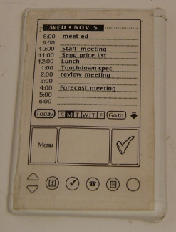
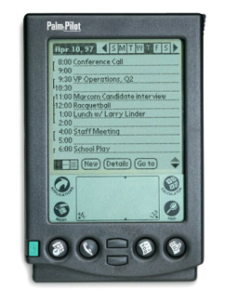
What is a Prototype?
“A prototype is an early sample or model built to test a concept or process or to act as a thing to be replicated or learned from.” – Wikipedia
a working representation of a final artifact
http://www.computerhistory.org/collections/accession/102716262
Notes:
Jeff Hawkins carried around a block of wood like this in his pocket & pulled it out when meeting people and used a pen to act like he was adding things to his device
This led to the prototype in the middle and
The final product: The PalmPilot (right)

Slide 15
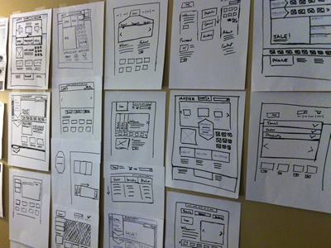
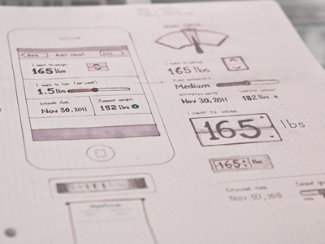
Types of Prototypes
Prototypes are concrete representations of a design
Prototype dimensions
representation: form of the prototype
off-line (paper) or on-line (software)
precision: level of detail (e.g., informal or polished)
interactivity: watch-only vs. fully interactive
fixed prototype (video clips)
fixed-path prototype (each step triggered by specified actions)
at extreme could be 1 path or possibly more open (e.g., Denim)
open prototype (real, but limited error handling or performance)
evolution: expected life cycle of prototype
e.g., throw away or iterative
PJ McCormick
Karem Suer
Notes:
PJ McCormick (left)
Kerem Suer (right)

Slide 16
Types of Prototypes
Prototypes are concrete representations of a design
Prototype dimensions
representation: form of the prototype
off-line (paper) or on-line (software)
precision: level of detail (e.g., informal or polished)
interactivity: watch-only vs. fully interactive
fixed prototype (video clips)
fixed-path prototype (each step triggered by specified actions)
at extreme could be 1 path or possibly more open (e.g., Denim)
open prototype (real, but limited error handling or performance)
evolution: expected life cycle of prototype
e.g., throw away or iterative

Slide 17
Fidelity in Prototyping
Fidelity refers to the level of detail
High fidelity?
prototypes look like the final product
Low fidelity?
artists renditions with many details missing

Slide 18
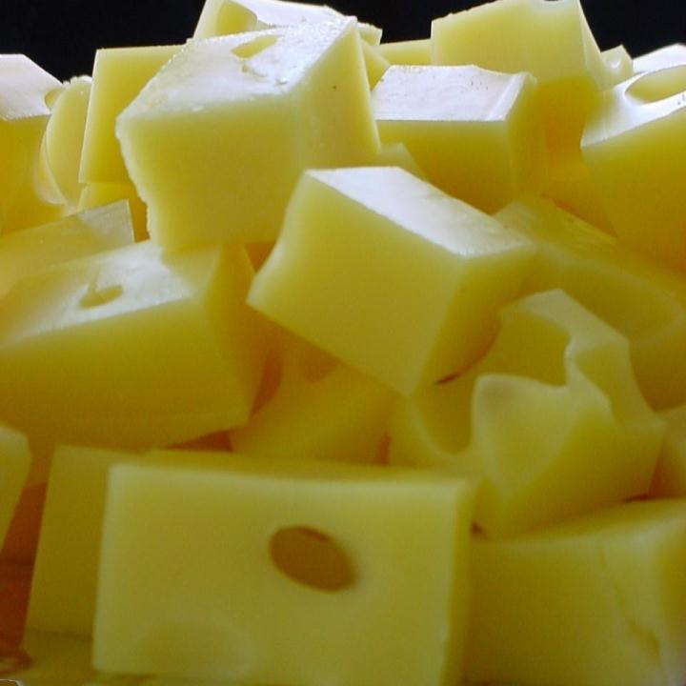
Hi-fi Prototypes Warp
Perceptions of the tester/reviewer
representation communicates “finished”
comments focus on color, fonts, & alignment
Time
encourage precision
specifying details takes more time
Creativity
lose track of the big picture

Slide 19
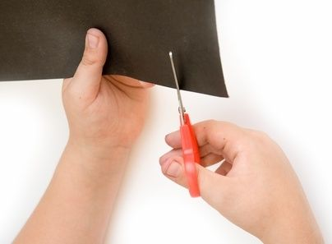
Why Use Low-fi Prototypes?
Traditional methods take too long
sketches → prototype → evaluate → iterate
Can instead simulate the prototype
sketches → evaluate → iterate
sketches act as prototypes
designer “plays computer”; others observe & record
Kindergarten implementation skills
allows non-programmers to participate

Slide 20
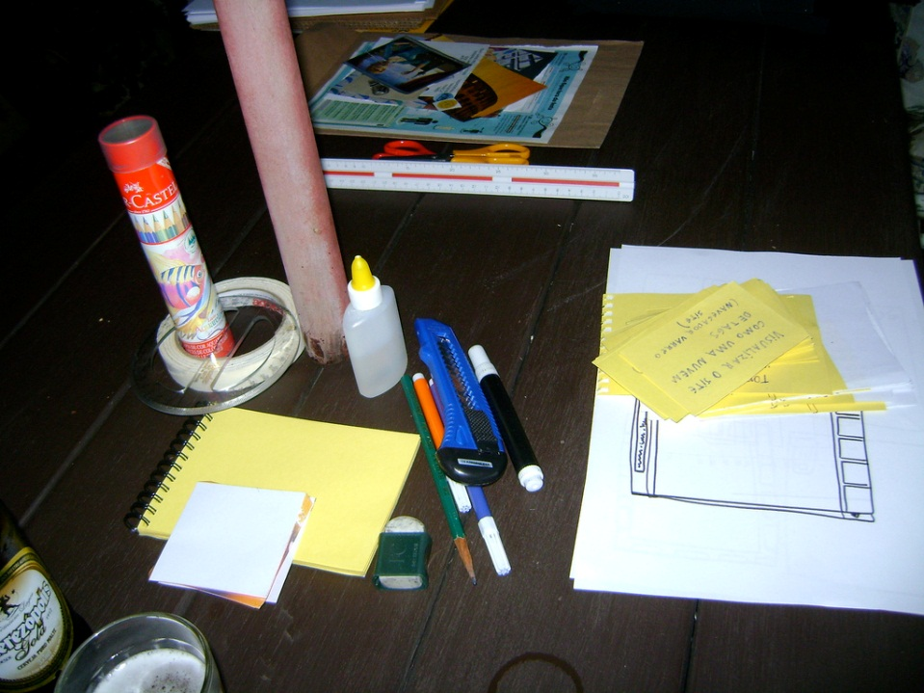
The Basic Materials
Large, heavy, white paper (A3 or 11x17)
5x8 in./A5/A6 index cards
Tape, stick glue, correction tape
Pens & markers (many colors & sizes)
Post-its
Overhead transparencies
Scissors
X-acto knives, etc.
http://www.flickr.com/photos/latitude14/3651034642/sizes/l/in/photostream/

Slide 21
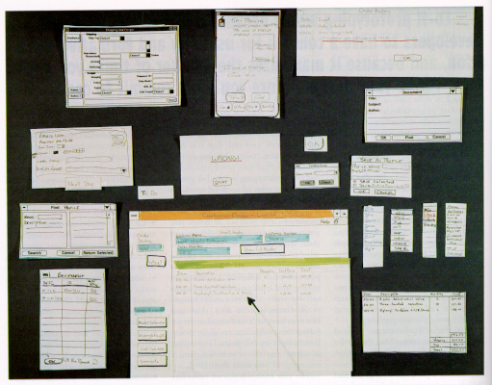
from “Prototyping for Tiny Fingers” by Rettig

Slide 22
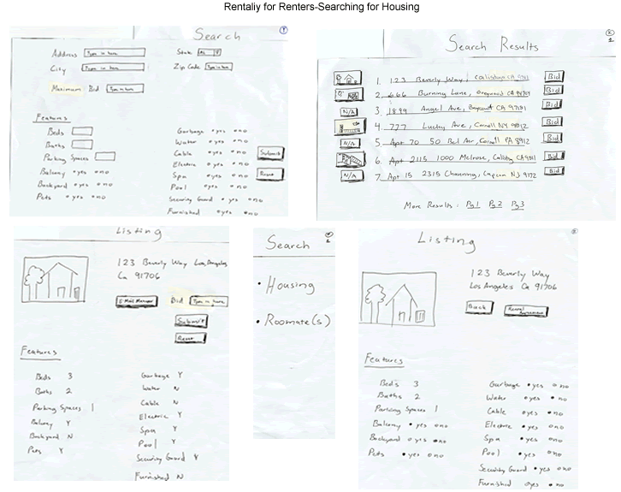

Slide 23
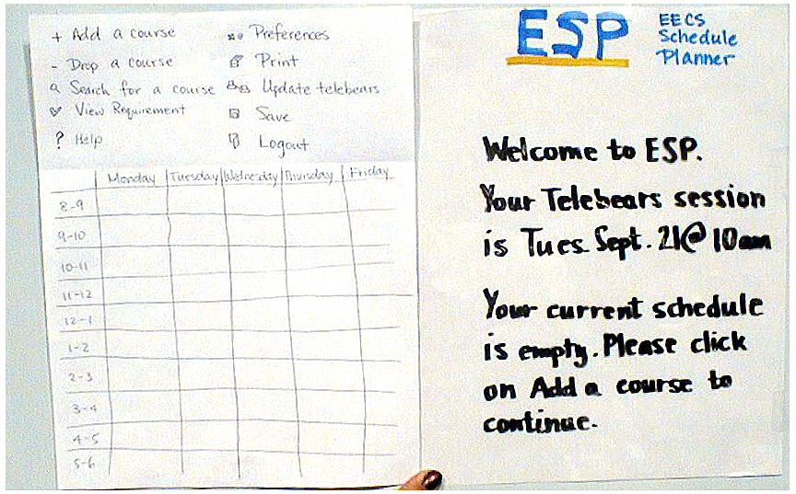
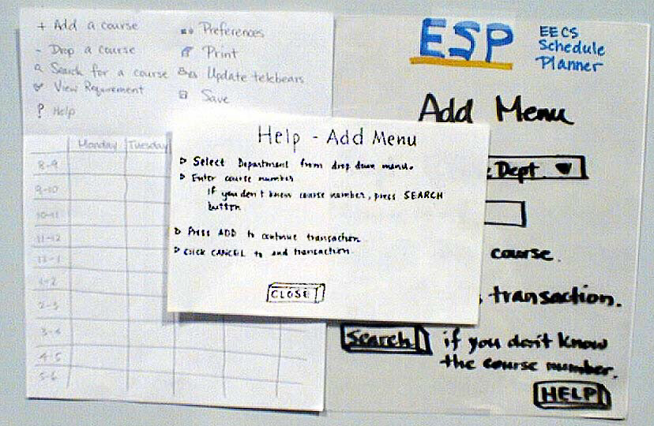
ESP

Slide 24
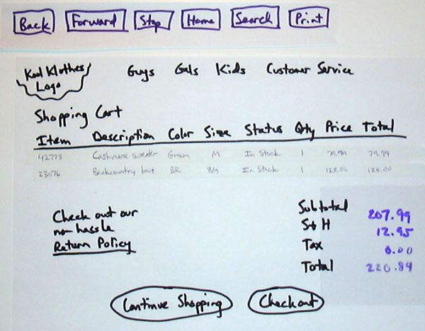

Slide 25
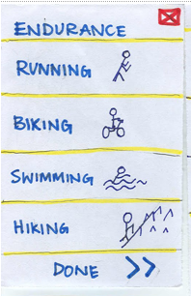
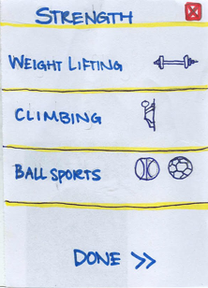
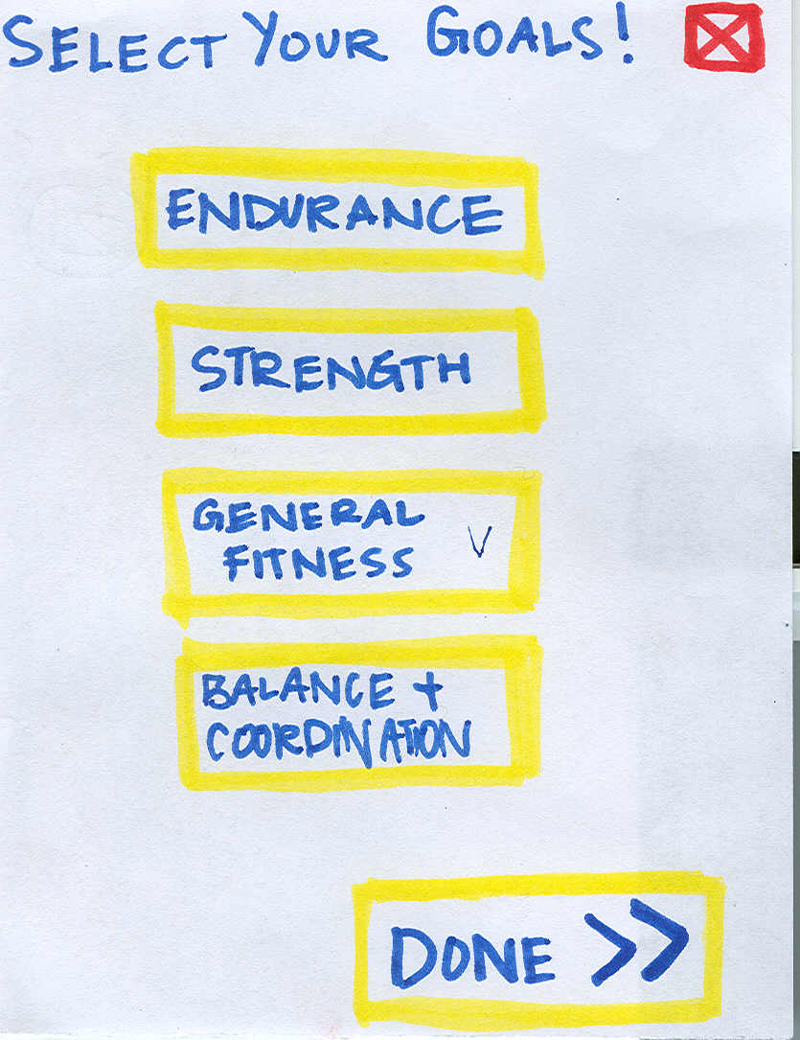
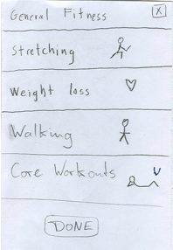
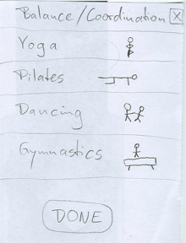
➔
ZAPT

Slide 26
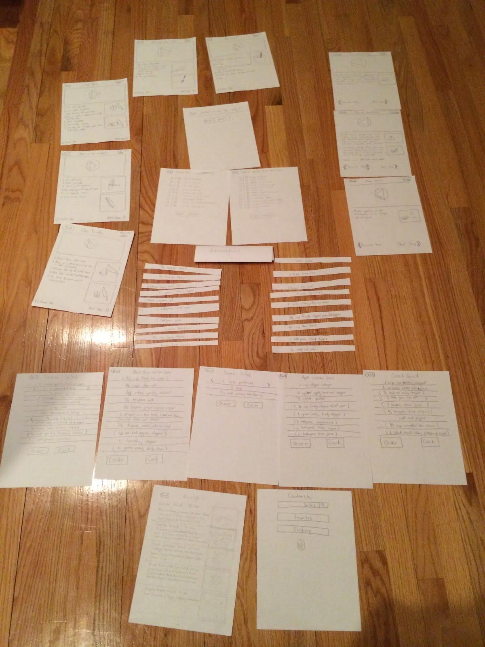
Cookable

Slide 27
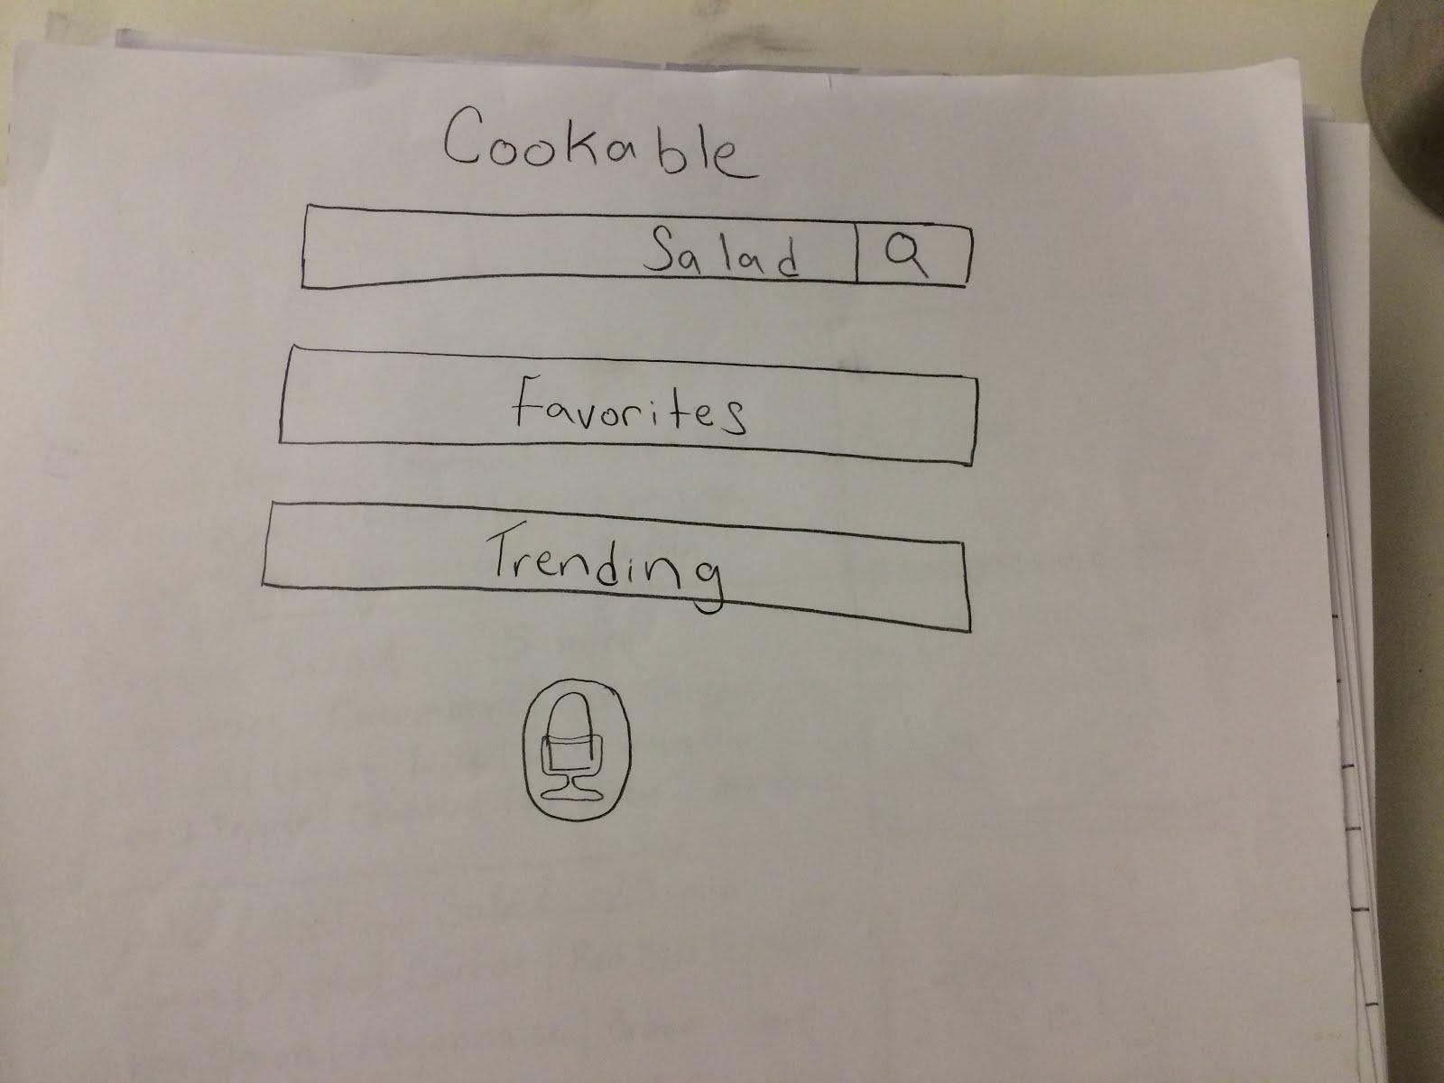
Cookable

Slide 28
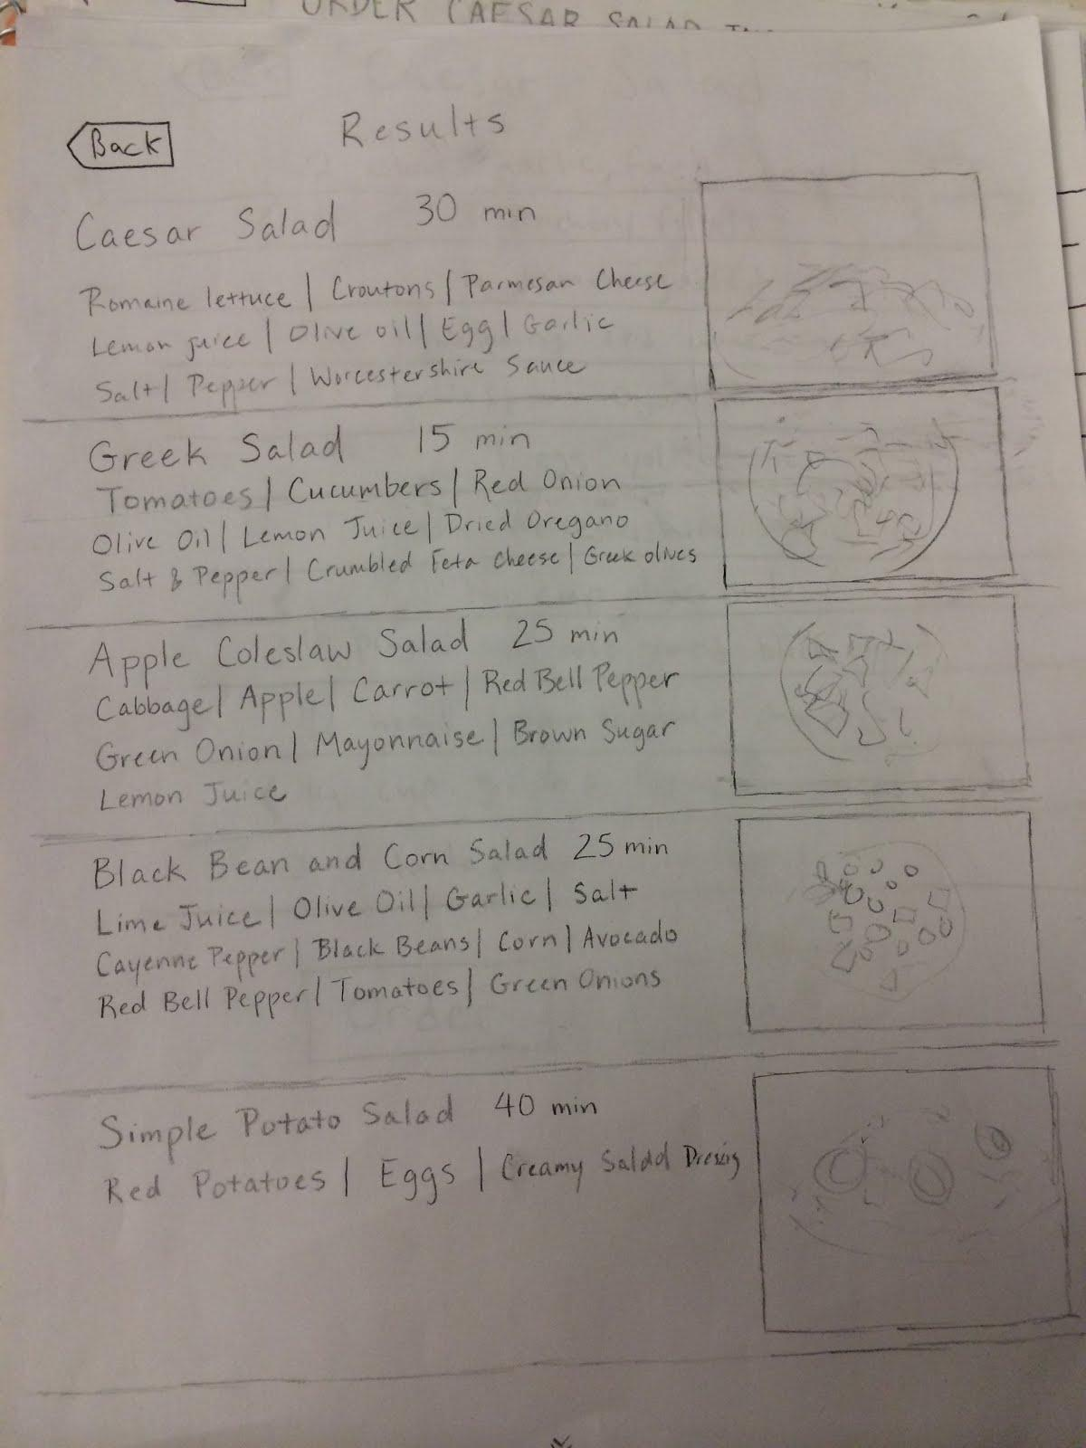
Cookable

Slide 29
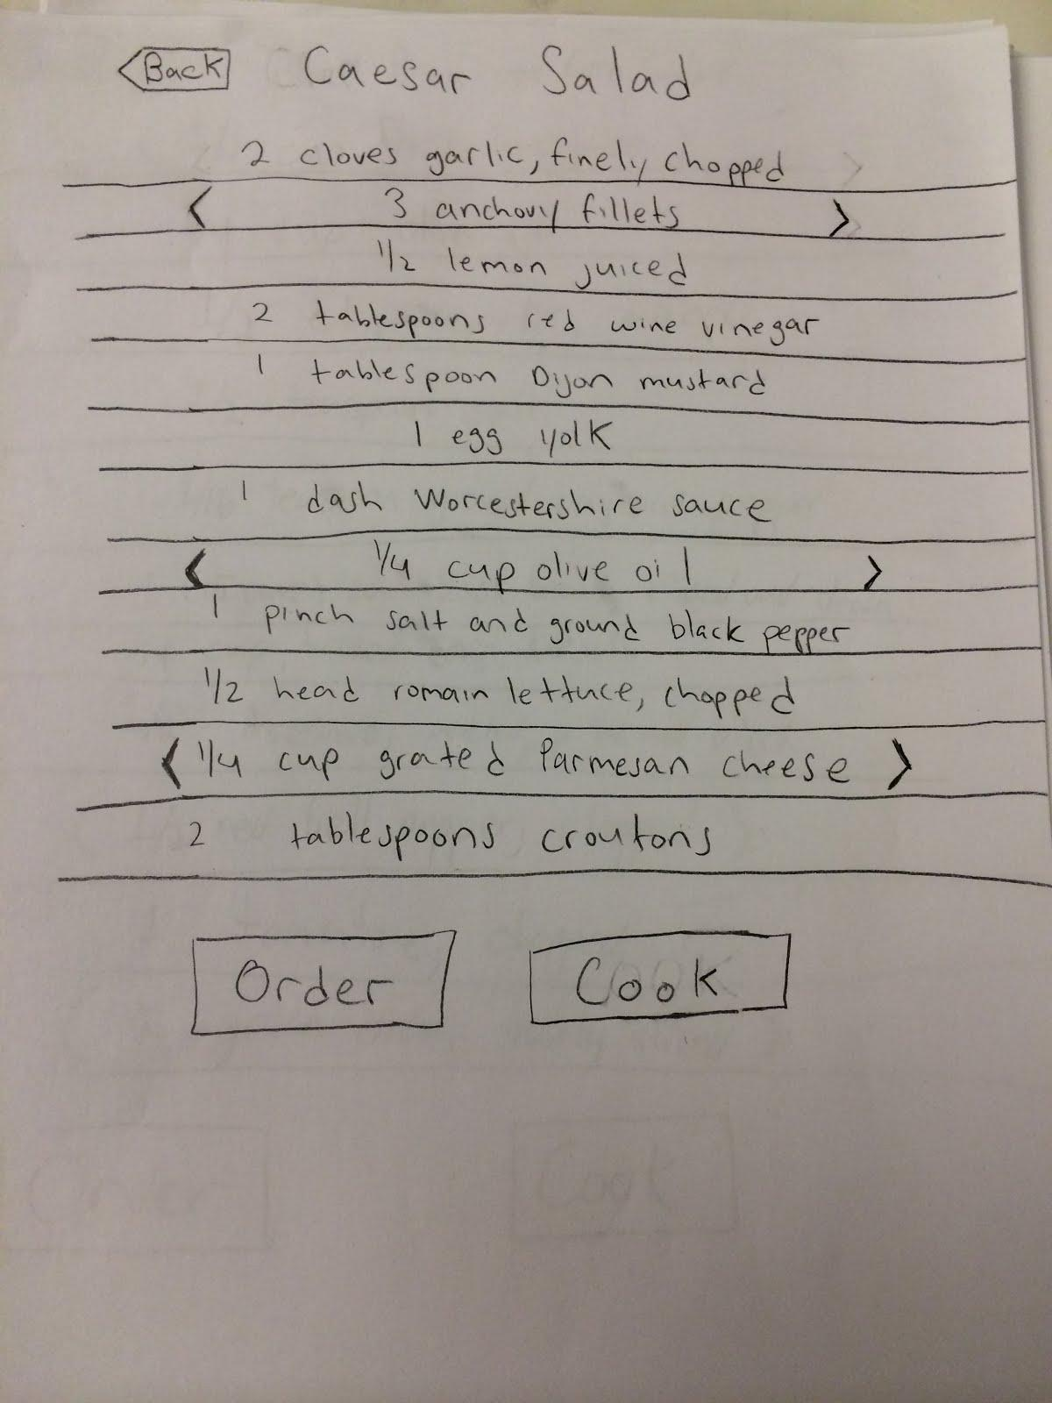
Cookable

Slide 30
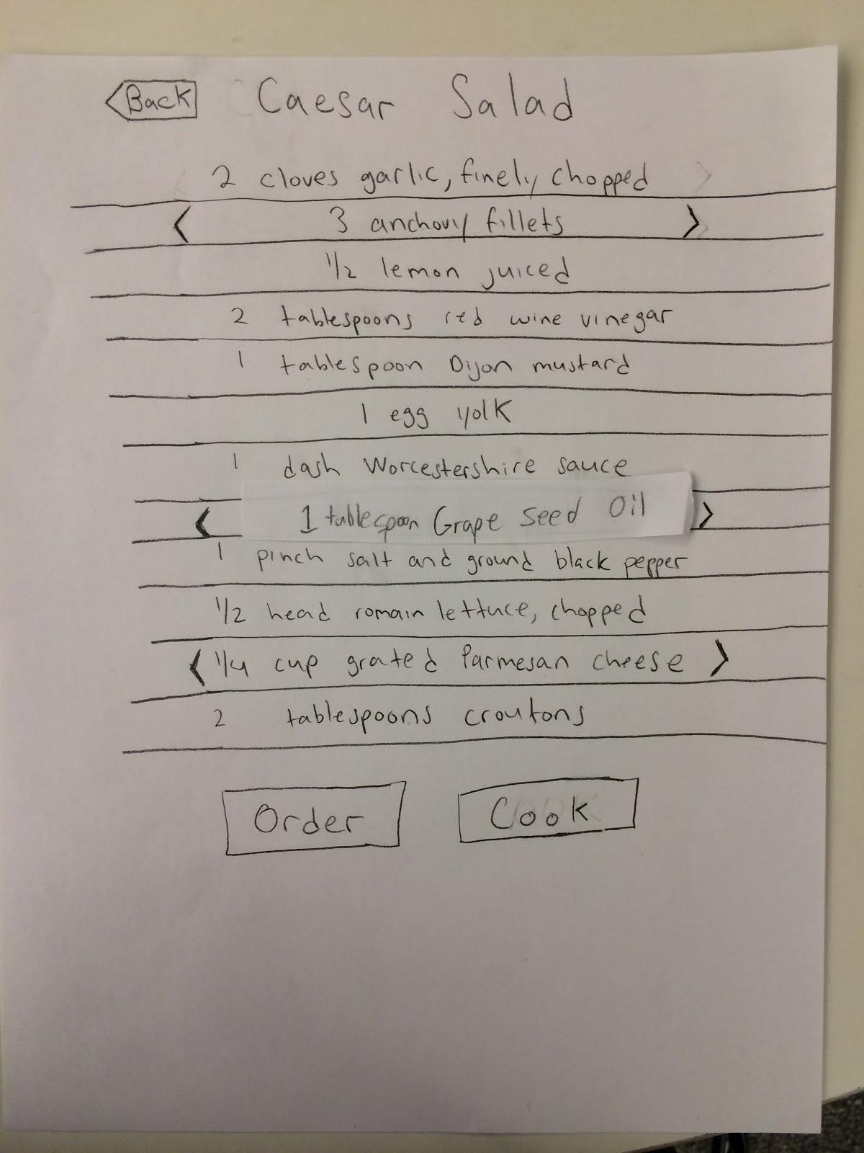
Cookable

Slide 31
Constructing the Model
Set a deadline
don’t think too long - build it!
Draw a window frame on large paper
Put different screen regions on cards
anything that moves, changes, appears/disappears
Ready response for any user action
e.g., have those pull-down menus already made
Use photocopier/printer to make many versions

Slide 32
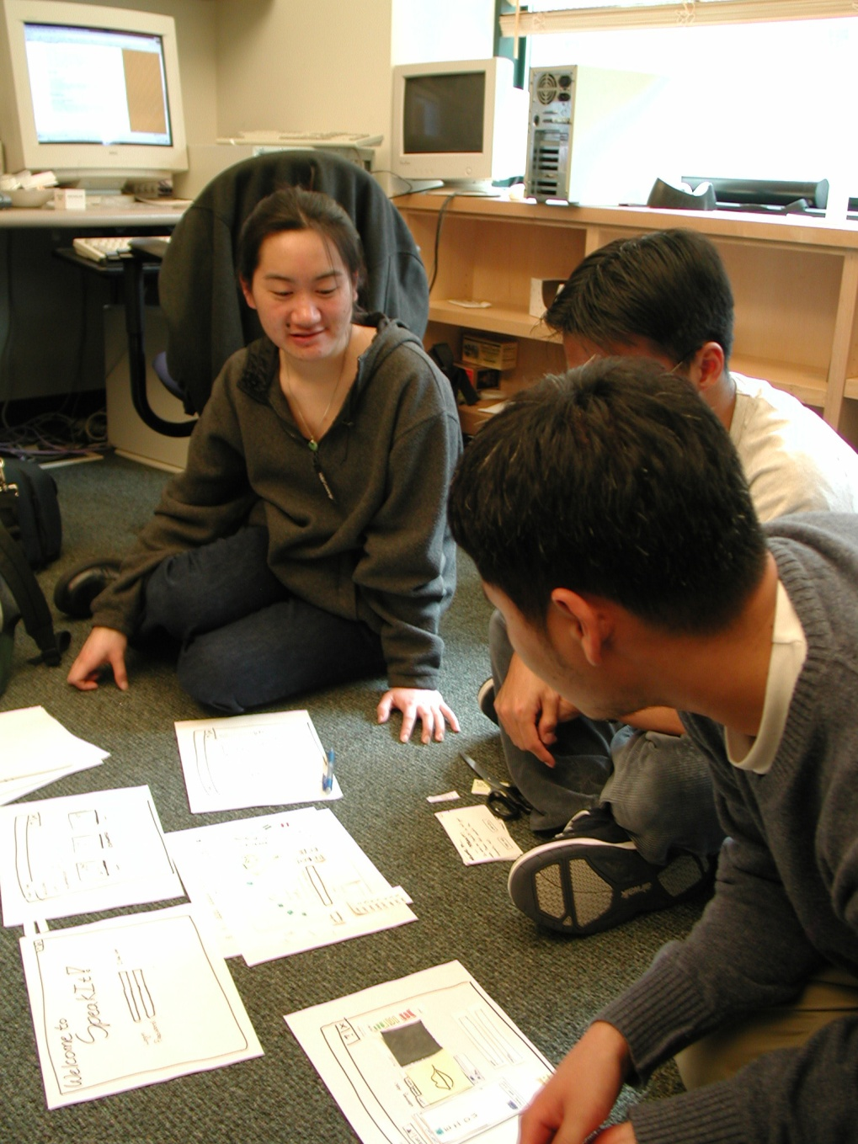
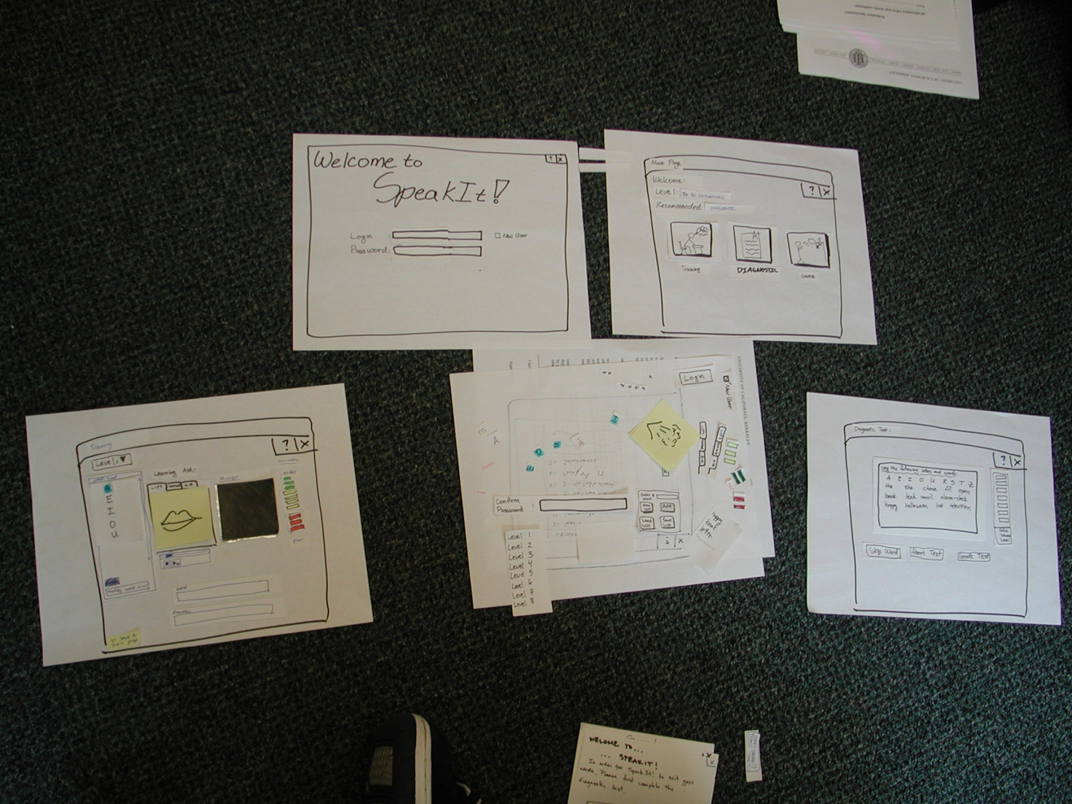
Constructing the Model

Slide 33
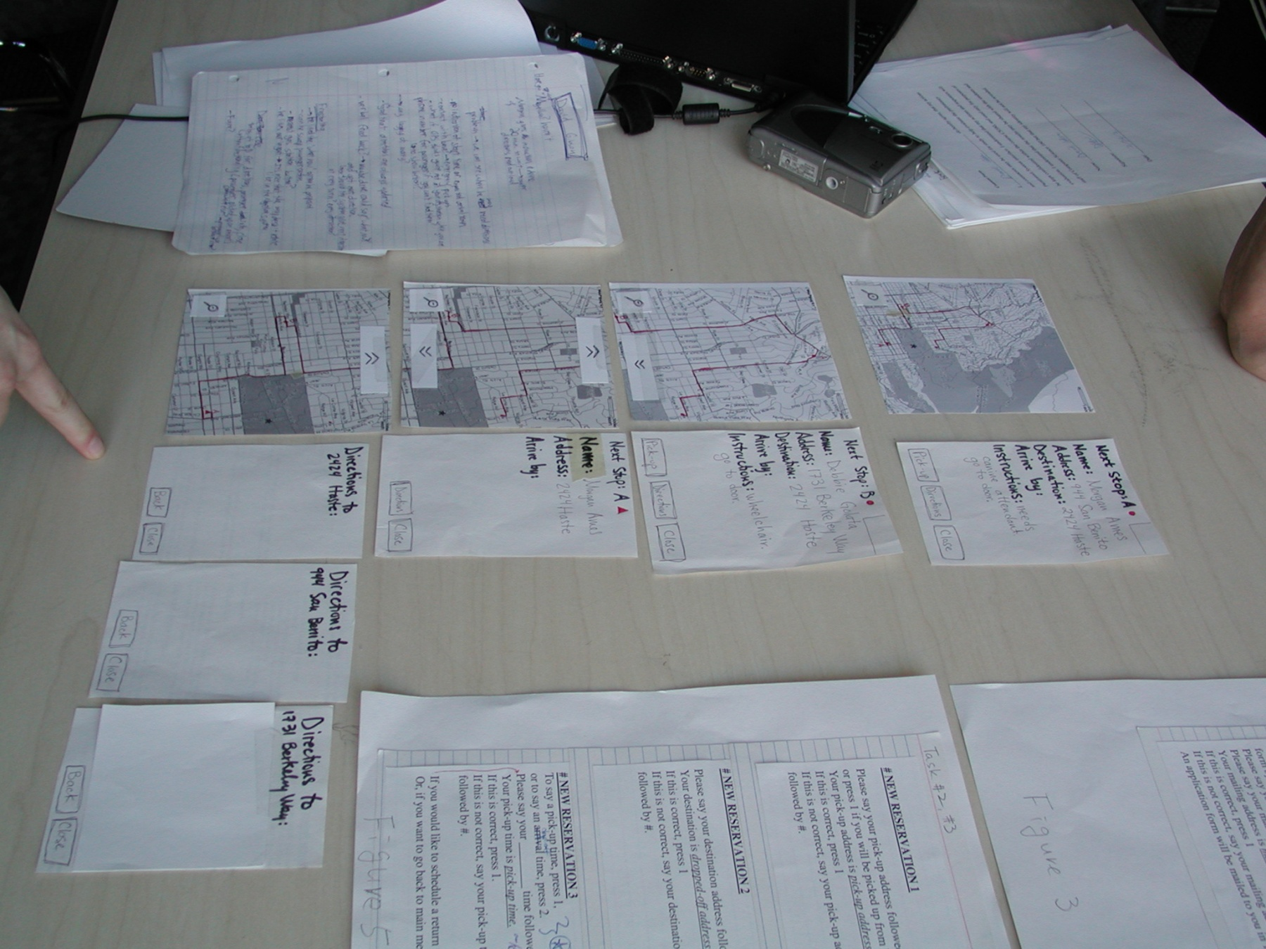
Constructing the Model

Slide 34
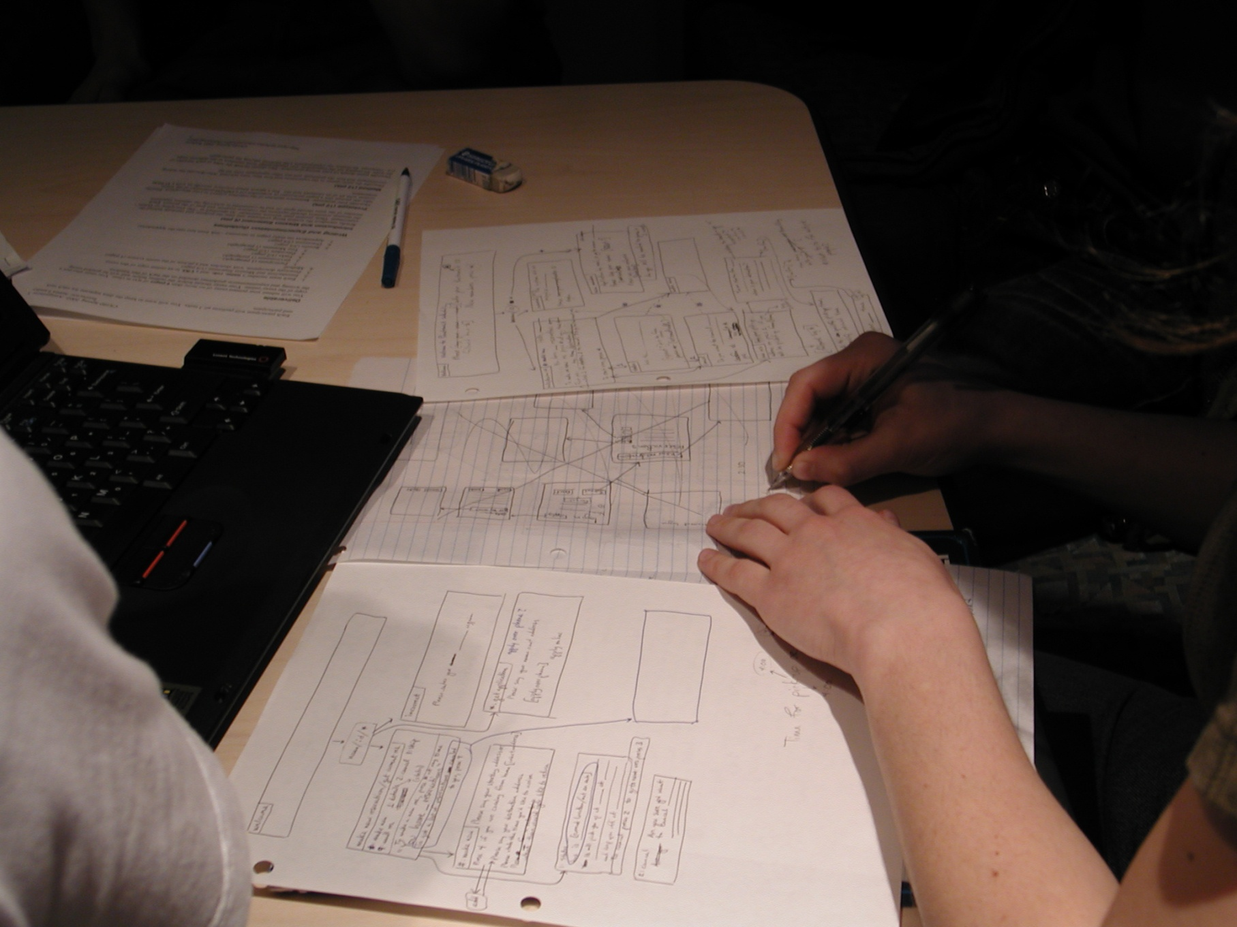
Constructing the Model

Slide 35
Constructing the Model

Slide 36
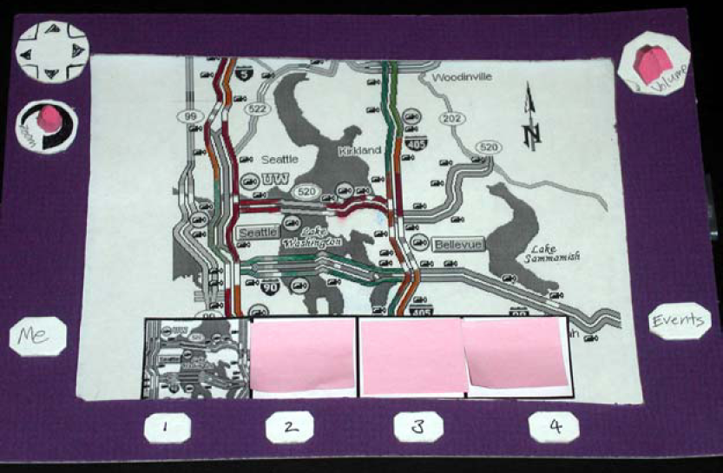
Constructing the Model

Slide 37
Preparing for a Test
Select your “customers”
understand background of intended users
use a questionnaire to get the people you need
don’t use friends or family
I think existing “customers” are OK (Rettig disagrees)
Prepare scenarios that are
typical of the product during actual use
make prototype support these (small, yet broad)
Practice to avoid “bugs”

Slide 38
Conducting a Test
Four roles
greeter – puts users at ease & gets data
facilitator – only team member who speaks
gives instructions & encourages thoughts, opinions
computer – knows application logic & controls it
always simulates the response, w/o explanation
observers – take notes & recommendations

Slide 39
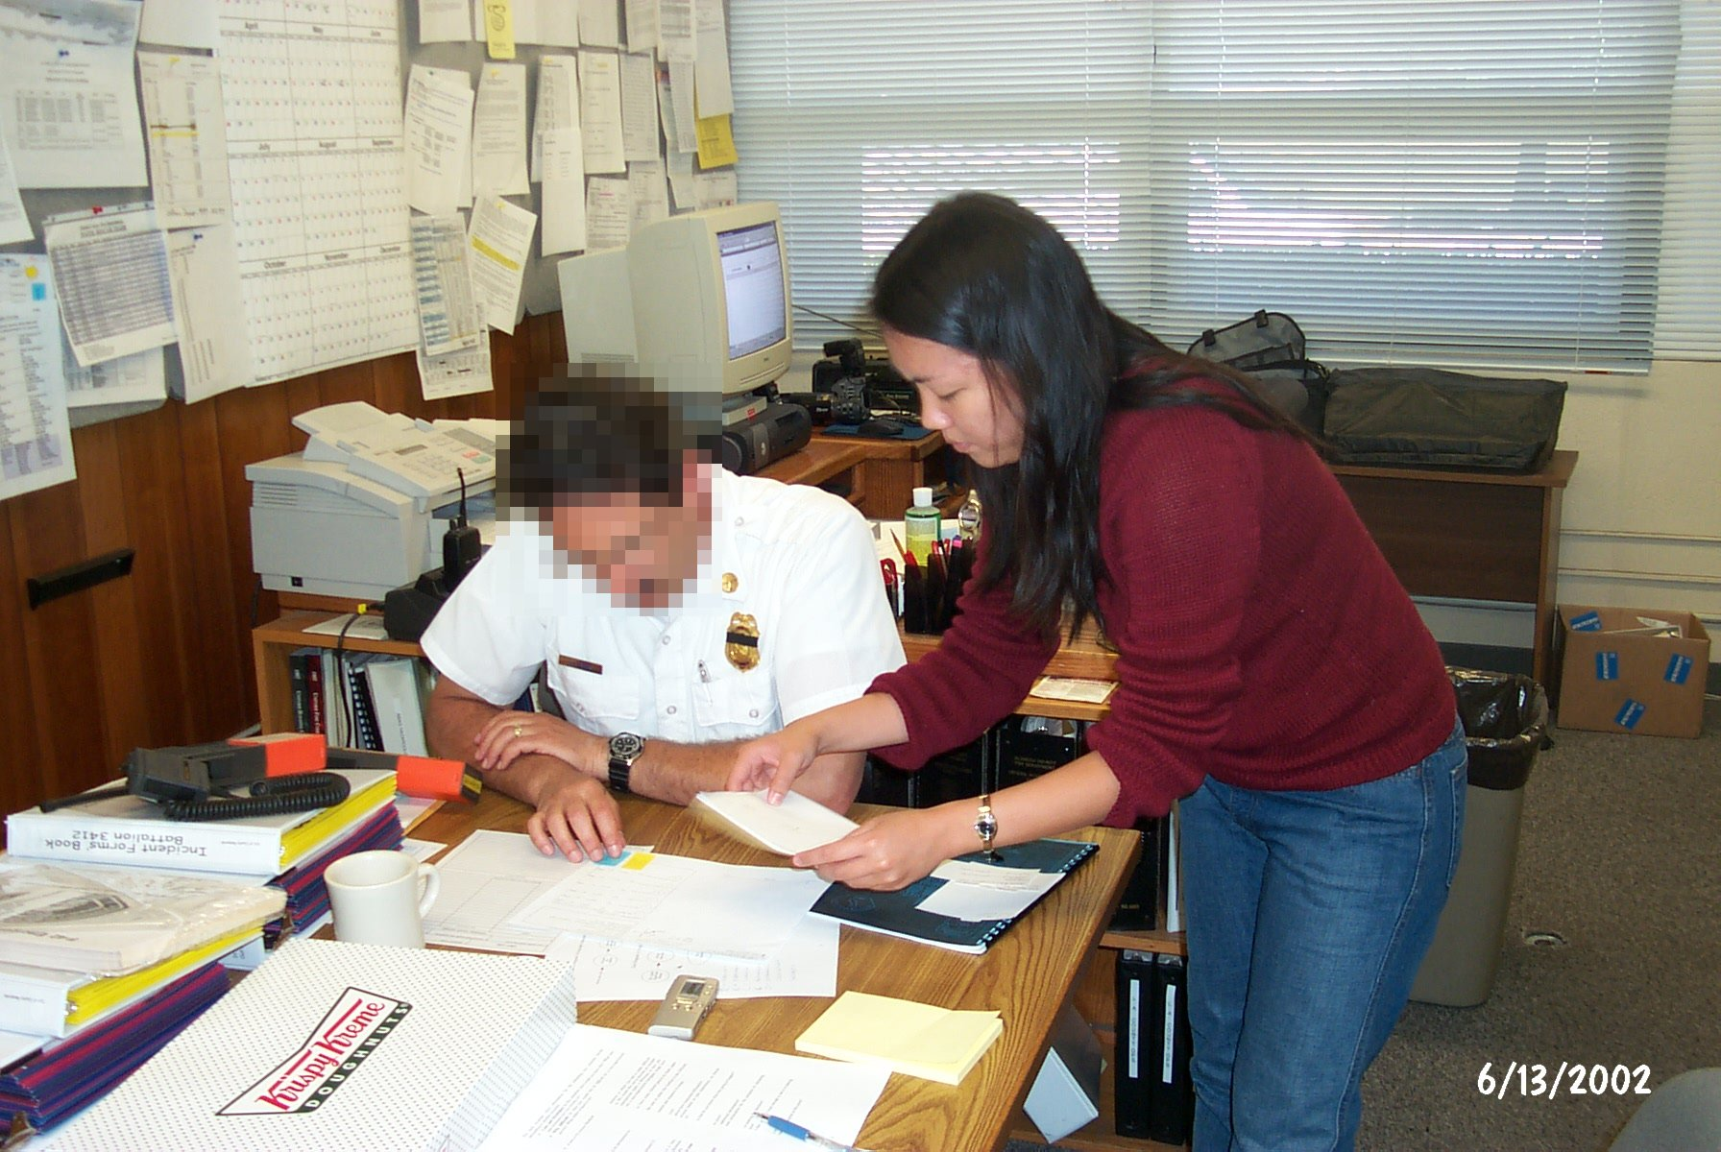
Conducting a Test

Slide 40
Conducting a Test
Four roles
greeter – puts users at ease & gets data
facilitator – only team member who speaks
gives instructions & encourages thoughts, opinions
computer – knows application logic & controls it
always simulates the response, w/o explanation
observers – take notes & recommendations
Typical session is 1 hour
preparation, the test, debriefing
Read the Gommol paper (1 page) for details on conducting a test

Slide 41
Evaluating Results
Sort & prioritize observations
what was important?
lots of problems in the same area?
Create a written report on findings
gives agenda for meeting on design changes
Make changes & iterate

Slide 42
Advantages of Low-fi Prototyping
Takes only a few hours
no expensive equipment needed
Can test multiple alternatives
fast iterations
number of iterations is tied to final quality
Almost all interaction can be faked

Slide 43
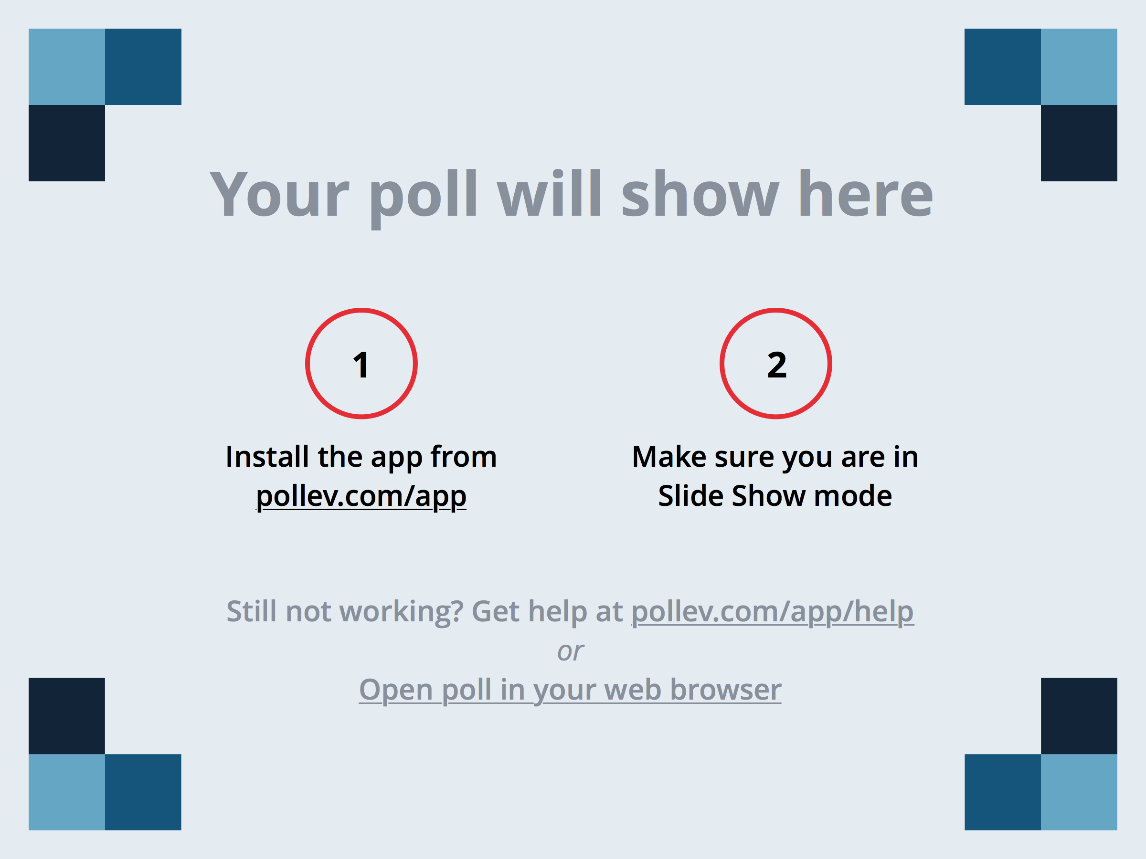

Slide 44
B R E A K

Slide 45
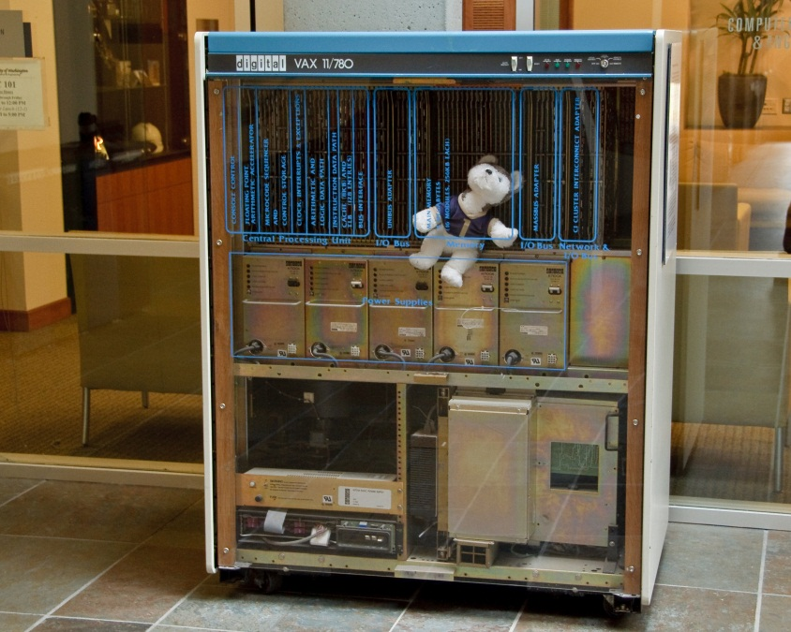
Wizard of Oz Technique
Faking the interaction. Comes from?
the film “The Wizard of OZ”
“the man behind the curtain”
Long tradition in computer industry
e.g., prototype of a PC w/ a DEC VAX behind the curtain

Slide 46
Wizard of Oz Technique
Faking the interaction. Comes from?
the film “The Wizard of OZ”
“the man behind the curtain”
Long tradition in computer industry
e.g., prototype of a PC w/ a DEC VAX behind the curtain
Much more important for hard to implement features
speech & handwriting recognition

Slide 47
Problems with Low-fi Prototypes
“Computer” inherently buggy
Slow compared to real app
timings not accurate
Hard to implement some functionality
pulldowns, feedback, drag, viz …
Won’t look like final product
sometimes hard to recognize widgets
End-users can’t use by themselves
not in context of user’s work environment

Slide 48
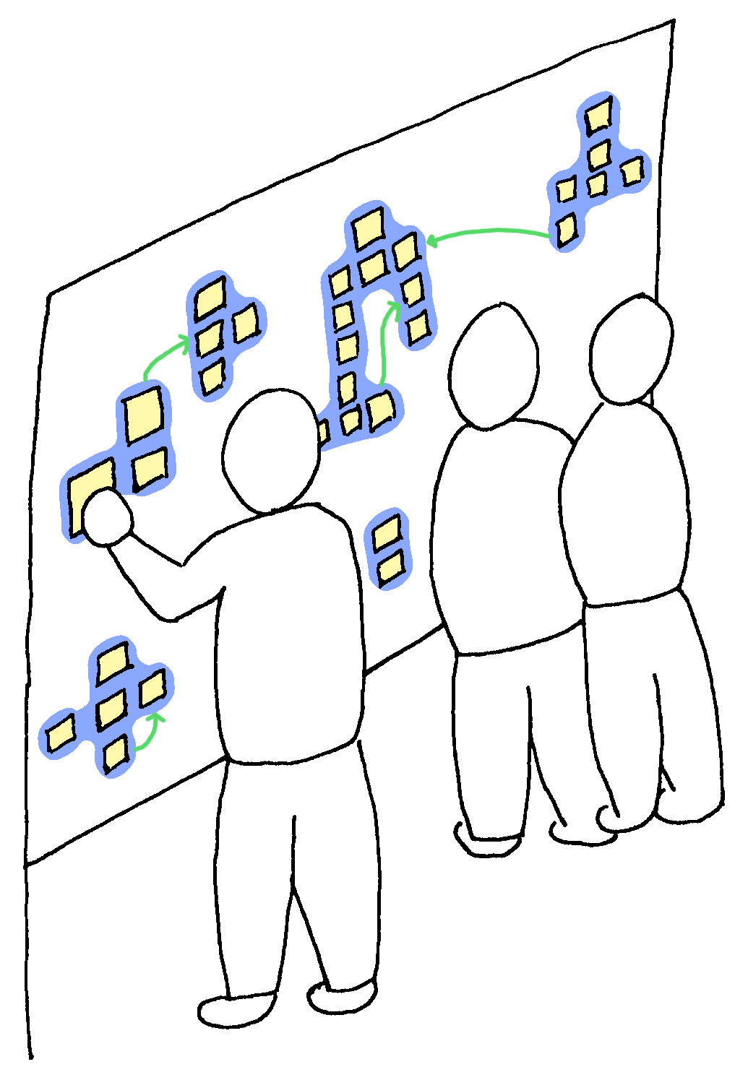
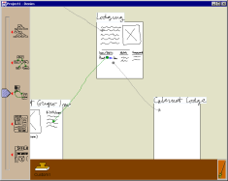
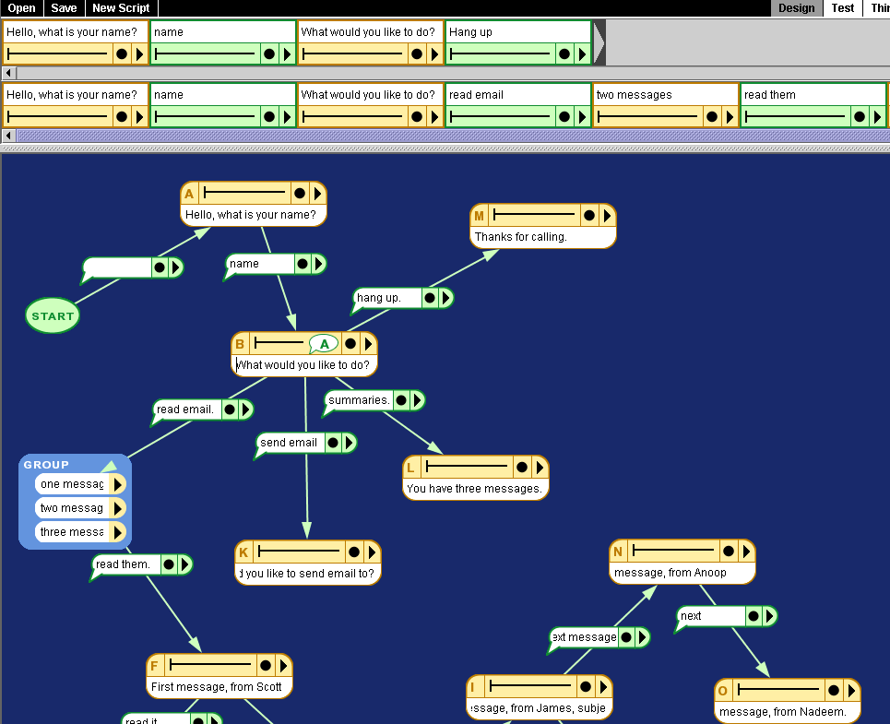
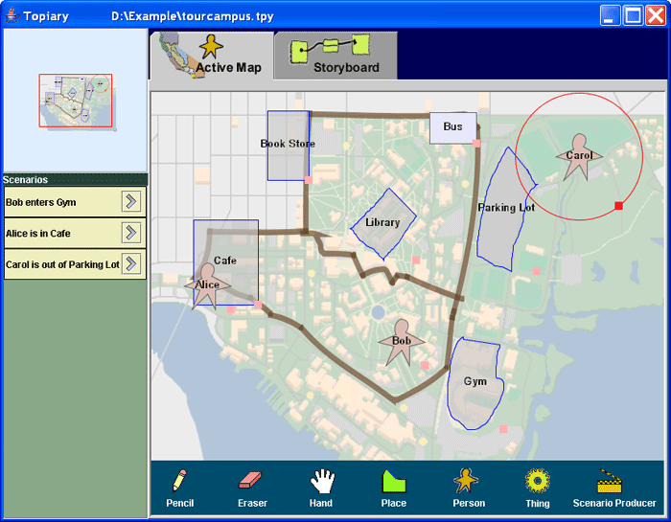
Informal UI Prototyping Tools
Outpost
Denim
Suede
Topiary
SketchWizard
Notes:
We don’t have the tried and true theories of other fields. Can’t follow a book, build it, and expect it to work.
The best tools let you enter a design, create an interactive prototype, & support testing it
This is the philosophy that our work supports!

Slide 49
Informal UI Prototyping Tools
Support advantages of low-fi paper prototypes
brainstorming
consider different ideas rapidly
do not require specification of details
incomplete designs
need not cover all cases, just illustrate important examples
Add advantages of electronic tools
evolve easily
support for “design memory”
transition to other electronic tools
allow end-user interaction
Notes:
Unlike designing a computer program, you do not need to consider all cases this early.
present several designs to give the client an idea of what I as the designer am thinking about.

Slide 50
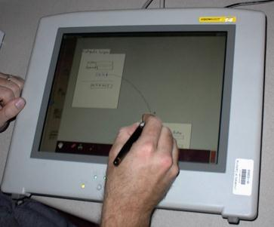
DENIM: Designing Web Sites by Sketching
Early-phase navigation & interaction design
Integrates multiple views
site map – storyboard – page sketch
Notes:
Follows Outpost

Slide 51
Video
Notes:
mention Chris Long’s GDT for designing gestures
6:30 minutes long

Slide 52
Commercial Tools
Balsamiq Mockups
see tutorial here
http://support.balsamiq.com/customer/portal/articles/107999
POP

Slide 53
Summary
Prototypes are a concrete representation of a design or final product
Low-fi testing allows us to quickly iterate
get feedback from users & change right away

Slide 54
Further Reading Prototyping
Books
Paper Prototyping: The Fast and Easy Way to Design and Refine User Interfaces, by Carolyn Snyder, Morgan Kaufmann, 2003
Articles
“Prototyping for Tiny Fingers” by Marc Rettig, in Communications of the ACM, 1994
“Using Paper Prototypes to Manage Risk” by Carolyn Snyder, http://world.std.com/~uieweb/paper.htm
“The Perils of Prototyping” by Alan Cooper,
http://www.chi-sa.org.za/Documents/articles/perils.htm
Web Sites
dub Group web site, for DENIM & SUEDE downloads, http://dub.washington.edu
InfoDesign Toolkit, http://www.infodesign.com.au

Slide 55
Next Time
Watch, Critique & Vote on Concept Videos
Mid-term course evaluation
No Reading

Slide 56
T E A M
M E E T I N G S

