Slide 1
Human Abilities: Vision & Cognition
October 14, 2014
Notes:
exactly 1:50 min with 5 min for quiz and two in class experiments. Cut 5 more slides if to fit in 1:20

Slide 2
Hall of Fame or Shame?

Slide 3
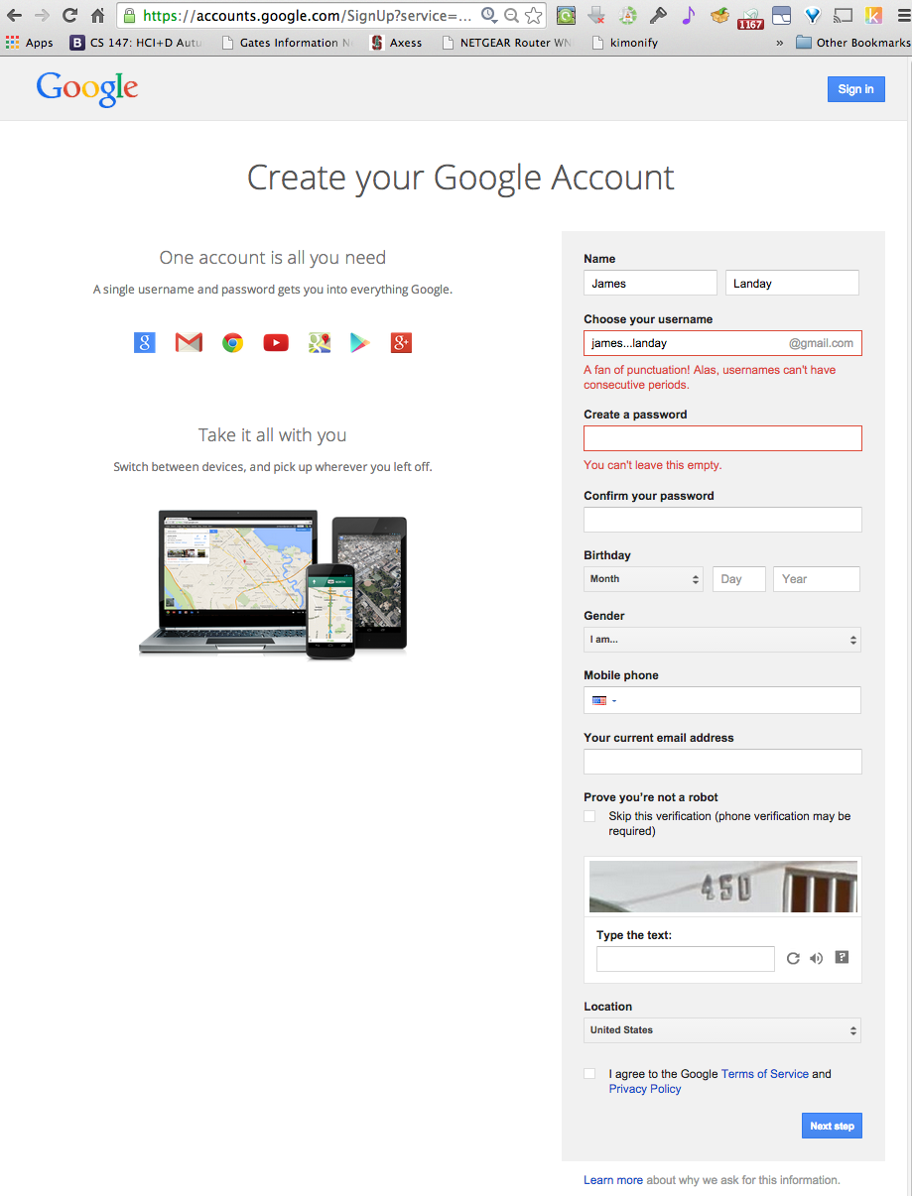
Hall of Fame or Shame?

Slide 4
Hall of Fame!
Clearly highlights error (red text & box)
Tells me what I did wrong/how to fix it
In user’s language
(careful w/ humor)

Slide 5
Hall of Fame or Shame?

Slide 6
Hall of Shame!
Error Messages
where is error?
what’s wrong with it?
parse & fix it yourself!

Slide 7
Hall of Fame or Shame?
Design based on a top retailer’s site
In study, user could not get by this screen, why?

Slide 8
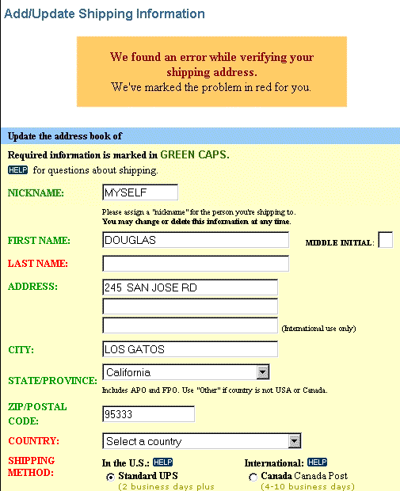
Hall of Shame!
Design based on a top retailer’s site
In study, user could not get by this screen, why?
Color deficiency
can’t distinguish between red & green
How to fix?
redundant cues

Slide 9
Human Abilities: Vision & Cognition
October 14, 2014
Notes:
Cut 1-2 more slides.

Slide 10
Outline
Video Prototyping / Concept Video Review
Human visual system
Guidelines for design
Models of human performance (MHP)
Memory

Slide 11
Video Review
Video prototypes allow us to quickly communicate how a user will use a design
Concept videos set up more of the story of use
Video planning storyboards allow quick design/iteration on a video before shooting
Keep it short! (~2 minutes)
Use music/tempo to highlight impact of product
Questions?

Slide 12
Why Study Color?
Color can be a powerful tool to improve user interfaces by communicating key information
Inappropriate use of color can severely reduce the performance of systems we build

Slide 13
Visible Spectrum

Slide 14
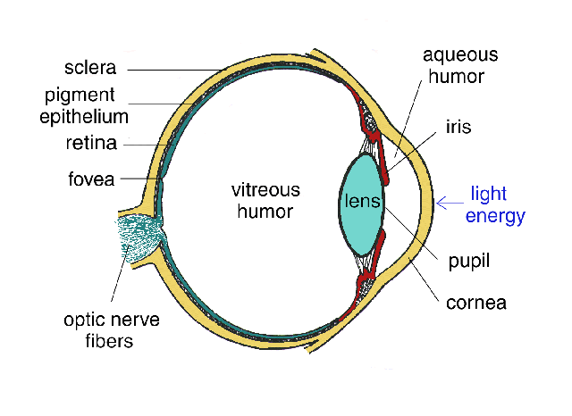
Human Visual System
Light passes through lens
Focussed on retina

Slide 15
Retina
Retina covered with light-sensitive receptors?
rods
primarily for night vision & perceiving movement
sensitive to broad spectrum of light
can’t discriminate between colors
sense intensity or shades of gray
cones
used to sense color

Slide 16
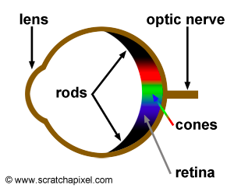
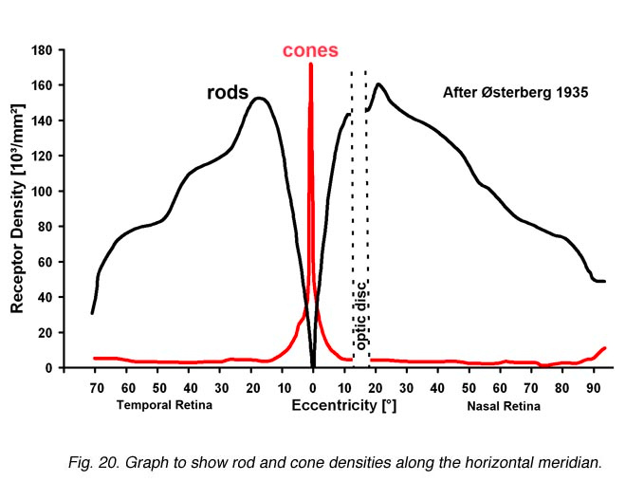
Retina
Center of retina has most of the cones →
allows for high acuity of objects focused at center
Edge of retina is dominated by rods →
allows detecting motion of threats in periphery
http://www.webexhibits.org/causesofcolor/1G.html
http://webvision.med.utah.edu/imageswv/Ostergr.jpeg

Slide 17
Color Perception via Cones
“Photopigments” used to sense color
3 types: blue, green, “red” (really yellow)
each sensitive to different band of spectrum
ratio of neural activity of the 3 → color
other colors are perceived by combining stimulation

Slide 18
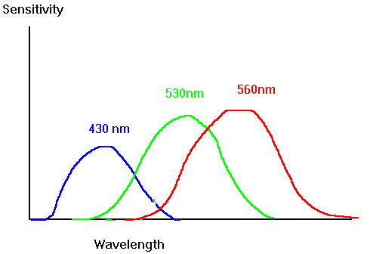
Color Sensitivity
Really yellow
not as sensitive to blue
lots of overlap
https://www.siggraph.org/education/materials/HyperGraph/color/images/colorspc.gif
Notes:
See anything interesting here?
We are NOT as sensitive to blue
There is lots of overlap between the 3 photopigments

Slide 19
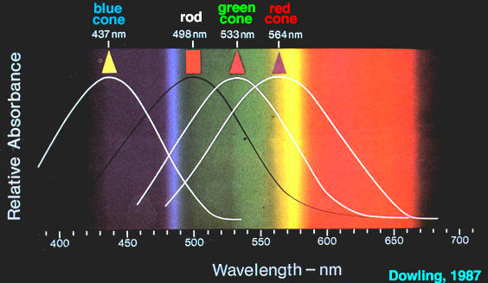
Color Sensitivity
Centered on yellow
http://retina.umh.es/webvision/imageswv/spectra.jpeg

Slide 20
Distribution of Photopigments
Not distributed evenly – mainly reds (64%) & very few blues (4%) →?
insensitivity to short wavelengths (blue)
No blue cones in retina center (high acuity) →?
“disappearance” of small blue objects you fixate on
As we age lens yellows & absorbs shorter wavelengths →?
sensitivity to blue is even more reduced
Implication
don’t rely on blue for text or small objects!
http://www.webexhibits.org/causesofcolor/1G.html
Notes:
Original choice of blue links on the web was a bad idea!

Slide 21
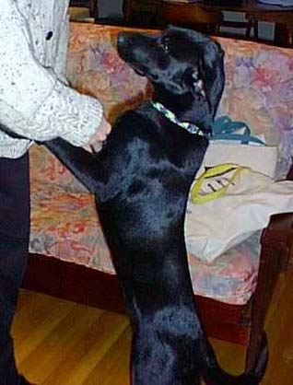
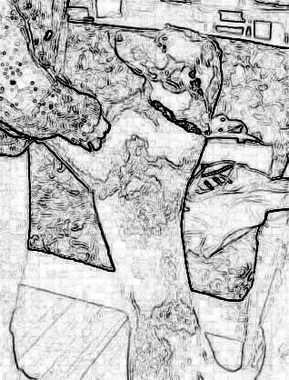
Color Sensitivity & Image Detection
Most sensitive to the center of the spectrum
blues & reds must be brighter than greens & yellows
Brightness determined mainly by G+R cones
Shapes detected by finding edges
we use brightness & color differences
Implication
hard to deal w/ blue edges & shapes

Slide 22
Focus
Different wavelengths of light focused at different distances behind eye’s lens
need for constant refocusing → ?
causes fatigue
be careful about color combinations
Pure (saturated) colors require more focusing then less pure (desaturated)
don’t use saturated colors in UIs unless you really need something to stand out (your product)
http://www.pallasweb.com/color.html
Notes:
Left image saturated, right desaturated (how much gray)
Decreasing lightness helps, but much better on right with desaturated colors than saturated
(sweater will still “pop”)

Slide 23
Color Deficiency (AKA “color blindness”)
Trouble discriminating colors
besets about 9% of population
Two main types
different photopigment response most common
reduces capability to discern small color diffs
red-green deficiency is best known
lack of either green or red photopigment → can’t discriminate colors dependent on R & G

Slide 24
Color Guidelines
Avoid simultaneous display of highly saturated, spectrally extreme colors
e.g., no cyans/blues at the same time as reds, why?
refocusing!
desaturated combinations are better → pastels

Slide 25
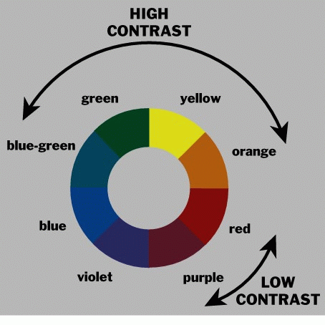
Use the Hue Circle
Pick non-adjacent colors
opponent colors go well together
(red & green) or (yellow & blue)

Slide 26
Color Guidelines (cont.)
Size of detectable changes in color varies
hard to detect changes in reds, purples, & greens
easier to detect changes in yellows & blue-greens
older users need higher brightness levels
Hard to focus on edges created by only color
use both brightness & color differences
Avoid red & green in the periphery (no RG cones)
Avoid pure blue for text, lines, & small shapes
also avoid adjacent colors that differ only in blue
Avoid single-color distinctions
mixtures of colors should differ in 2 or 3 colors
helps color-deficient observers
Notes:
blue makes a fine background color

Slide 27
Q U I Z

Slide 28
IN CLASS ONLY URL

Slide 29
B R E A K

Slide 30
Administrivia
Readings
should have been Pages 66-99 (NOT 85) for "Cognitive Aspects in Interaction Design”
Grading:
Assignment #1 (Project Proposals)
avg.=89/100, low=67, high=100
Assignment #2 (Problem Finding/Research)
avg.=97.7, median=100, stdev=7
Assignment #3 (Hall of Fame/Shame)
avg.=92/100, low=69, high=100

Slide 31
Administrivia
Quiz #1:
avg.=4.2
scores: 5/5 (80), 4/5 (49), 3/5 (28), 2/5 (9), 1/5 (2)
47% got 100%
answers:
Douglas Engelbart showed NLS in “The Mother of All Demos”
The Dynabook was invented by: Alan Kay
The key observation technique used in Contextual Inquiry is: Master-apprentice model
Which group in the ceramics class described in the Buxton reading produced the highest quality pots: Graded by Quantity Group
At IDEO the person who gets the most credit is
The person with the best idea
The person with the wildest idea

Slide 32
Why Model Human Performance?
To test understanding
To predict influence of new technology

Slide 33
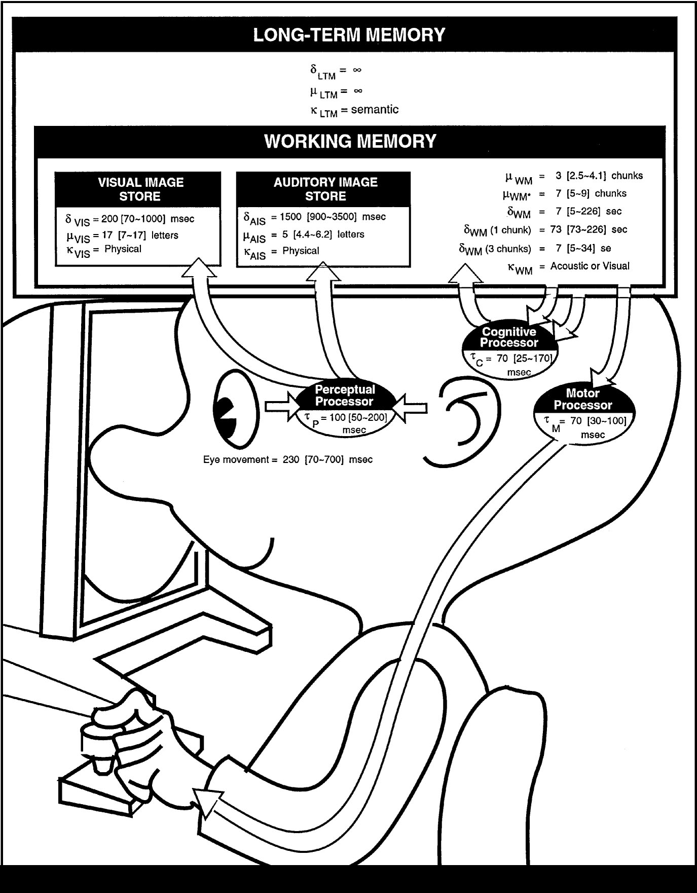
The Model Human Processor
Developed by Card, Moran & Newell (’83)
based on empirical data
Notes:
This is the classic image form the book

Slide 34
The Model Human Processor
Developed by Card, Moran & Newell (’83)
based on empirical data
Long-term Memory
Working Memory
sensory
buffers
Visual Image
Store
Auditory Image
Store
Eyes
Perceptual
Processor
Motor
Processor
Cognitive
Processor
Ears
Fingers, etc.
Notes:
I’ll use this simpler model

Slide 35
MHP Basics
Sometimes serial, sometimes parallel
serial in action & parallel in recognition
pressing key in response to light (serial)
driving, reading signs, & hearing at once (parallel)
Parameters
processors have cycle time (T) ~ 100 ms
memories have capacity, decay time, & type

Slide 36
What is missing from MHP?
Long-term Memory
Working Memory
sensory
buffers
Visual Image
Store
Auditory Image
Store
Eyes
Perceptual
Processor
Motor
Processor
Cognitive
Processor
Ears
Fingers, etc.

Slide 37
What is missing from MHP?
Haptic memory
for touch
Moving from sensory memory to WM
attention filters stimuli & passes to WM
Moving from WM to LTM
elaboration
Notes:
Perception of Touch… Smell… Taste….

Slide 38
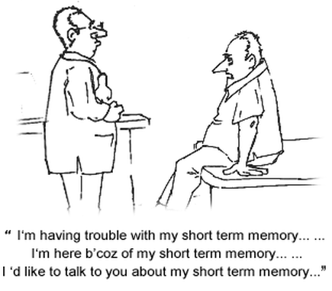
Memory
Working memory (short term)
small capacity (7 ± 2 “chunks”)
6174591765 vs. (617) 459-1765
NBCIBMGMC vs. NBC IBM GMC
rapid access (~ 70ms) & decay (~200 ms)
pass to LTM after a few seconds of continued storage
Long-term memory
huge (if not “unlimited”)
slower access time (~100 ms) w/ little decay

Slide 39
MHP Principles of Operation
Recognize-Act Cycle of the CP
on each cycle contents in WM initiate actions associatively linked to them in LTM
actions modify the contents of WM

Slide 40
MHP Principles of Operation
Long-term Memory
Working Memory
sensory
buffers
Visual Image
Store
Auditory Image
Store
Eyes
Perceptual
Processor
Motor
Processor
Cognitive
Processor
Ears
Fingers, etc.
Notes:
I’ll use this simpler model

Slide 41
MHP Principles of Operation
Recognize-Act Cycle of the CP
on each cycle contents in WM initiate actions associatively linked to them in LTM
actions modify the contents of WM
Discrimination Principle
retrieval is determined by candidates that exist in memory relative to retrieval cues
interference by strongly activated chunks

Slide 42
Experiment
Task: Quickly tap each target 50 times accurately
Conditions:
Two ½” diameter targets 6” apart
Two ½” diameter targets 24” apart
Two 2” diameter targets 24” apart
Two 2” diameter targets 24” apart (no accuracy required)
Notes:
Draw two circles on the board
both around 1/2 inches in diameter
1) distance of 6 inches
2) Repeat by extending the distance to 24 inches
Ask volunteer to put mark in circle 50 times each quickly, but accurately (outside of circle at most 4 times)
TURN to a partner and discuss what you think will happen and WHY????
ID=Log2(d/w+1) : try easy ID of 4 and hard of ID 8
log2 (13)=3.7
Log2 (49)=5.6
Now try it again with 24 inches but make the target 2 inches wide
3) log2 (13)=3.7
) Now try again asking the person to go as fast as they can independent of accuracy (should get more speed but see spread of circles outside)
Results:
30 sec
48 sec
31 sec (as predicted, almost the same as #1)
21 sec (lots of spread)

Slide 43
Experimental Results
Task: Quickly tap each target 50 times accurately
Conditions:
30 sec
48 sec
31 sec
21 sec (lots of spread)
Notes:
Draw two circles on the board
both around 1/2 inches in diameter
1) distance of 6 inches
2) Repeat by extending the distance to 24 inches
Ask volunteer to put mark in circle 50 times each quickly, but accurately (outside of circle at most 4 times)
TURN to a partner and discuss what you think will happen and WHY????
ID=Log2(d/w+1) : try easy ID of 4 and hard of ID 8
log2 (13)=3.7
Log2 (49)=5.6
Now try it again with 24 inches but make the target 2 inches wide
3) log2 (13)=3.7
) Now try again asking the person to go as fast as they can independent of accuracy (should get more speed but see spread of circles outside)
Results:
30 sec
48 sec
31 sec (as predicted, almost the same as #1)
21 sec (lots of spread)

Slide 44
Principles of Operation (cont.)
Fitts’ Law
moving hand is a series of microcorrections
correction takes T_{p +} T_{c +} T_{m} = 240 msec
time T_{pos} to move the hand to target size S which is distance D away is given by:
T_{pos} = a + b log₂ (D/S + 1)
summary
time to move the hand depends only on the relative precision required

Slide 45
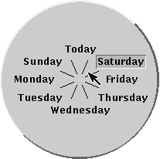
Fitts’ Law Example
Pop-up Linear Menu
Pop-up Pie Menu
Today
Sunday
Monday
Tuesday
Wednesday
Thursday
Friday
Saturday
Which will be faster on average?
pie menu (bigger targets & less distance)

Slide 46
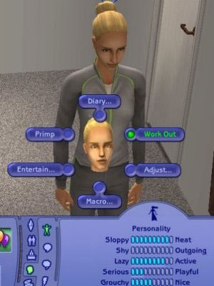
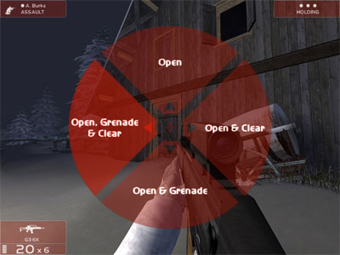
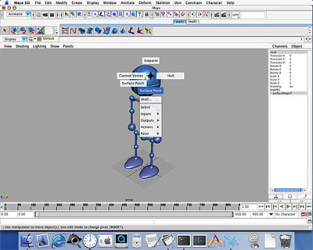
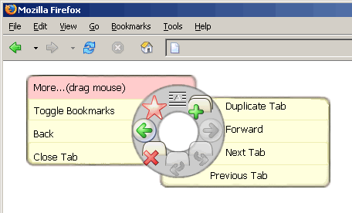
Pie Menus in Use Today
Rainbow 6
The Sims
Maya

Slide 47
Perception
Stimuli that occur within one PP cycle fuse into a single concept
frame rate needed for movies to look real?
time for 1 frame < Tp (100 msec) → 10 frame/sec.
Perceptual causality
two distinct stimuli can fuse if the first event appears to cause the other
events must occur in the same cycle

Slide 48
Perceptual Causality
How soon must red ball move after cue ball collides with it?
must move in < Tp (100 msec)

Slide 49
Simple Experiment
Volunteer
Start saying colors you see in list of words
when slide comes up
as fast as you can
Say “done” when finished
Everyone else time it…

Slide 50
Paper
Home
Back
Schedule
Page
Change

Slide 51
Simple Experiment
Do it again
Say “done” when finished

Slide 52
Bandana
Forward
Home
Test
Basket
Paper

Slide 53
Simple Experiment
Do it again
Say “done” when finished

Slide 54
Yellow
White
Black
Blue
Red
Green

Slide 55
Memory
Interference
two strong cues in working memory
link to different chunks in long term memory
Why learn about memory?
know what’s behind many HCI techniques
helps you understand what users will “get”
aging population of users

Slide 56
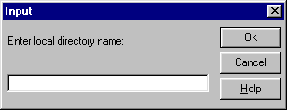
Design UIs for Recognition over Recall
Recall
info reproduced from memory
e.g., command name & semantics
Recognition
presentation of info provides knowledge that info has been seen before
e.g., command in menu reminds you of semantics
easier because of cues to retrieval
cue is anything related to item or situation where learned
e.g., giving hints, icons, labels, menu names, etc.

Slide 57
Human Abilities Summary
Color can be helpful, but pay attention to
how colors combine
limitations of human perception
people with color deficiency
Model Human Processor
perceptual, motor, cognitive processors + memory
model allows us to make predictions
Memory
three types: sensor, WM, & LTM
interference can make hard to access LTM
cues in WM can make it easier to access LTM
Key time to remember: 100 ms

Slide 58
Further Reading Vision and Cognition
Books
The Psychology Of Human-Computer Interaction, by Card, Moran, & Newell, Erlbaum, 1983
Human-Computer Interaction, by Dix, Finlay, Abowd, and Beale, 1998.
Perception, Irvin Rock, 1995.

Slide 59
Next Time
Early Stage Prototyping
“Involving Customers with Iterative Design” (Ch 4) of The Design of Sites
“Making a Paper Prototype” (Ch 4) from Paper Prototyping by Carolyn Snyder
Studio
Show concept videos

