Slide 1
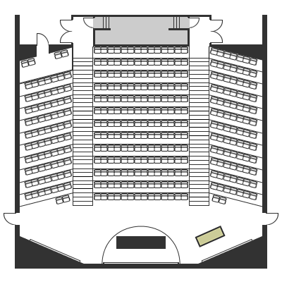
Please sit with your team + studio
Crowd
Behavioral
Discovery
Sustainability
Information
Creation
Learning
Motivation

Slide 2
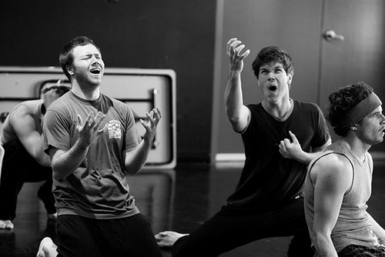
Accepting offers
Image source: Zenmirror.wordpress.com
Notes:
Warm up: This is an exercise on accepting offers and building on them. This activity highlights the basis of all collaborative teamwork and group creativity. And since you don't know what the person ahead of you will say, you can't plan ahead - just like an actual user interview!
Basic rule: we build a story one sentence at a time.

Slide 3
Objective
Tell a story in 15 seconds,
using 3 back and forth sentences
Image source: Zenmirror.wordpress.com
Notes:
Makiko and Jess enact one example
Pretend you came up with this in the moment
A: Are we theerreee yettttt
B: Not yet, we just got back on the road from IN N Out!
A: But Daaaaad I wanna go potty againnnn
these behaviors are to be avoided. It is best to alert the group to these No Nos up front:
Do not argue with the what was just added to the story. *BAD EXAMPLE: Are we there yetttt? > What are you talking about?
Do not question what was just added to the story. Questioning in this game is really a kind of argument because the action stops cold and nothing is added. People should say the first thing on their minds, the sillier the better.
Do not hesitate.

Slide 4
Within 3 sentences, you should show the context:
who (and the relationship)
what (the topic concerning you)
where (your location, environment)
etc.
Person designed by Kyle Tezak from the Noun Project
Notes:
Make sure you take questions.

Slide 5
Your turn
Form pairs!
Person designed by Kyle Tezak from the Noun Project
Notes:
Make sure you take questions.

Slide 6
Notes:
Then say go! and cut them off at exactly 15 seconds. I recommend this timer: https://www.youtube.com/watch?v=qEtlms4au2A
At the end, ask for a few pairs to share their sequence. Then give feedback. Repeat activity twice, maybe three times.

Slide 7
Needfinding Exercise

Slide 8
Tips for effective user research
1. Build rapport
2. Awkward silences are great
3. Embrace the user’s perspective
4. Listen more, talk less
5. Minimize leading questions
6. Stories are great!
7. Steer the focus
Notes:
1. body and speech
2. pause after users answer. silence makes people uncomfortable, and they usually add on the juicy stuff
no judging!
4. “Wow can you tell me more?” “That sounds really hard!” (works for cocktail parties too)
5. "Do you think that AppX helps you with Y?"
6. Stories are great! (when possible, get users to tell anecdotes)

Slide 9
Your turn
and
Interviewer
Note Taker
X 2
User
Person designed by Kyle Tezak from the Noun Project
Notes:
Split the teams into the above roles.
Interviewer leads the discussion (remember to use the Master-APpre
note takers intervene when necessary

Slide 10
Interviewers
You are concerned with how young people use social media. Interview the subject to gauge his/her current perspective (experience, struggles, likes/dislikes...

Slide 11
Feedback
What worked and what didn’t work?

