Slide 1
Design Discovery:
Contextual Inquiry & Task Analysis
September 30, 2014
Notes:
Took 1:52

Slide 2
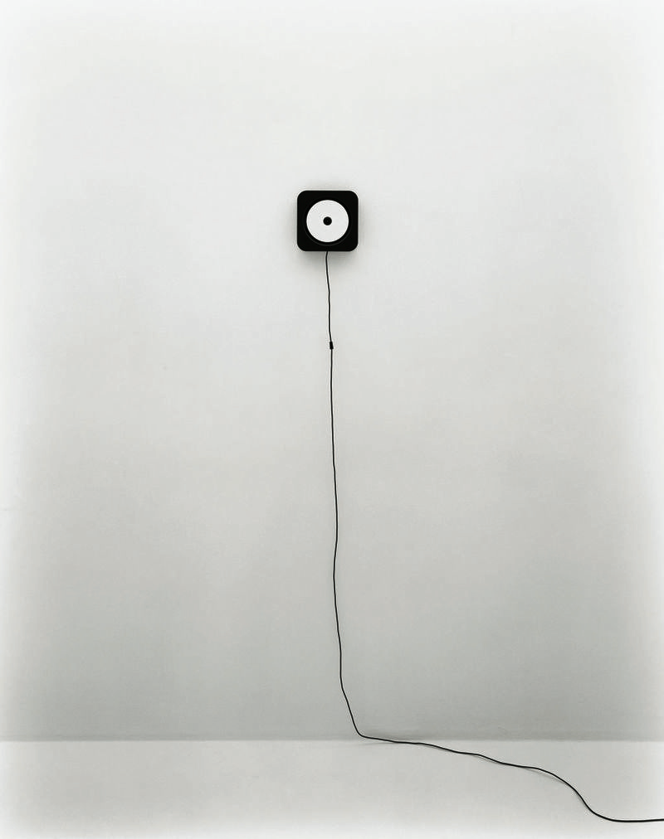
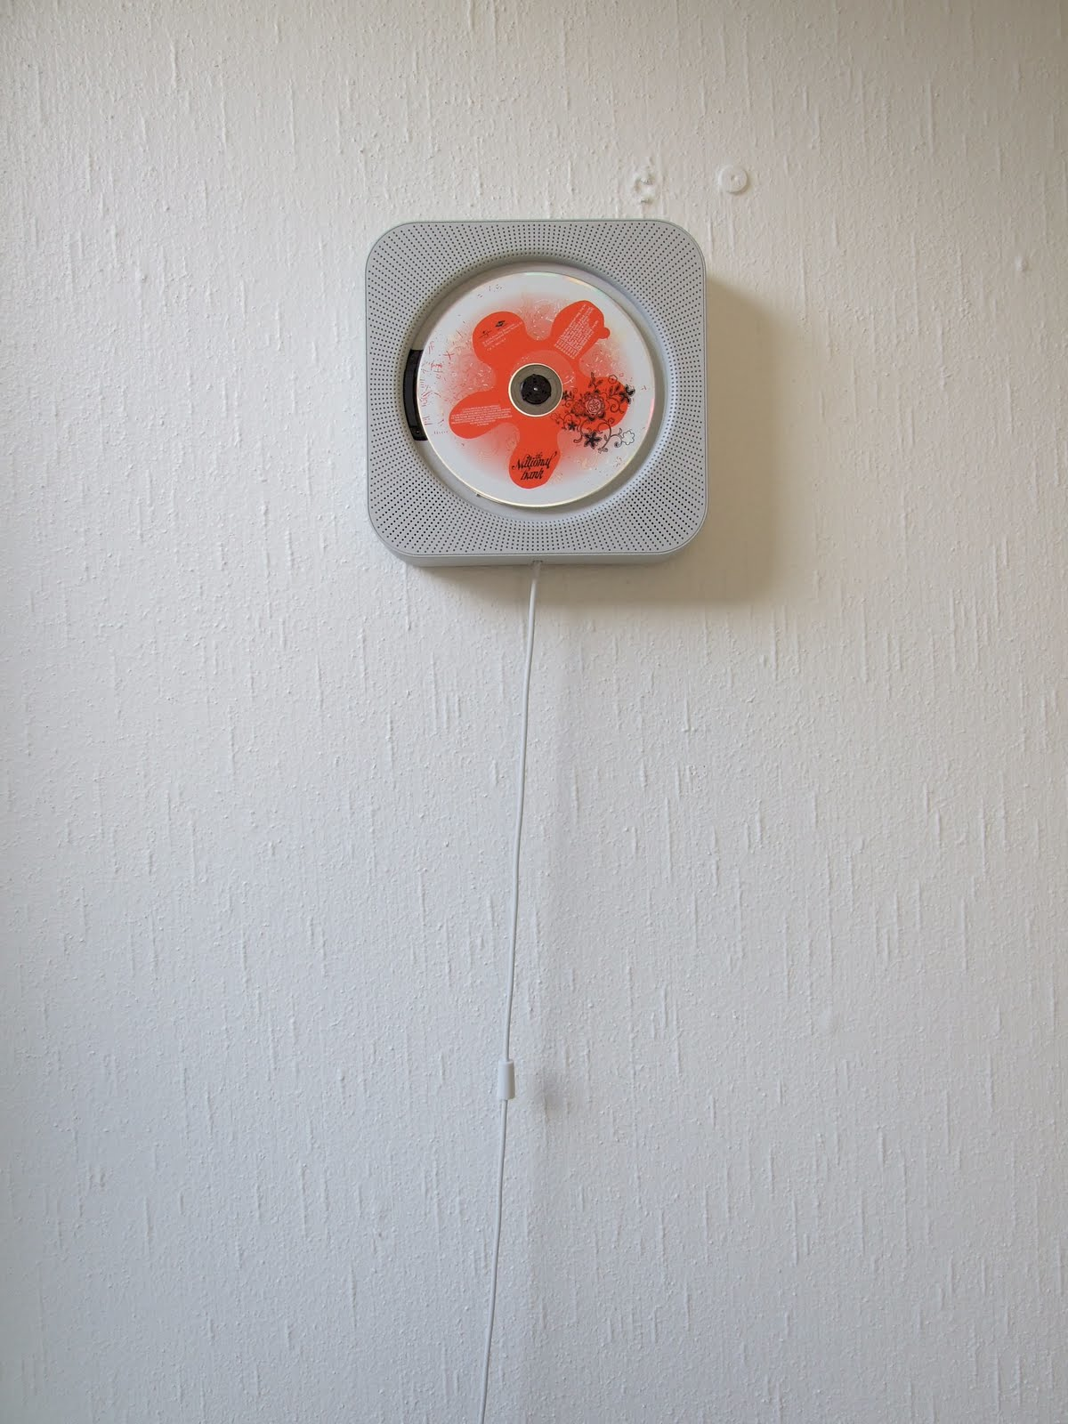

Interface Hall of Fame or Shame?
Muji CD Player
by IDEO

Slide 3

Interface Hall of Fame!
Guides the user with a familiar action
+ Perceived Affordance (string)
+ Directs user towards major function
Does not have functionality of other CD players
If unfamiliar w/ fans, may not be obvious

Slide 4

Hall of Fame or Shame?
Alessi Juicy Salif Citrus Juicer
By Philippe Stark

Slide 5

Hall of Shame!
Aesthetically pleasing but...
Does not perform it’s only function well: To make Juice.
  Amazon review:
  You’ll get almost as much juice on the wall and counter as you do in the glass since the juice will spray in every direction.
An example of where beauty can overpower purpose
Notes:
How could we fix this?

Slide 6
Design Discovery:
Contextual Inquiry & Task Analysis
September 30, 2014
Notes:
Took ? minutes

Slide 7
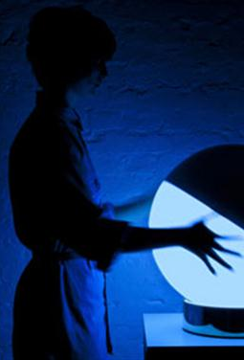
Outline
Review
Design Discovery
Contextual Inquiry
Break
Task Analysis

Slide 8
Review
What was NLS & what was the goal of the system?
  oNLine System, design led by Douglas Engelbart
  augmenting human intellect
Features of NLS?
  mouse, groupware, client-server, windows, version control, hypertext, 2d editing, context-sensitive help, …
How does a chorded keyboard work & who is it for?
  can press multiple keys at once like on a piano
  NLS was for experts
Who invented the Dynabook, what is it like today, and who was it targeted at?
  invented by Alan Kay (1969-74)
  similar to today’s iPad
  target at children

Slide 9
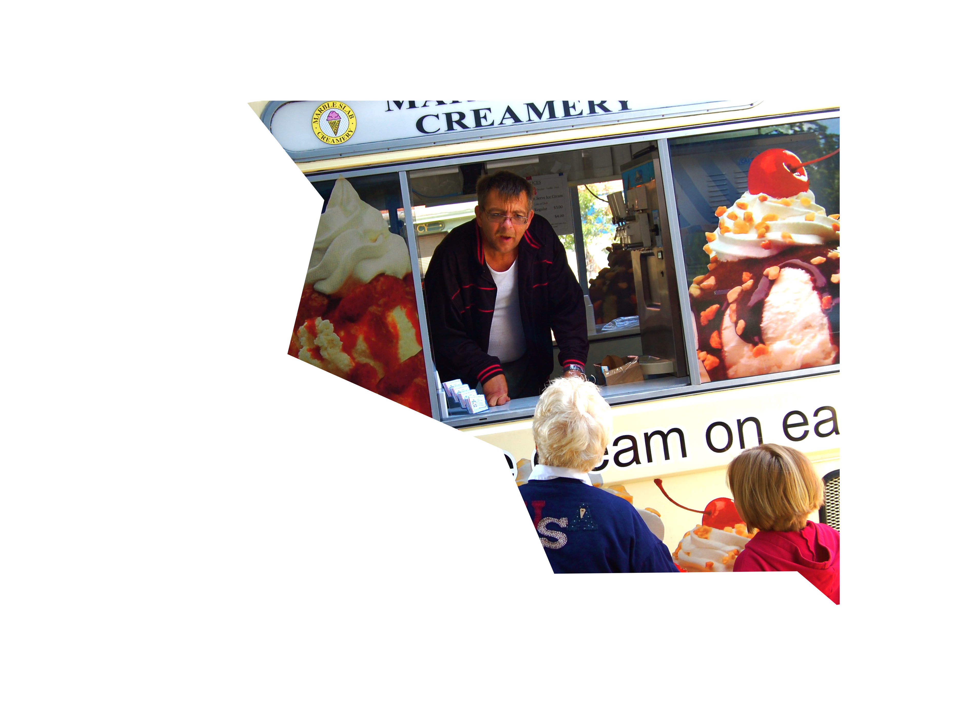
“ You Are Not the Customer”
Seems obvious, but…
  different experiences
  different terminology
  different ways of looking at the world
Easy to think of self as typical customer
Easy to make mistaken assumptions

Slide 10
Design Process: Discovery
Assess needs
understand client’s expectations
determine scope
of project
characteristics of customers & tasks
evaluate existing practices & products
Discovery
Design Exploration
Design Refinement
Production

Slide 11
Understanding the Customer
How do you learn how your customers work?
  task analysis, interviews, self report, experience sampling (ESM), logging/analytics & observation
How do you learn how your customers think?
  understand human cognition
  observe users performing tasks
How do you learn how your customers interact with UIs?
  analytics & logging
  observe!

Slide 12
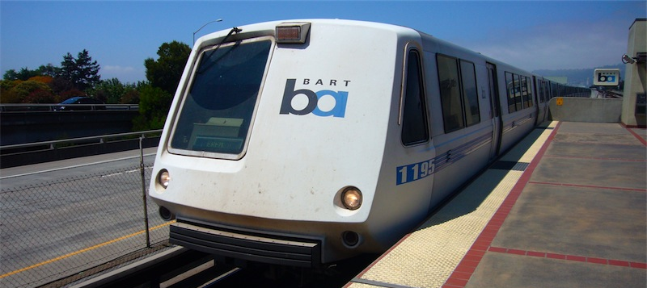
Example of Design Failure
BART “Charge-a-Ticket” Machines
  allow riders to buy BART tickets or add fare
  takes ATM cards, credit cards, & cash

Slide 13
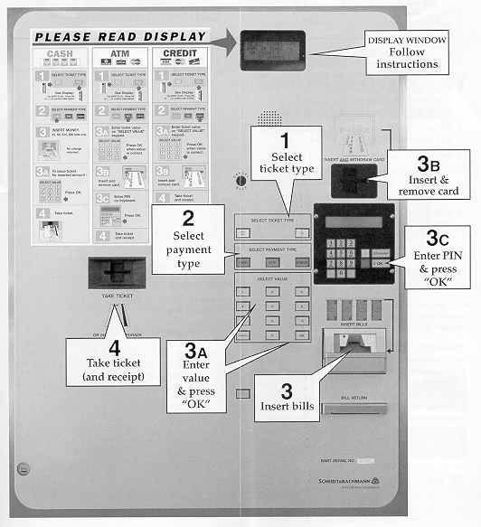

Slide 14
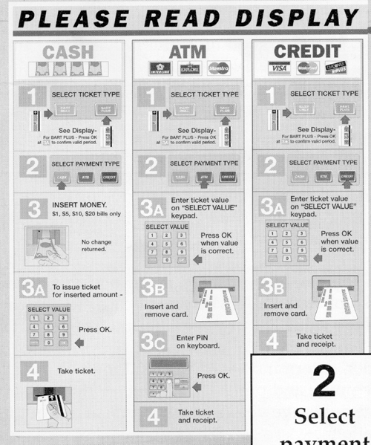

Slide 15
Example of Design Failure: Problems?
One “path” of operation
  ticket type → payment type → payment → ticket
BART Plus has minimum of $28, no indication of this until after inserting >= $1
  can’t switch to regular ticket
Large dismiss transaction button does nothing
Multiple keypads/screens
Order of actions around panel feels random

Slide 16
Lessons from the BART machine
Failure to create convenient machine
Did the designers understand or care
  range of customers using the machine?
  what tasks they would want to carry out?
  that some would find the behavior of the machine disconcerting?
How can we avoid similar results?
  “What is required to perform the customer’s task?”

Slide 17
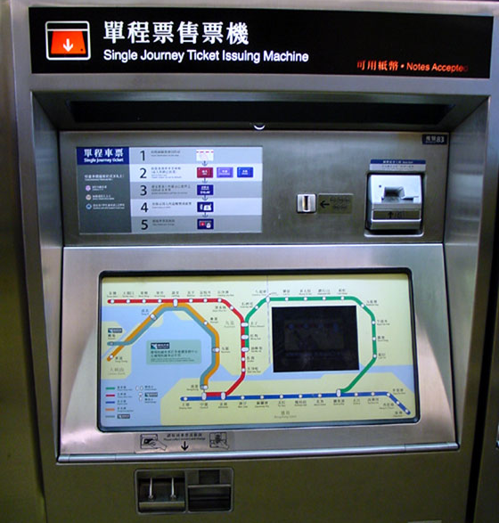
A Better BART Machine
Hong Kong
MTR System

Slide 18
Contextual Inquiry
Way of understanding customers’ needs and work practices
Notes:
Master apprentice in contrast to other kinds of relationships, ex. scientist-observer or parent-child

Slide 19
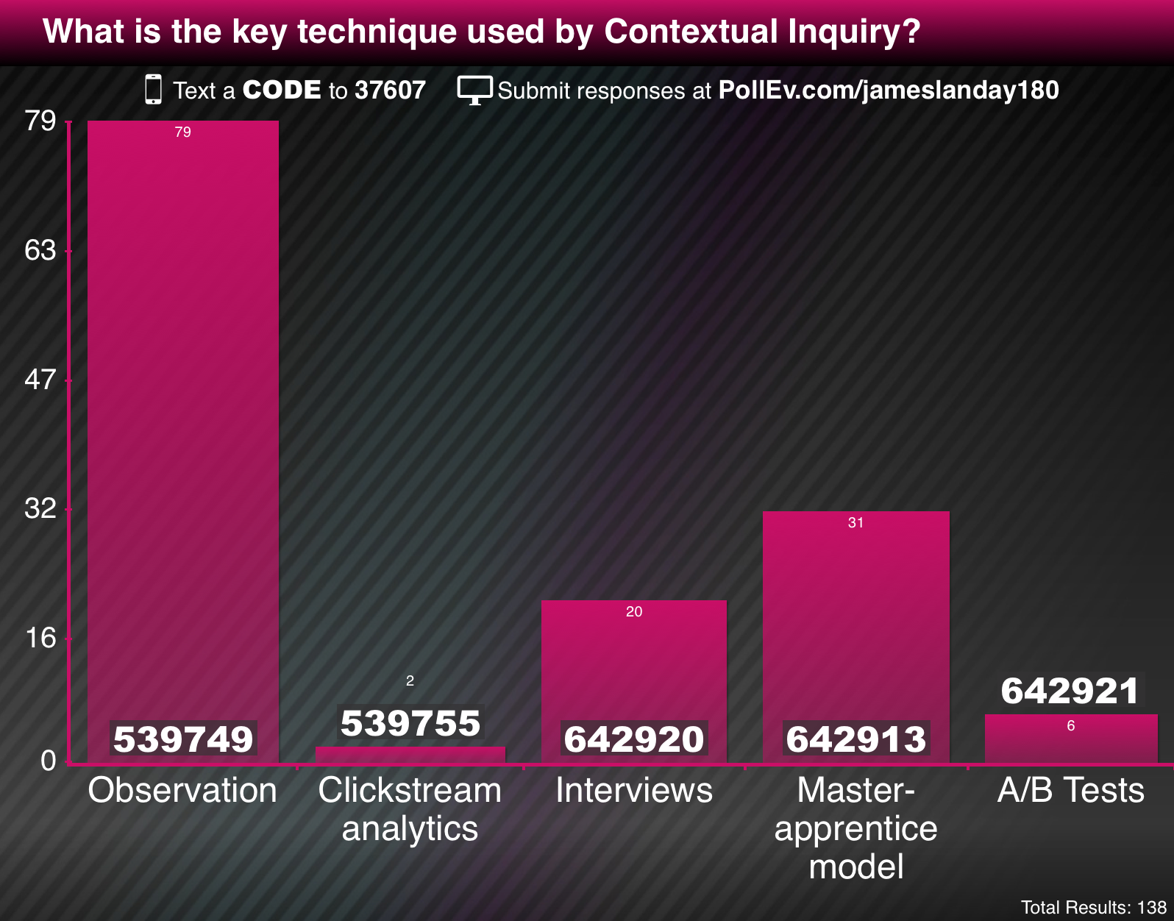
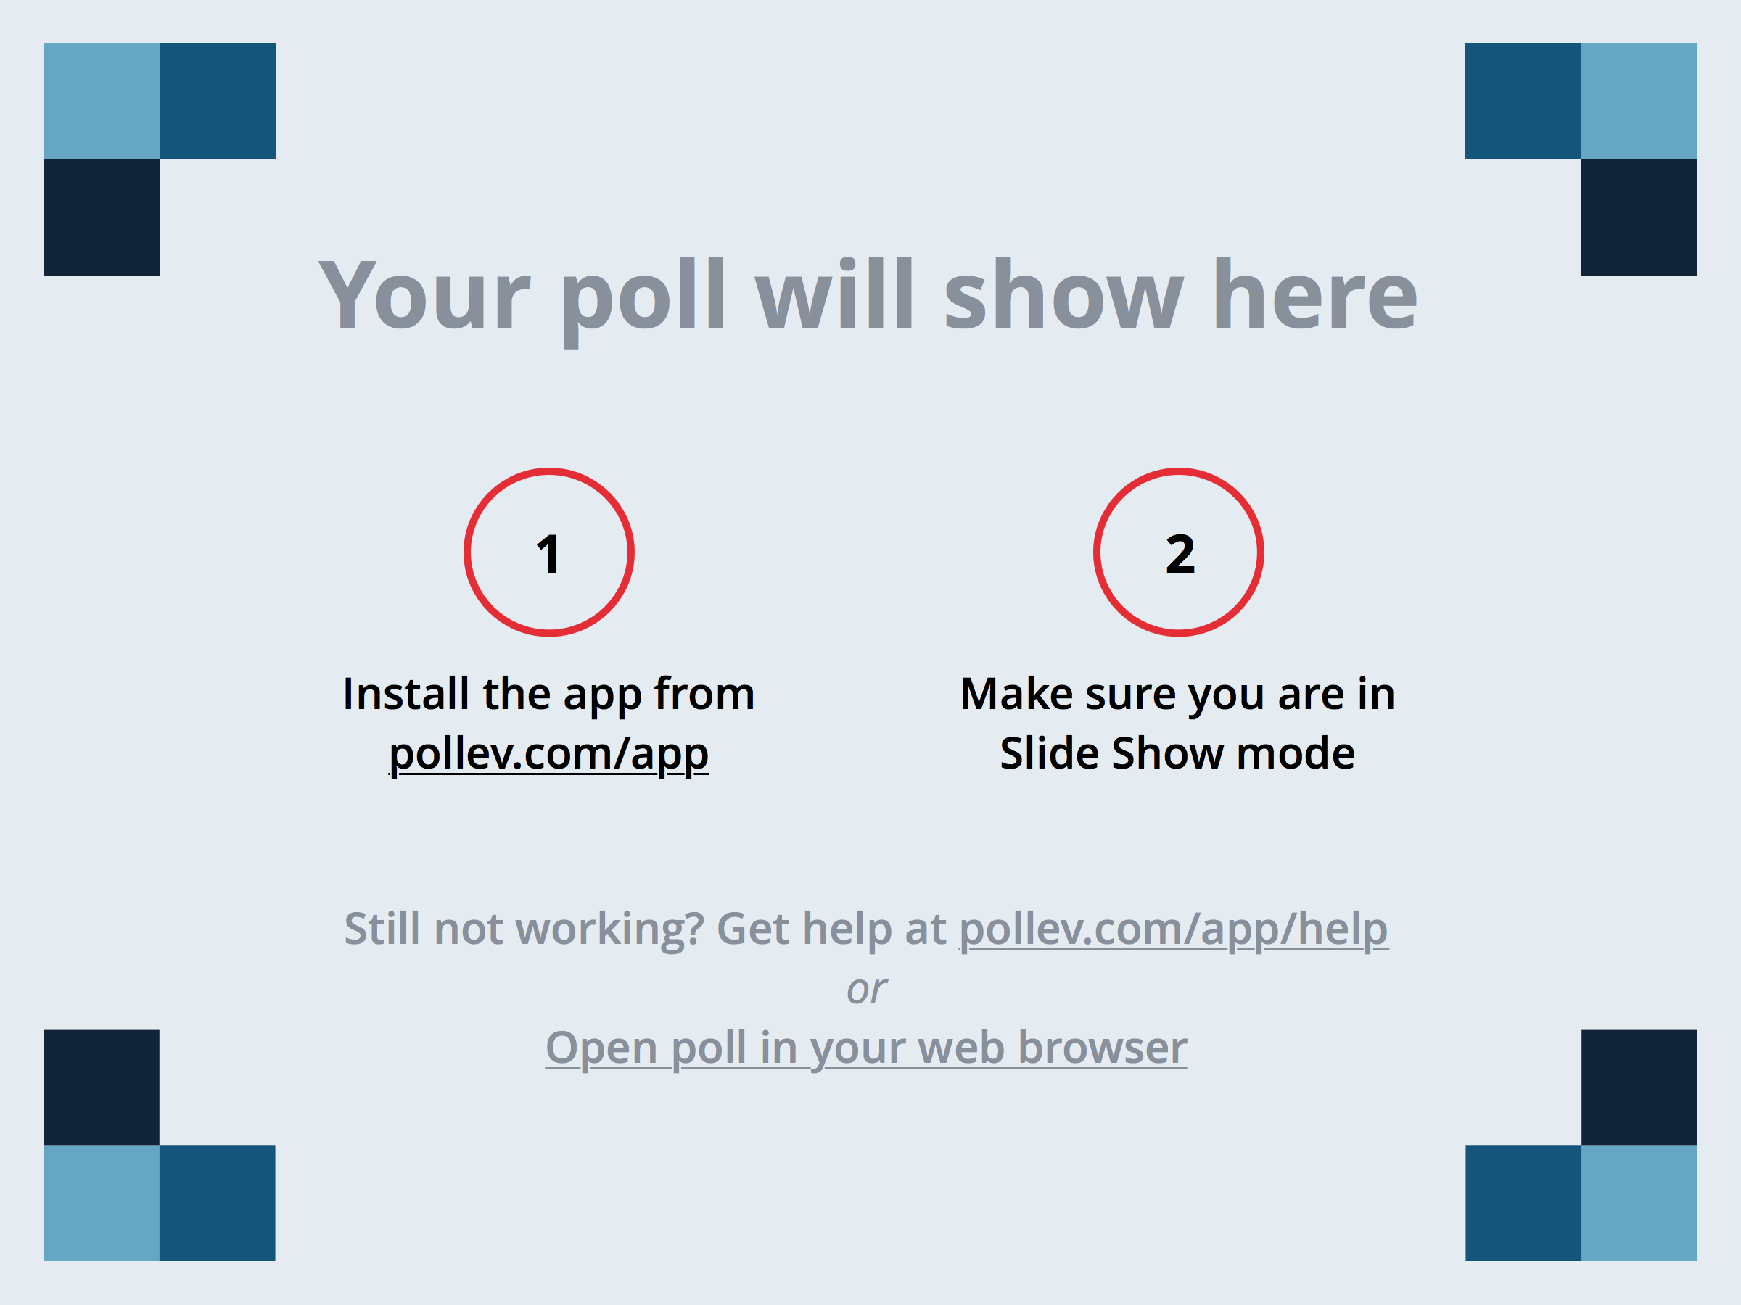
Notes:
What is the key technique used by Contextual Inquiry?
https://www.polleverywhere.com/multiple_choice_polls/DQMd8IaBp9IuRBS

Slide 20
Contextual Inquiry
Way of understanding customers’ needs and work practices
Master / Apprentice model allows customer to teach us what they do! ?
  master does the work & talks about it while working
  we interrupt to ask questions as they go
The Where, How, and What expose the Why
Notes:
Master apprentice in contrast to other kinds of relationships, ex. scientist-observer or parent-child

Slide 21
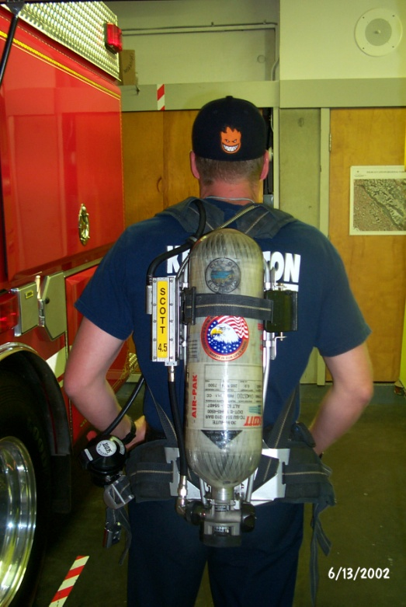
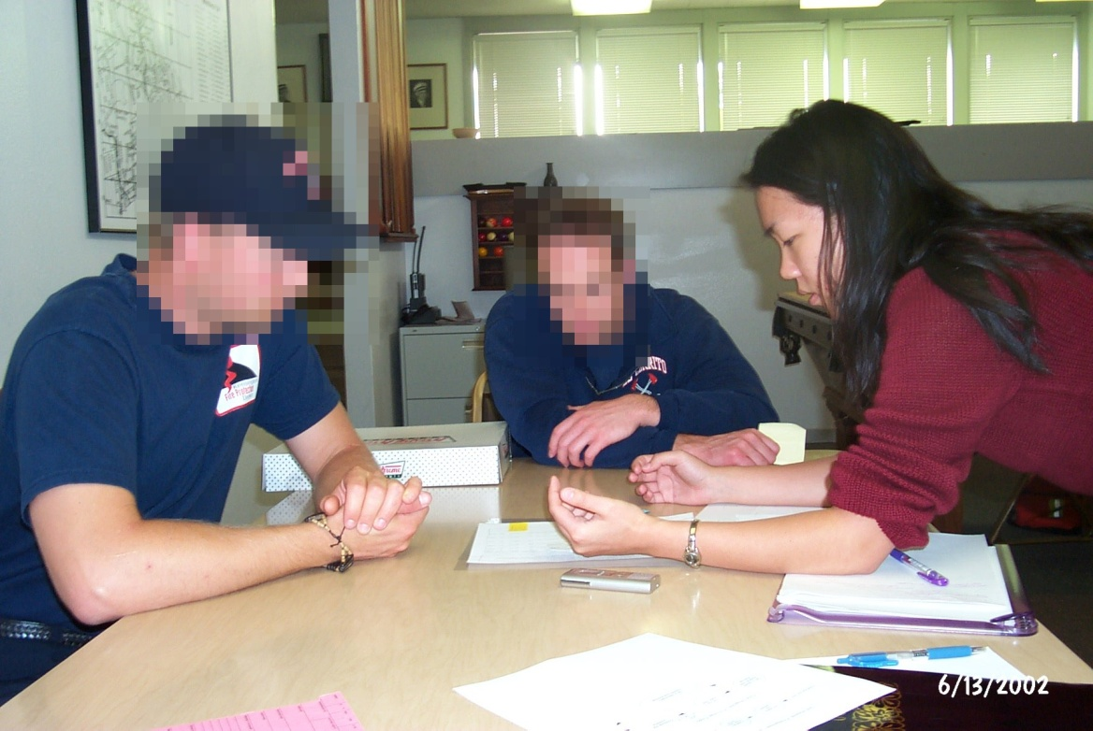
Principles
Context
  contact real/intended customers
  go to the workplace/home & see the activity as it unfolds
  people summarize, but we want details
    keep it concrete when people start to abstract
      “We usually get reports by email”, ask “Can I see one?”
Notes:
not there to get a list of questions answered
not there to answer their questions either (easy traps to fall into)
Contextual inquiry is not an interview, more of an process for understanding

Slide 22
Principles (cont.)
Context
  contact real/intended customers
  go to the workplace & see the work as it unfolds
  people summarize, but we want details
    keep it concrete when people start to abstract
      “We usually get reports by email”, ask “Can I see one?”
Interpretation
  facts are only the starting point, design based on interpretation
  validate & rephrase
    share interpretations to check your reasoning
      Ex. “So accountability means a paper trail?”
      No, not here. It means safety for personnel/equipment
    people will be uncomfortable until the phrasing is right
      be committed to listening (“Huh?”, “Umm…”, “Yes, but…”)
Notes:
not there to get a list of questions answered
not there to answer their questions either (easy traps to fall into)
Contextual inquiry is not an interview, more of an process for understanding

Slide 23
Principles (cont).
Focus
  interviewer needs data about specific kind of activity
    “steer” conversation to stay on useful topics
  respect triggers (flags to change focus)
    shift of attention (someone walks in)
    surprises (you know it is “wrong”)

Slide 24
Users: Unique or One of Many?
“Take the attitude that nothing any person does is done for no reason; if you think it’s for no reason, you don’t yet understand the point of view from which it makes sense.
Take the attitude that nothing any person does is unique to them, it always represents an important class of customers whose needs will not be met if you don’t figure out what’s going on.”
(p. 63, Contextual Design)

Slide 25
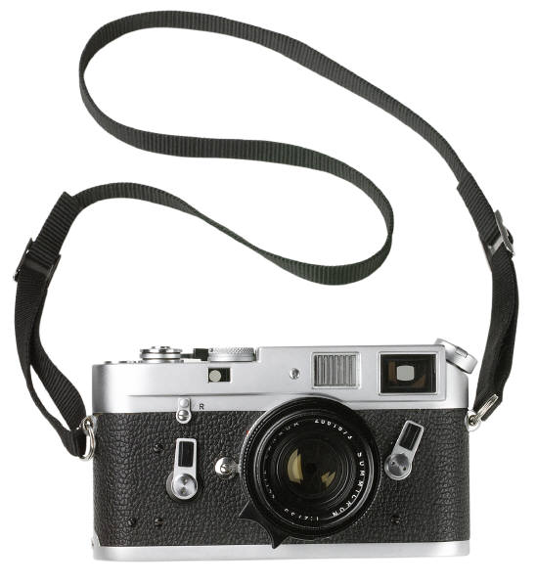
Thoughts on Interviews
Use recording technologies
  notebooks, digital/phone recorders, still & video images
Structure
  conventional interview (15 minutes)
    introduce focus & deal with ethical issues
    get used to each other by getting summary data
  transition (30 seconds)
    state new rules – they work while you watch & interrupt
  contextual interview (1-2 hours)
    take notes, draw, be nosy! (“who was on the phone?”)
  wrap-up (15 minutes)
    summarize your notes & confirm what is important
Master / apprentice can be hard
  e.g., sometimes need to put down your company

Slide 26
What Customers Might Say
“This system is too difficult”
“You don’t have the steps in the order we do them”
Do not take comments personally
  you shouldn’t have a personal stake
Be careful not to judge participants
Goal is to make the system easy to use for your intended customers

Slide 27
In Situ (“in place”)
Studying people in naturalistic settings
  direct observation
  indirect observation
  diary method
  Experience Sampling Method (ESM)
Naturalistic data collection method
  outside the lab
    “Ecologically valid”
  studying behaviors in real-life situations…
Key for places we will deploy contextually-aware and/or mobile apps
Notes:
This problem is important because it is in precisely these environments that people will
want to deploy contextually-aware applications. Researchers attempting to study
people in natural settings must carefully design their studies to collect sufficient data
describing a subject's context without significantly influencing their environment or
behavior. The ideal balance between these factors is diffcult to achieve because the
strategies that are the most descriptive, such as direct observation, also tend to be the
most disruptive and expensive. However, by leveraging new tools and technologies
to acquire context-specific information while minimizing the burden on the subject,
naturalistic and cost-effective data can be collected.
More intrusive data collection techniques provide more detailed data but are also
more likely to impact subjects' actions or environment in a signi¯cant manner. For
example, subjects that know they are being observed may be careful to wash their
hands after using the bathroom. However, those same subjects may occasionally
forget to do so in the absence of an observer.
From http://architecture.mit.edu/house_n/documents/Rondoni03.pdf

Slide 28

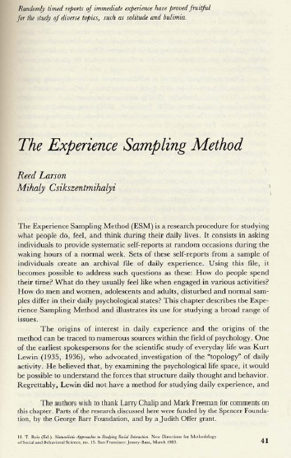
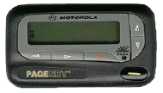
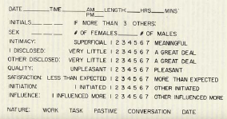
Experience Sampling Method (ESM)
beep… beep…
Me-hi Chick-sent-me-hi-ee
Also called “signal-contingent” sampling...
Notes:
pronounced Me-high Chick-sent-me-high-ee

Slide 29
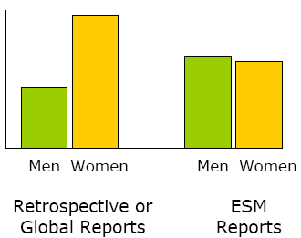
Why is esm Interesting?
Emotional Intensity
Men Women
Men Women
retrospective
surveys
esm
Barrett, Cognition and Emotion, 1998
People are inaccurate in recalling their behavior later…
Notes:
Barrett, 1998, Are Women the ``More Emotional’’ Sex? Evidence From Emotional Experiences in Social Context, COGNITION AND EMOTION, 1998, 12 (4), 555± 578
You can also collect data on things in the moment, like a user’s current location, what their current activity is, etc.

Slide 30
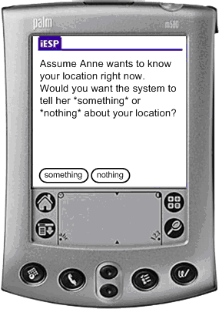
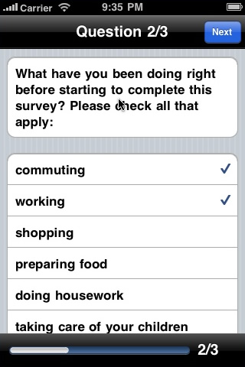
Computerized ESM
Advantages
ensures compliance
sophisticated presentation
  conditionals
  probabilities
  “question pools”
record reaction times
data already in computer
  reduces data entry error

Slide 31
Computerized ESM
Disadvantages
input constraints (limited free response)
human factors
  small screen, buttons, etc.
  requires some prior experience with technology
costs (if need to handout devices…)

Slide 32

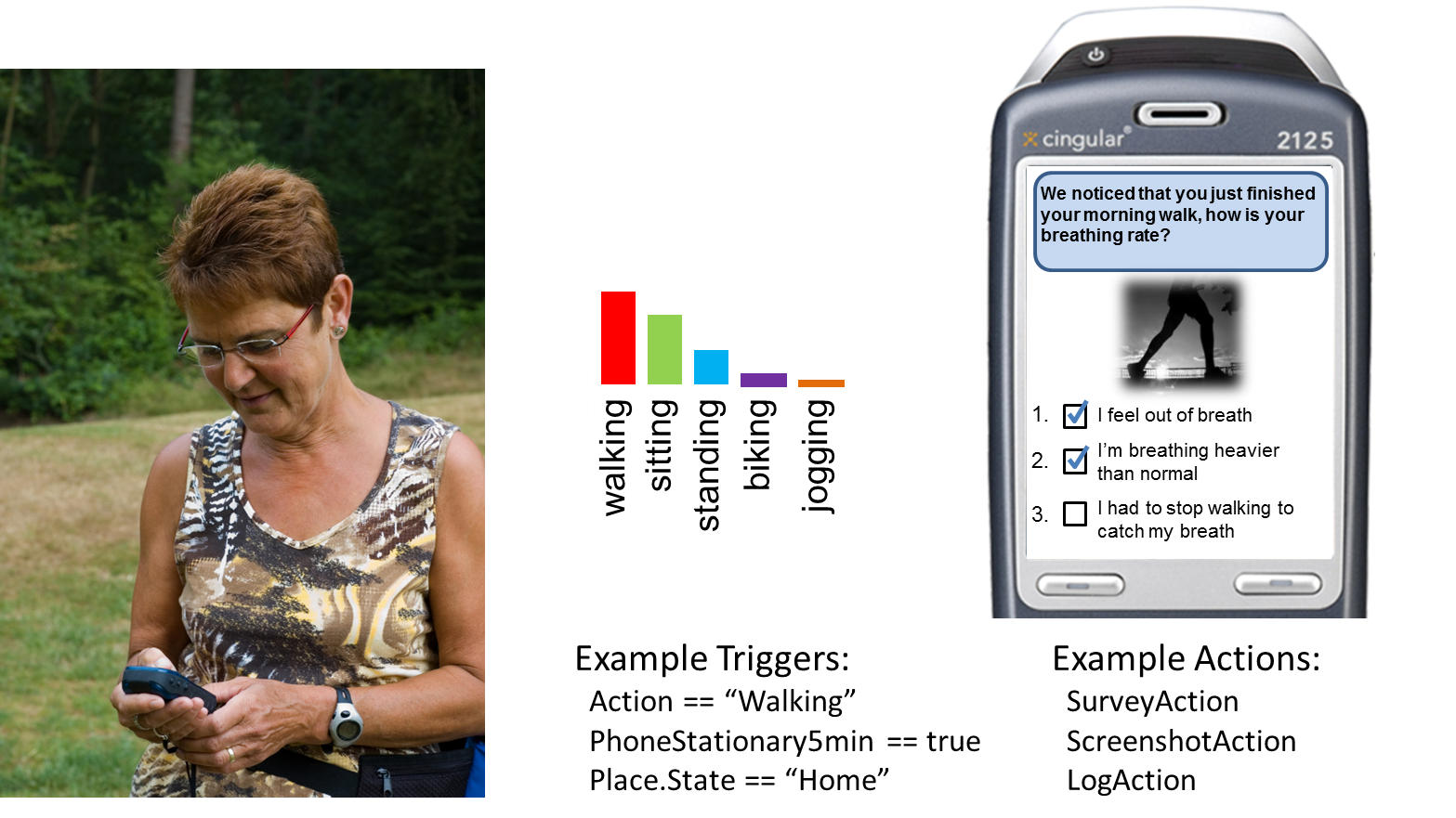
Context-Triggered Sampling
Use sensors to achieve targeted triggers
Do not need to bug the customers as often
  e.g., after a walk, in a certain place, etc.
0%
walking
jogging
sitting
standing
biking
Example Triggers
Activity == walking
DeviceIdle > 15 mins
Place.State == “Home”
Example Actions
SurveyAction
ScreenshotAction
LogAction

Slide 33
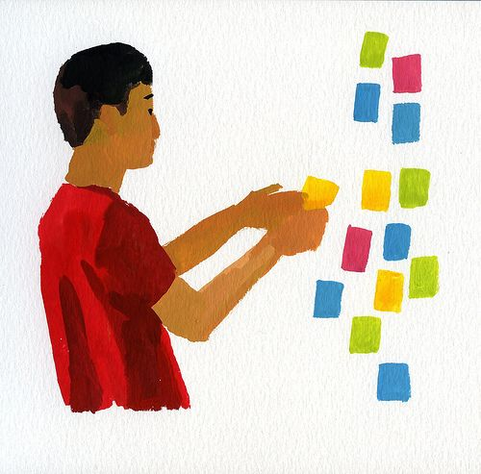
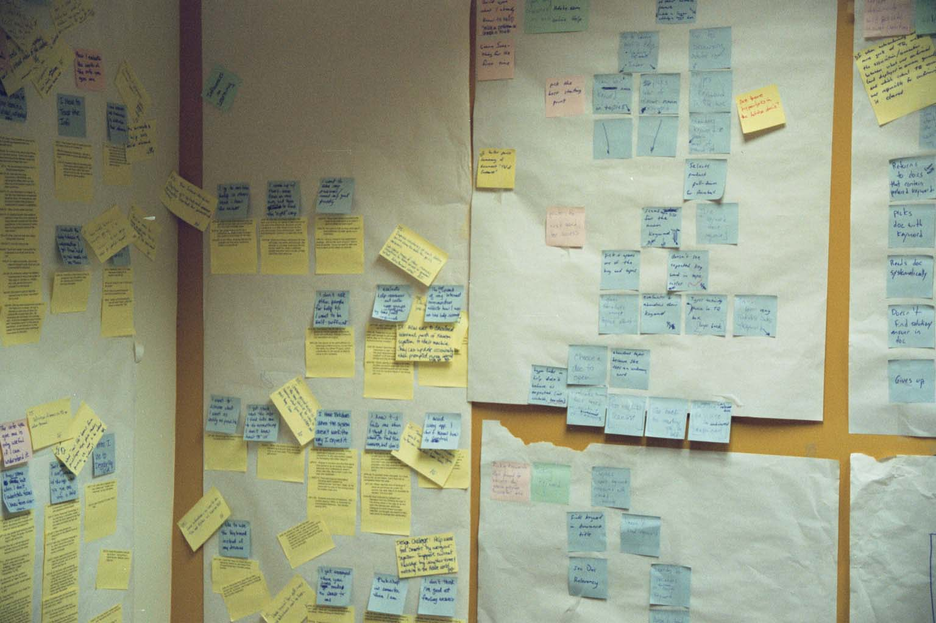
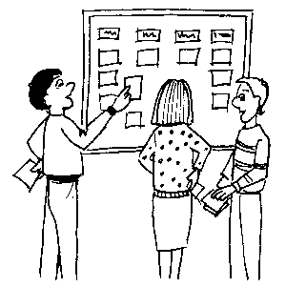
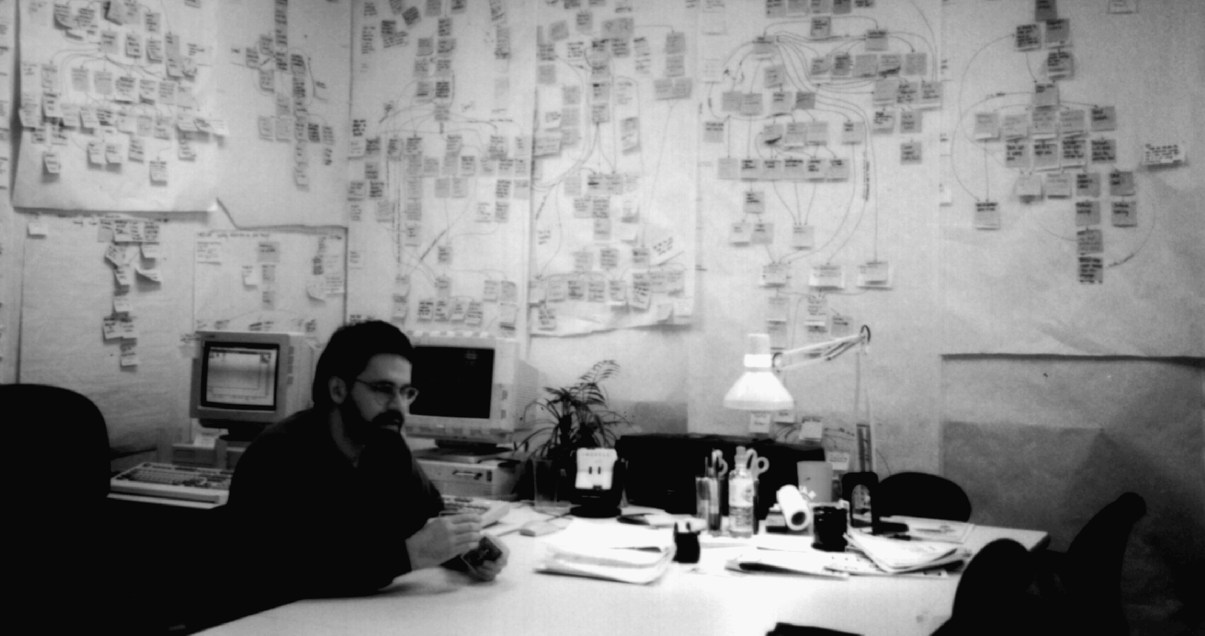
Using the Data from CI or ESM
Figure out what is important
Affinity diagramming
  group info & find relations between groups
  Post-Its on
  large surfaces
    haptic UI
    brainstorming
    immersive
    persistent
  also used for
  creating web
  info architecture
Reprinted by permission from Contextual Design by Hugh Beyer & Karen Holtzblatt, InContext Enterprises, http://www.incent.com,
© Morgan Kaufmann, 1998

Slide 34
Administrivia
Project Proposal (individual)
  due tonight at 11:59 PM
  turn in via coursework (sorry for the change)
  https://coursework.stanford.edu/portal/site/F14-CS-147-01
Hall of Fame/Shame (individual)
  due Thursday night at 11:59 PM
  reading on how to give & take critique
  discuss in Studio on Friday
  Studio key this week: team preferences
Notes:
NOT: 30 sketches including multiple screens of same UI!
imagine some piece of software is being made simultaneously by Google, Apple, and Microsoft - it will probably end up supporting similar features, but do it in pretty different ways. Get even more divergent than that (like exploring different interaction methods, physical and digital).

Slide 35
B R E A K
Notes:
3 minutes

Slide 36
Contextual Inquiry Exercise
Turn to someone on your right
Interview that person using Master-Apprentice model to find out how they schedule appointments
2 minutes
Switch places & repeat
2 minutes

Slide 37
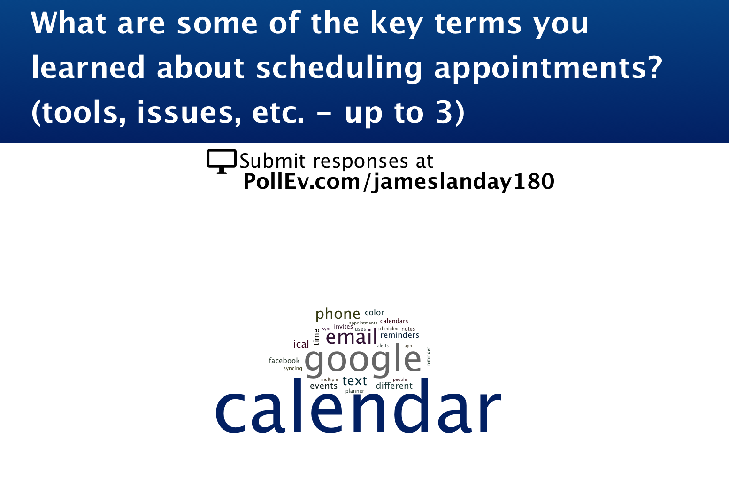
Notes:
What are some of the key terms you learned about scheduling appointments? (tools, issues, etc. - up to 3)
http://www.polleverywhere.com/free_text_polls/M6wzASOHj2TqSxU

Slide 38

Task Analysis
Use this to organize contextual inquiry data
Find out
  who customers are
  what tasks they need to perform

Slide 39
Task Analysis Questions (11)
Who is going to use the system?
What tasks do they now perform?
What tasks are desired?
How are the tasks learned?
Where are the tasks performed?
What’s the relationship between customer & data?

Slide 40
Task Analysis Questions (cont.)
What other tools does the customer have?
How do users communicate with each other?
How often are the tasks performed?
What are the time constraints on the tasks?
What happens when things go wrong?

Slide 41
Who?
Identity
  in-house or specific customer is easy
  need several typical users for broad product
Background
Skills
Work habits and preferences
Physical characteristics
  height?

Slide 42
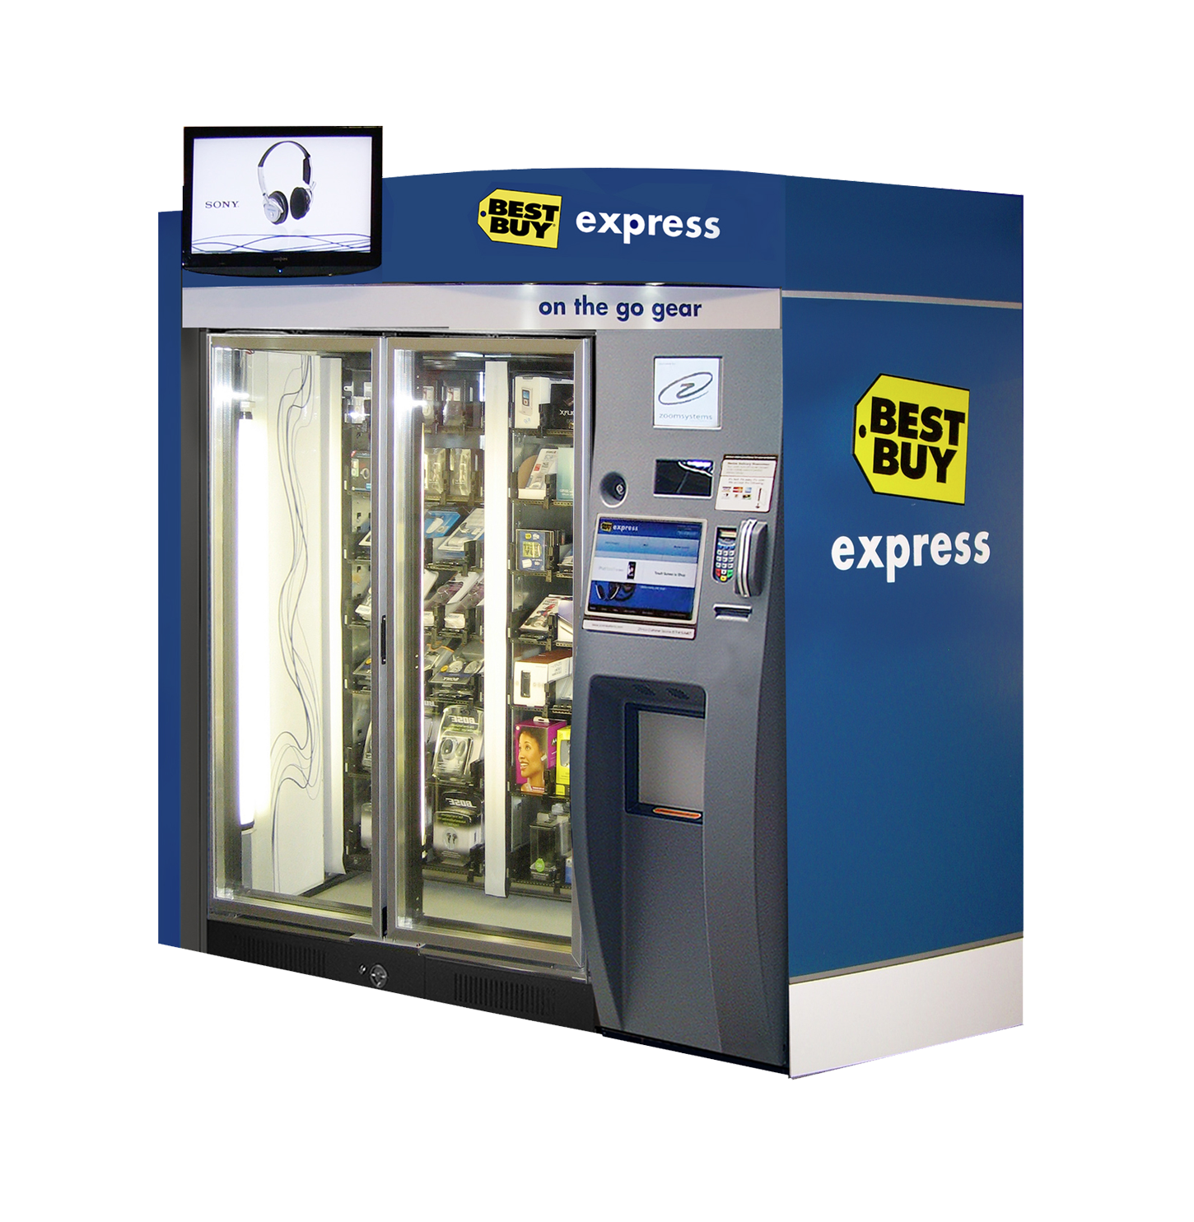
Best Buy Express: On the Go Gear

Slide 43
Who (Best Buy Express)?
Identity?
  people who are passing through airport
    business people, tourists, airline employees…
Background?
  must have an ATM card or credit card
  have used other vending/ticket machines before
Skills?
  may know how to put cards into ATM

Slide 44
What Tasks?
Important for both automation and
new functionality
Relative importance of tasks?
Observe customers, see it from their perspective
  on-line billing example
    small dentists office had billing automated
    assistants were unhappy with new system
    old forms contained hand-written margin notes
      e.g., patient A’s insurance takes longer than most, etc.

Slide 45
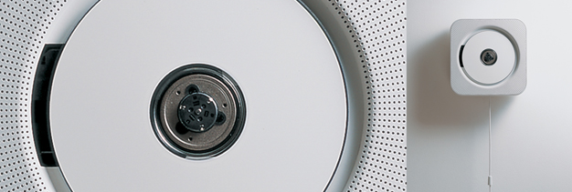
How are Tasks Learned?
What does the customer need to know
Do they need training?
  academic
  general knowledge / skills
  special instruction / training

Slide 46
Where is the Task Performed?
Office, laboratory, point of sale?
Effects of environment on customers?
Users under stress?
Confidentiality required?
Do they have wet, dirty, or slippery hands?
Soft drinks?
Lighting?
Noise?

Slide 47
What is the Relationship Between Customers & Data?
Personal data
  always accessed at same machine?
  do users move between machines?
Common data
  used concurrently?
  passed sequentially between customers?
Remote access required?
Access to data restricted?

Slide 48
What Other Tools Does the Customer Have?
More than just compatibility
How customer works with collection of tools
  Ex. automating lab data collection
    how is data collected now?
    by what instruments and manual procedures?
    how is the information analyzed?
    are the results transcribed for records or publication?
    what media/forms are used and how are they handled?

Slide 49

How Do Customers Communicate with Each Other?
Who communicates with whom?
About what?
Follow lines of the organization? Against it?
Notes:
Harry Hersh 1982 Electronic Mail Usage Analysis
At the inter-personal l e v e l , we found that users saw the EMS system as providing increased f l e x i b i l i t y in inter-personal communication through t h i s additional, welcomed communication mode. I t avoids the real-time, two-party requirements for telephone
usage while preseving the phone's t i m e l i n e s s . I n t e r e s t i n g l y , 49% of the respondents access the
mail system from locations in addition to t h e i r o f f i c e s , with h a l f of these people accessing the
system from t h e i r homes. Also at the inter-personal l e v e l , we found that users were adjusting the
intended purpose of the system in order to preserve e x i s t i n g organizational relations. For example,
within the current organization there is t y p i c a l l y manager. Secretaries often produce and distribute
outgoing mail, as well as screen incoming mail. As a result, the secretary is often an integral part
of the communications loop involving the manager. The EMS system, however, only recognizes one type
of user, and messages only go to designated users. I f a manager is an official user of the EMS system,
but the secretary is not, the secretary is effectively cut out of the communiications loop.
In response to this situation, a significant number of the respondents (29%) reinserted the
secretary into the communications loop by making the secretary an unofficial, but actual, user. The
result is that many of the respondents never go near the system, but send and receive their messag-
es through an intermediary. Becoming an indirect user of the EMS system accomplishes several objec-
tives from the user's perspective: (a) The secretary is now put back in the communications loop, (b)
the secretary retains the job function of producing and distributing internal mail, and (c) the manager
can continue to interact with paper copies of messages, as was previously done.

Slide 50
How Often Do Customers Perform the Tasks?
Frequent customers remember more details
Infrequent customers may need more help
  even for simple operations
  make these tasks possible to do
Which function is performed
  most frequently?
  by which customers?
  optimize system for these tasks will improve perception of good performance

Slide 51
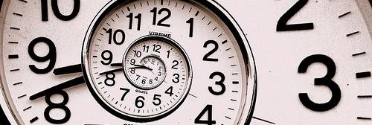
What are the Time Constraints on the Task?
What functions will customers be in a hurry for?
Which can wait?
Is there a timing relationship between tasks?

Slide 52

What Happens When Things Go Wrong?
How do people deal with
  task-related errors?
  practical difficulties?
  catastrophes?
Is there a backup strategy?

Slide 53
Caveats of User-Centered Design
Politics
  “agents of change” can cause controversy
  get a sense of organization & bond w/ interviewee
  important to get buy-in from all those involved
Customers are not always right
  cannot anticipate new technology accurately
  job is to build system customers will want
    not system customers say they want
    be very careful about this (you are outsider)
Design/observe forever without prototyping
  rapid prototyping, evaluation, & iteration is key
Notes:
not system customers say they want
be very careful about this (you are outsider)
if you can’t get customers interested in your hot idea, you’re probably missing something

Slide 54
Further Reading
Task Analysis & Personas
Books
  User and Task Analysis for Interface Design by
  Joann T. Hackos, Janice C. Redish
  The Inmates are Running the Asylum by Alan Cooper

Slide 55
Summary
Know thy user & involve them in design
Contextual inquiry
  way to answer the task analysis questions
  interview & observe real customers
  use what model to get them to teach you?
    the master-apprentice model to get them to teach you
Experience Sampling Method (ESM)
  way to get self-report data where?
    in situ

Slide 56
Next Time
Lecture
  Design Exploration
Readings
  Pg. 35-51 from Buxton's Sketching User Experiences
  Tom Kelley, The Perfect Brainstorm, Excerpt from The Art of Innovation
Watch
  ABC News Nightline IDEO Deep Dive, July 1999 (22 minutes)
  Bonus video: ABC News, IDEO Design Thinking, January 2013 (60 minutes)

